Slide 1
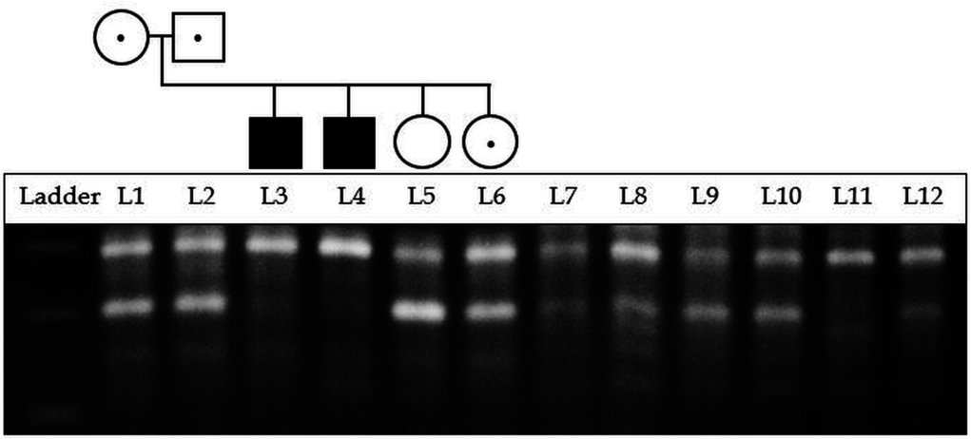
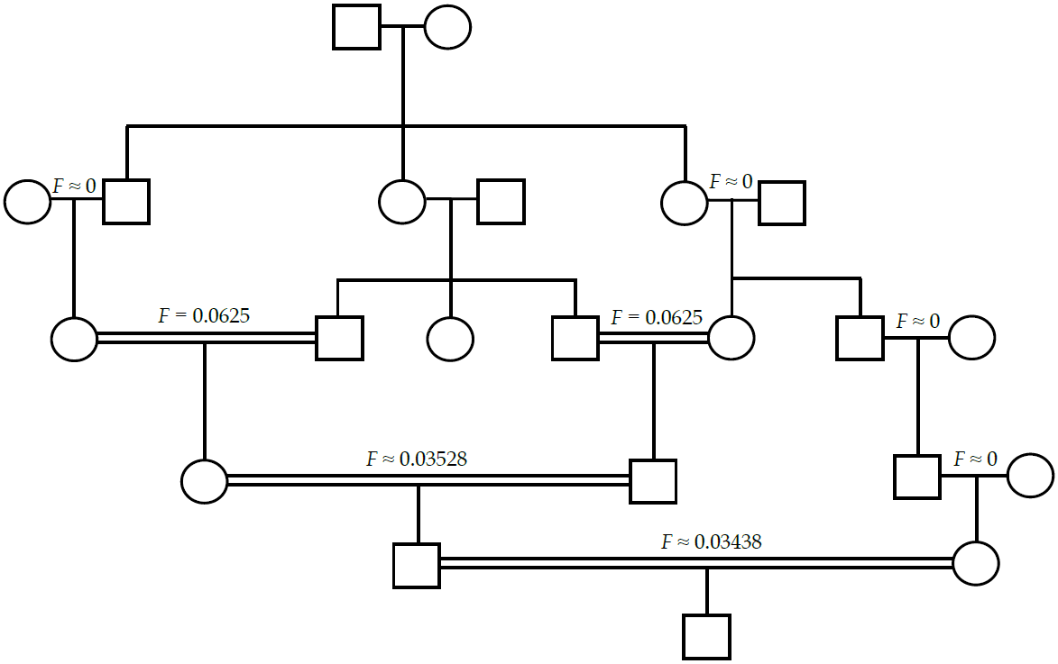
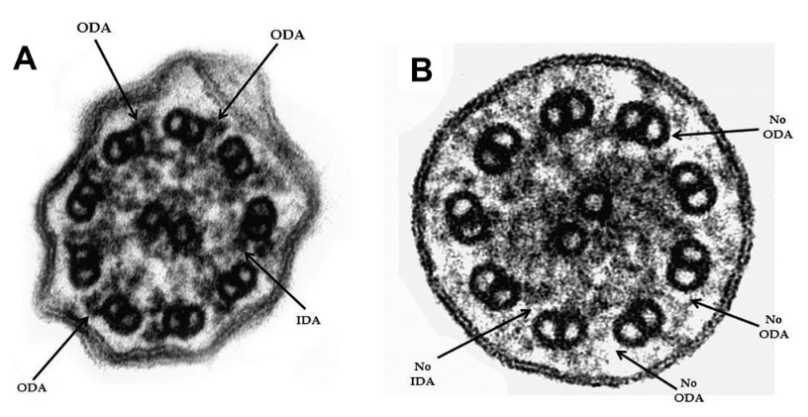
Postdoctoral Research Associate in Genetic Epidemiology
A. Mesut Erzurumluoglu
10/02/16
Interested in a career in 'following your curiosity'?
Become an academic!
Erzurumluoglu et al, 2015
Alsaadi and Erzurumluoglu et al, 2014
Notes:
Talk for 20mins
Explain what a postdoc is

Slide 2
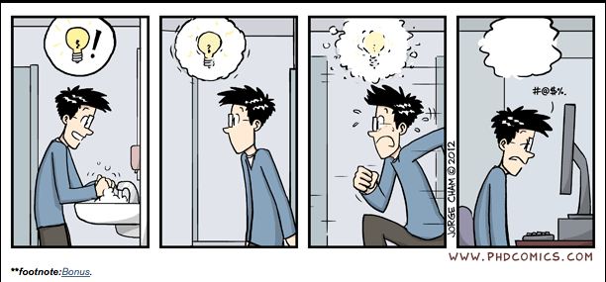
Contents
What is a Postdoc?
  Genetic Epidemiology
My background
Why I chose academia/research?
  Why you shouldn’t choose
Suggestions

Slide 3
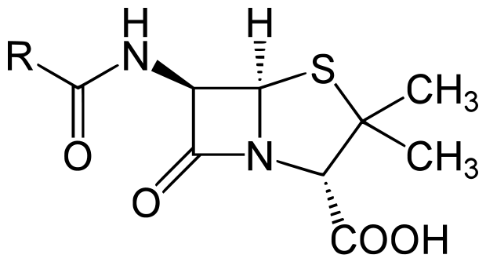




Penicillin
Microwave oven
Serendipity
Crisps
Post-It notes
X-ray scan
Notes:
Fleming (1928): Some bacteria he had left in a petri dish had been killed by naturally occurring penicillium mould
George Crum: A customer at his restaurant complained this French fries were too thick. Crum sliced potatoes as thin as he could and deep-fried them until they were hard, then sent them out to the complainer, who loved them
Wilhelm Roentgen (1895): He was trying to make electrons pass through air, when he noticed that with a high charge, his vacuum tube caused a screen all the way across his lab to light up
Spencer Silver (1968): He was attempting to develop a super-strong adhesive. Instead he accidentally created a "low-tack", reusable, pressure-sensitive adhesive
Percy Spencer (1945): He saw the specific heating effect of a high-power microwave beam

Slide 4
What do I do?
Postdoctoral RA in Genetic Epidemiology
Study the genetic aetiology of common and rare respiratory diseases
  Chronic Obstructive Pulmonary Disease (COPD)
  Smoking addiction
  Primary Ciliary Dyskinesia (PCD)
Consanguineous unions
  Novel gene functions
  Autosomal recessive disease causal variants
  Genetic counselling and diagnostics
Notes:
Explain what Genetic epidemiology is
What do I do day-to-day?

Slide 5
My background
A levels in Maths (A), Further Maths (B), Physics (B) and Electronics (A) – WQEI
A level in Biology (B) – External student
BSc in ‘Biological Sciences (Genetics)’ – University of Leicester (2.1)
  Genetics – DNA fingerprinting
PhD in ‘Genetic Epidemiology’ – University of Bristol
  Genetics of Consanguineous unions

Slide 6
Biography Timeline
Crown Hills Com. College
WQEI
Univ. of Leicester
Univ. of Bristol
Moved to Leicester
Sept 2000
Born
Aug 1988
GCSEs
Jun 2004
A Levels
Jun 2006
BSc
Jun 2011
PhD
Nov 2015
Turkey
UK
Turkey
Two Gap years
“You’re dumb!”
Ms. P
Dr. Fred Tata
Prof. Annette Cashmore
A level in Biology
Work Experience
Parents returned to Turkey

Slide 7

Hardships
Visa issues (& fee status)
Never settled in one place
Separation from parents ~ age 15
  No relatives in the UK
Financial issues
  Harsh environments
  Setting priorities
Language/cultural
No margin for error

Slide 8
If I can do it, you can do it!
Nothing special
  No photogenic memory
  Average IQ
Dream as a kid: Football player
One academic in the whole family
  No contacts
  Not much advice
Not from a privileged background
Learned English afterwards (age of 13)

Slide 9
Made the right choice
Happy, proud and respected
Looking forward to work
  Exciting projects
Meet brilliant people
  See fantastic places
Decent wage and amount of free time
Working for myself (ultimately!)
So many job opportunities!
  Genetic Epidemiology
  Bioinformatics and Biostatistics

Slide 10
Why I chose Academia?
Ideals: making a difference in people’s lives
  Mankind as a whole
  Students
  Local community
Learning all the time
  Endless knowledge
  Always new challenges
  Serendipity
Work in your own tempo
  Indeterminate hours

Slide 11
Why you shouldn’t choose Academia?
Money
Respect
  ‘Dr.’ title
Your parents want you to
You feel it’s going to be easy
  “I’m too clever”
  It won’t get easier
“Everyone (around you) is doing it”
“I’ll work on my own”
Notes:
Because you were too clever at A levels or during your tutorials – writing a paper or proposal is a nightmare! Politics, competitive environments, Collaboration is a must!

Slide 12
Suggestions from a friend
Get your priorities right
Listen to people wiser than you!
  Take notes
  Attend seminars
Learn from others’ mistakes/experiences
Work experience/Volunteering/Sports
  Put something concrete in CV
  Everyone’s “hard working” and “enthusiastic”
Imposter syndrome
  Trust yourself!
If you don’t hate what you’re doing, then you’ll learn to like it as you mature
Work hard!
Notes:
Show notebook to students

Slide 13
Some of the places I got to see/visit during my PhD

Slide 14

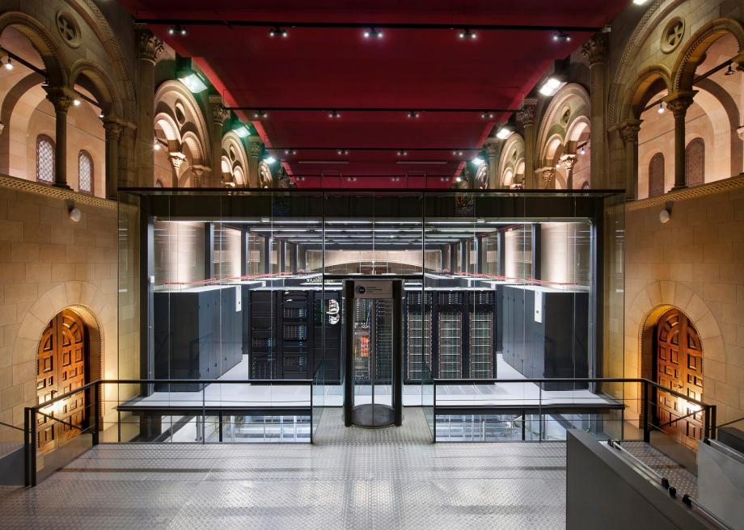
CSHL, Long Island, NY
Some of the places I got to see/live in during my PhD
Barcelona Supercomputer centre

Slide 15
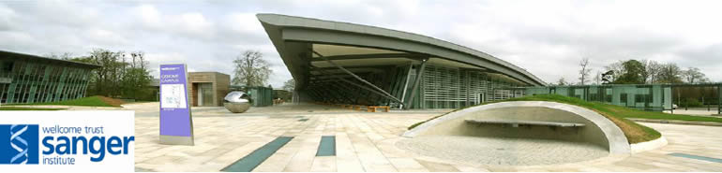
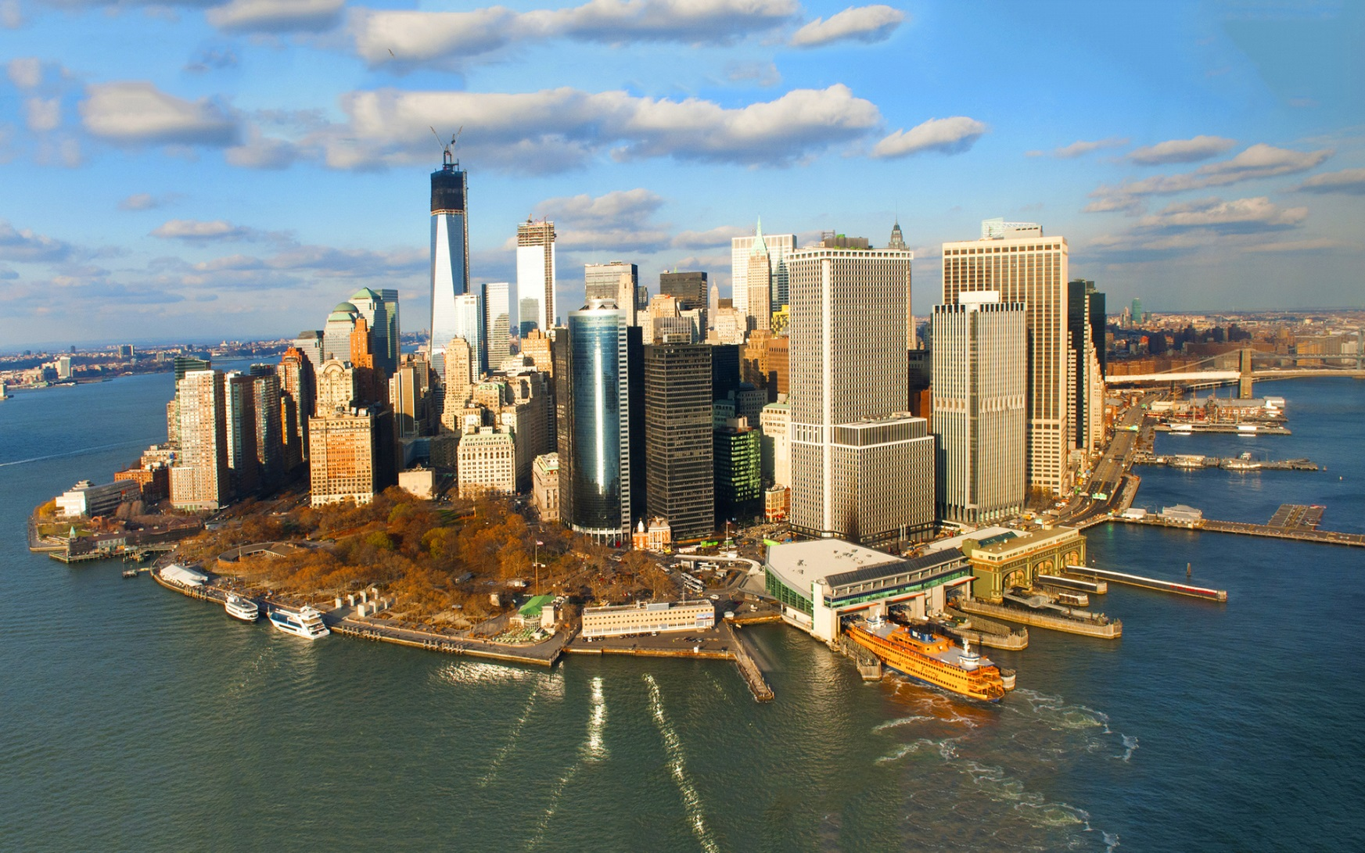
European Bioinformatics Institute, Cambridge
Manhattan

Slide 16
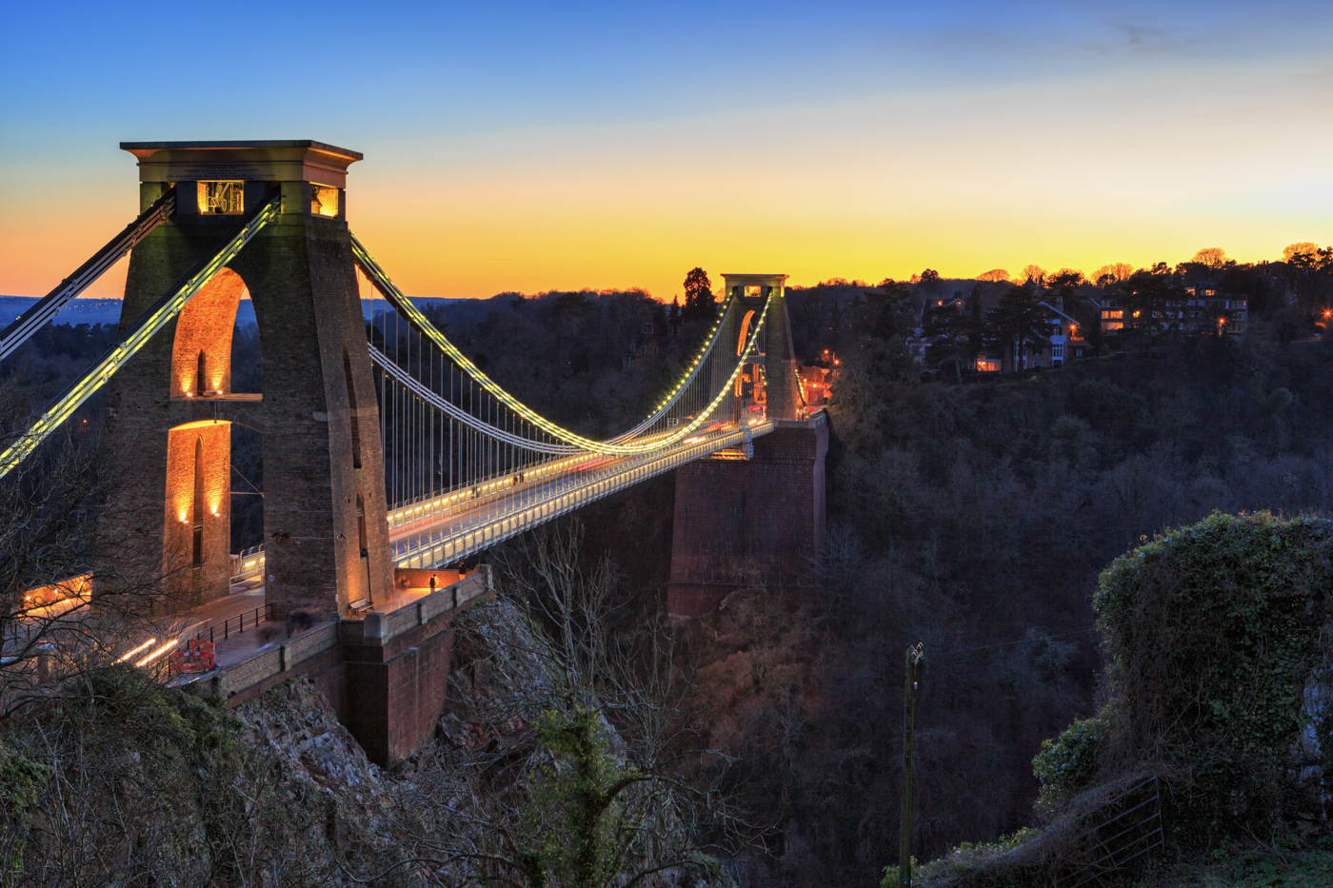
Clifton Suspension Bridge, Bristol

Slide 17
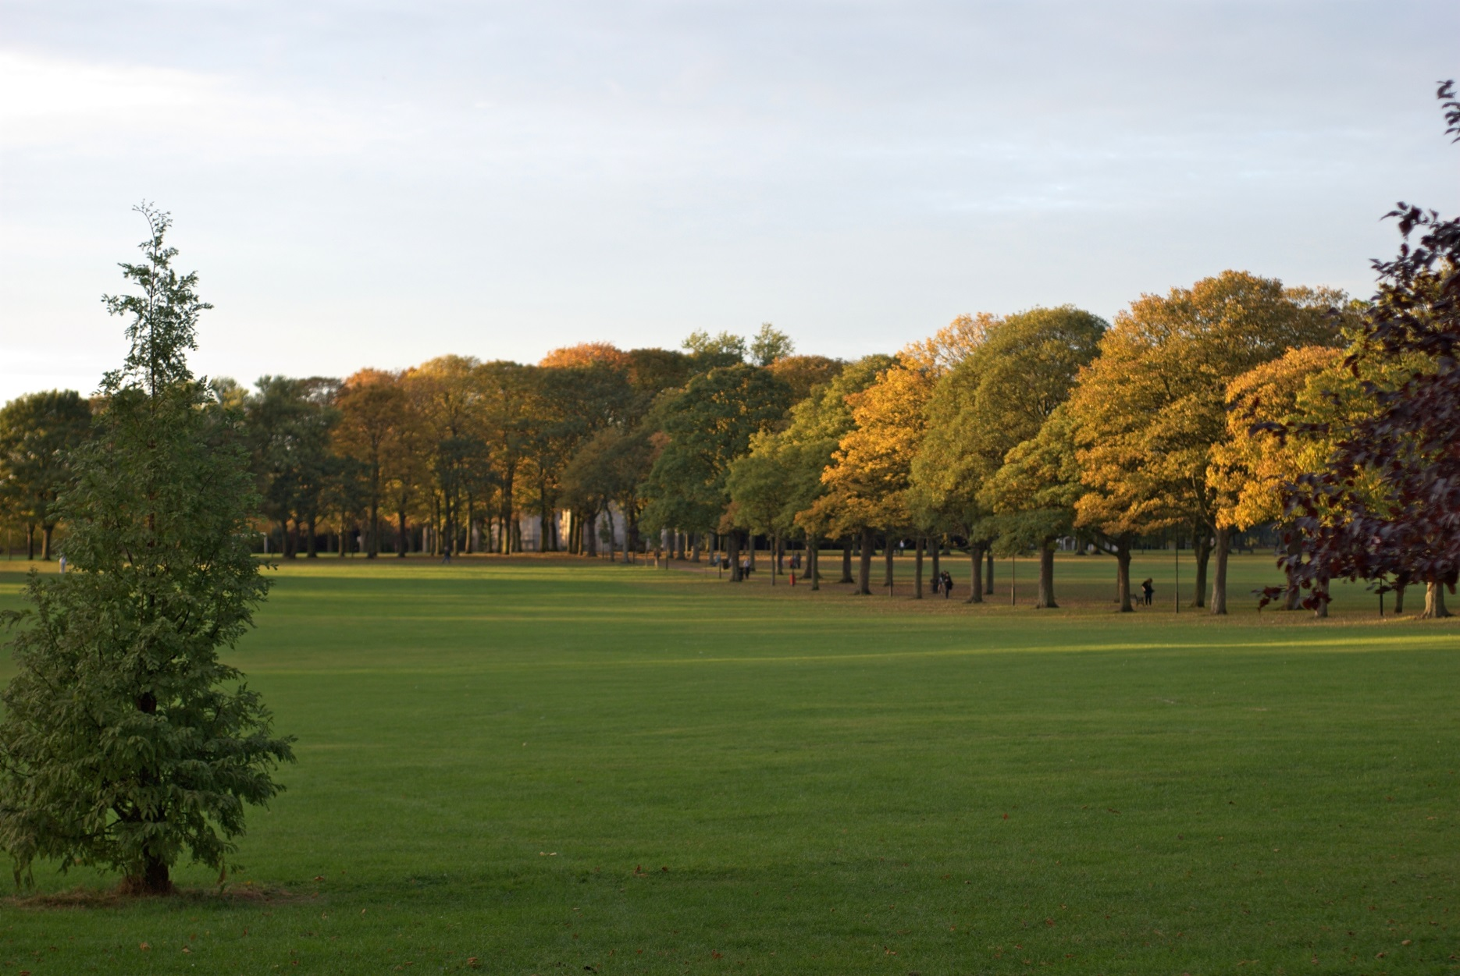
The best of all ☺ - Victoria Park, Leicester

