Slide 1

Identification of a large set of rare complete human knockouts
Sulem P et al., May 2015
Translation: “Here’s a list of genes we don’t need”
Also see:
Sequence variants from whole genome sequencing a large group of Icelanders Gudbjartsson et al, Mar 2015, Scientific Data
Large-scale whole-genome sequencing of the Icelandic population, Gudbjartsson et al, Mar 2015, Nat Genet
Journal club: 27/01/16
Mesut Erzurumluoglu
Notes:
Received 04-14, Accepted 02-15

Slide 2
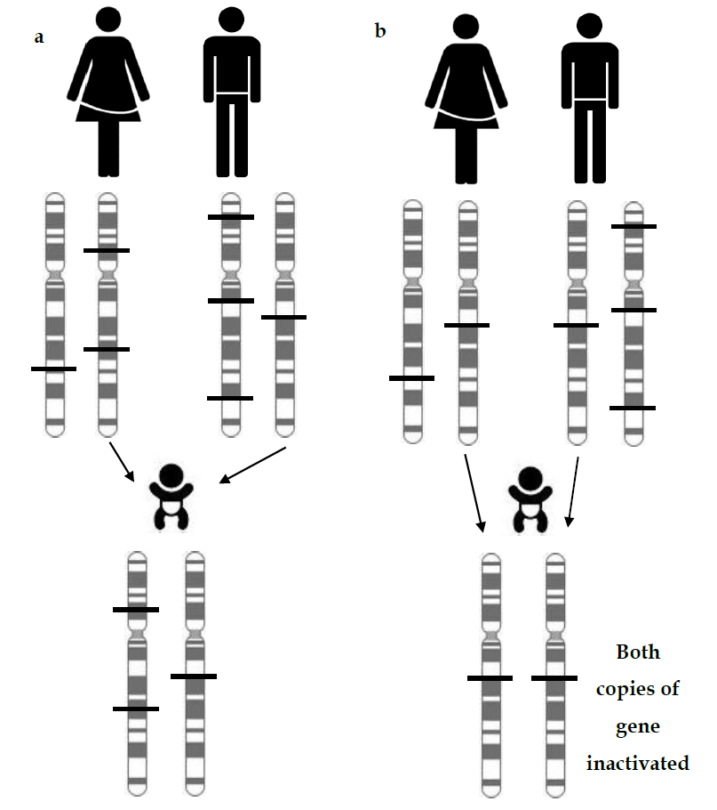
Introduction
Example of difference between union of (a) unrelated (b) related individuals
Everyone possesses LoF variants
  Rare
  Unique to you/your family
  Heterozygous
P(Hom|Unr) ≈ 0

Slide 3
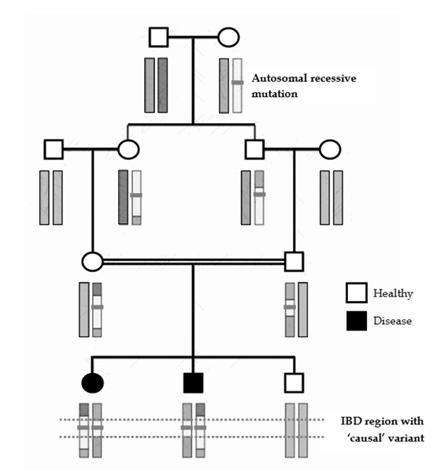
P(Hom|Cons) ≈ 0.0625

Slide 4
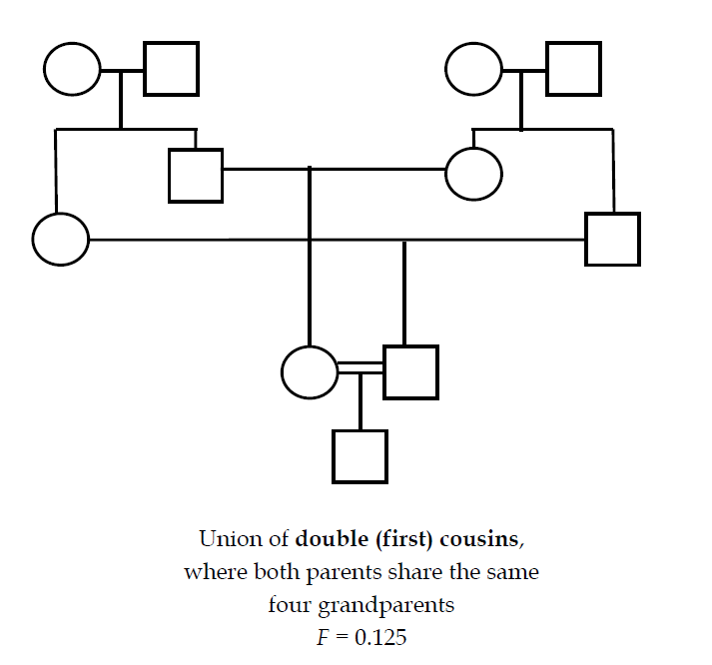

Slide 5
Iceland
Founded ~9th century by a small founder group of Norwegians (~8-20k) without much genetic admixture in future generations – Genetic isolate
Current population size: ~320k
Endogamous population
  Geography
  Elevated levels of homozygous variants
    Violation of HWE

Slide 6
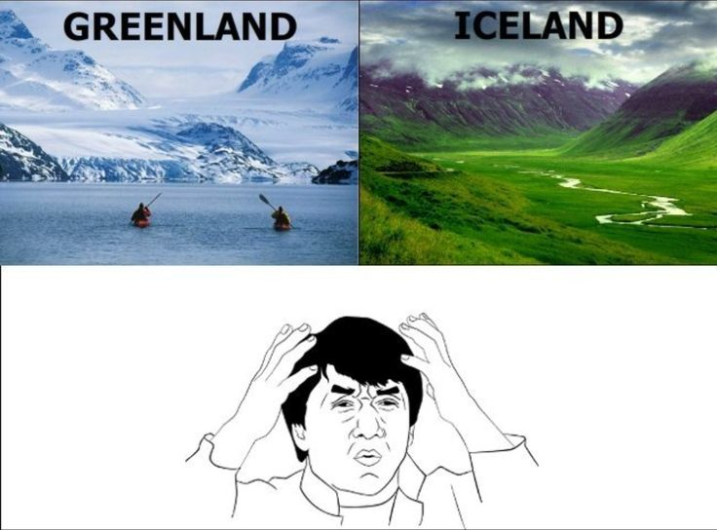

Slide 7
Aims
Impute the genotype data of ~101.5k Icelanders from the whole-genome sequence of ~2600 Icelanders
Identify all loss of function (LoF) mutations
Identify all complete ‘knockouts’
Deficit of knockouts in certain genes
Deficit of human knockouts per se

Slide 8
Aims (2)
Phenotype human knockouts and assess whether they have medical conditions that may be attributed to these gene knockouts
  Link their genetic data with death records in the Icelandic population
MAF of known disease causal mutations

Slide 9
Methods
Genome-wide SNP chip genotyping of 101584 individuals participating in the deCODE Genetics project
Whole-genome sequencing (20x) of 2636 individuals participating in the deCODE Genetics project
  Demographics: Supp. Table 2 and 3
Read alignment – BWA (& GATK)
Variant calling and QC – GATK
  SNPs and short indels
  Comparison with ESP and dbSNP
    for SNP/indels with MAF>2% ~ 100%
  Trio comparisons
    Haplotype sharing <99% excluded
  Sanger sequencing of ‘knockouts’
    47/49 of complete knockouts (96%)
    152/155 of carriers (98%)

Slide 10
Methods (2)
Imputation and QC - IMPUTE
Variant annotation - VEP
Excluded sex chromosomes
MAF of 2% chosen as threshold
  Cystic fibrosis being the most common Mendelian disease in northern Europeans with an incidence of 1 in 3200
  HWE => 1.8%
Screen for known mutations - HGMD

Slide 11
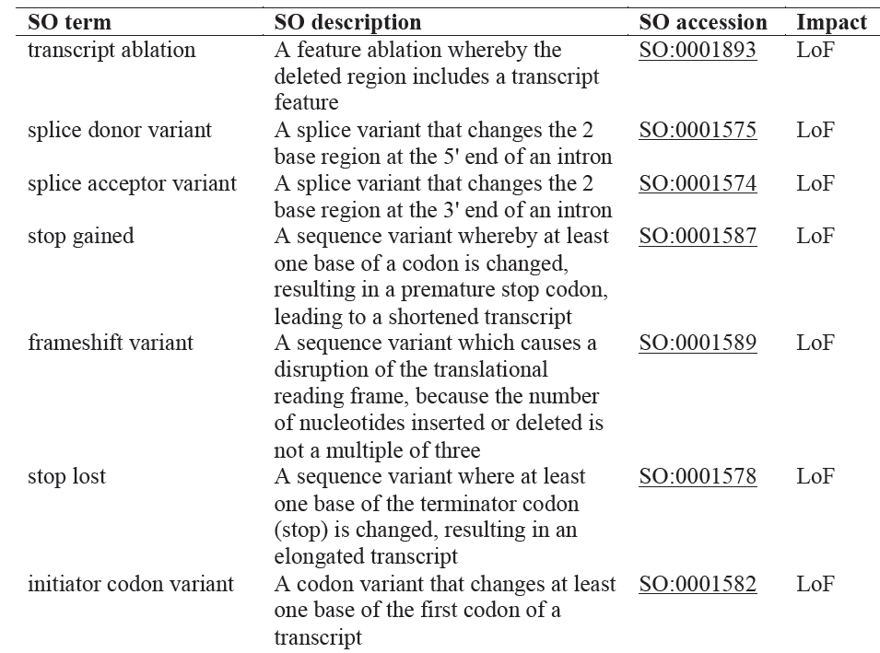
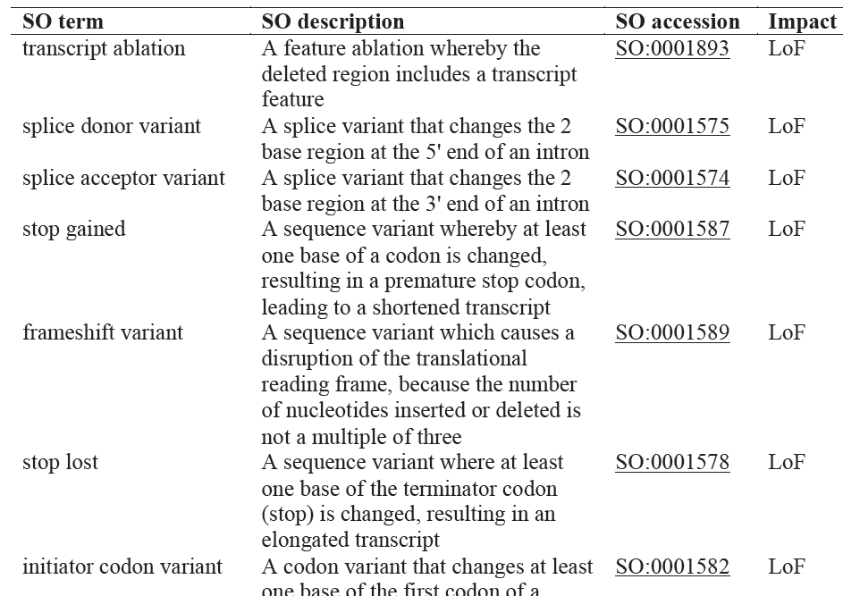
Methods (3)

Slide 12
Methods (4)
Genes highly expressed in 27 tissues
  FPKM> 20
  Excluded gene if FPKM>20 in all tissues
RNA-seq in 262 Icelanders with stop gains (n=215)
  Read alignment – Tuxedo protocol
  Allele specific expression of a gene – Samtools (mpileup)
Notes:
Fragments per kilobase of exon per million fragments mapped – Fagerberg et al

Slide 13
Results
All variants called in 101584 + 2636 individuals
SO terms from VEP
6795 loss of function variants in 4924 genes
MAF <2%
6285 loss of function variants in ? genes
Homozygous
Unique variants
1485 homozygous loss of function variants in 1171 genes
Unique genes
1171 unique genes ‘completely knocked out’ in 8041 individuals

Slide 14
Results (MAF <0.5%)
All variants called in 101584 + 2636 individuals
SO terms from VEP
MAF <0.5%
5775 loss of function variants in ? genes
Homozygous
Unique variants
907 homozygous loss of function variants in 775 genes
Unique genes
775 unique genes ‘completely knocked out’ in 1741 individuals

Slide 15
Results
Overall, they identified 4924 genes that harboured disruptive mutations (n= 6795, 3979 SNVs)
  Singletons in 3603 genes
85% of LoF variants were rare (<0.5%)
For 1171 of these genes, they found ~7.7% (n= 8041) of Icelanders are either homozygous or compound heterozygous for a LoF mutation
Notes:
Singleton: Single LoF mutation found in 3603 genes

Slide 16
Results (2)
Homozygous LoF of two heterozygous parents occurred less frequently than expected
  1.36% deficit (95% CI: 0.1-2.61%) for variants with MAF <2%
Genes highly expressed in the brain (3.1%) are less often ‘completely knocked out’ compared to other genes (3.9-6.9%)

Slide 17
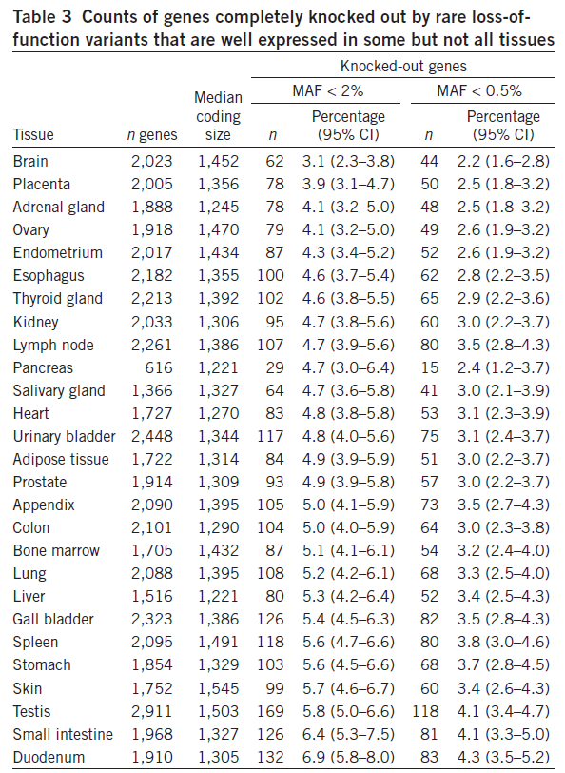
Results (3)
Table 3:
Highly expressed gene set
Supp. Table 9:
Tissue-specific gene-set

Slide 18
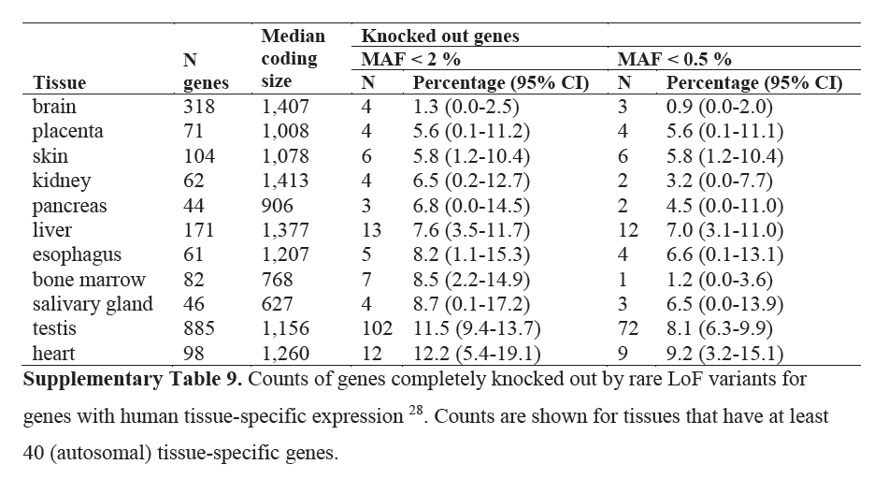
Results (3) continued…

Slide 19
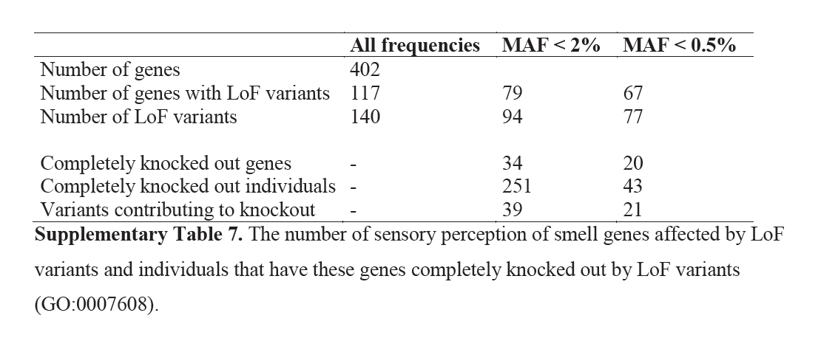
Results (4)
34 out of 1171 genes (~3%) belong to a class of olfactory receptor genes
Similar results (9.2%, highest %) were also observed when the mouse knockout homologues were analysed (Supp. Table 10)

Slide 20
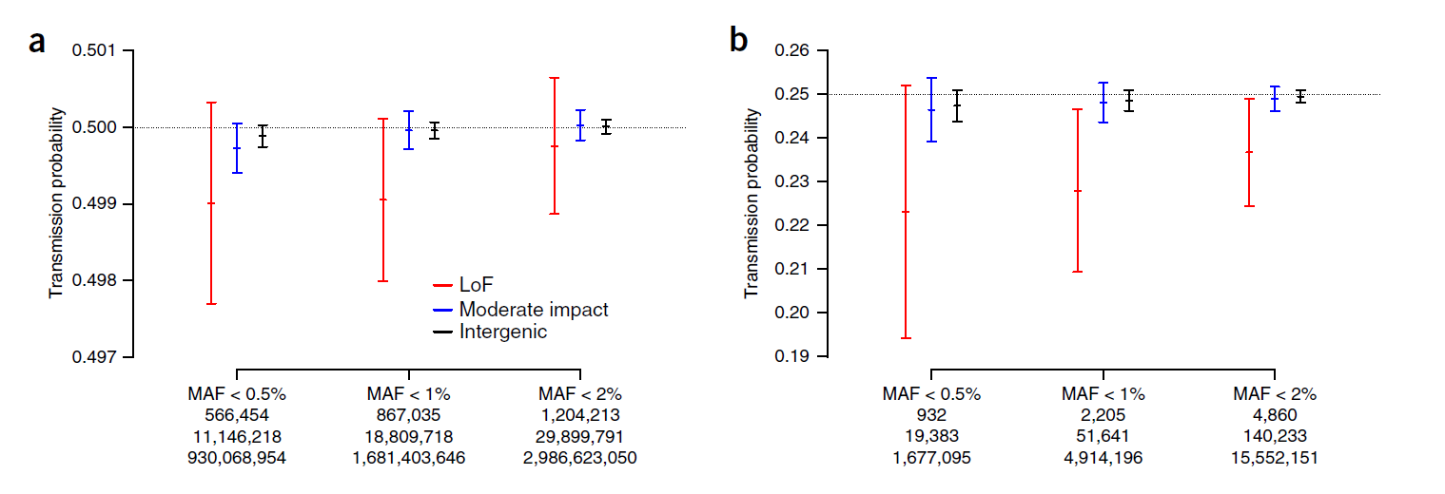
Results (5)
Figure 1: Transmission probabilities from carrier parents (a) from a single heterozygous parent (b) two heterozygous parents
Notes:
No of informative transmissions, where both parents are heterozygous are below graphs

Slide 21
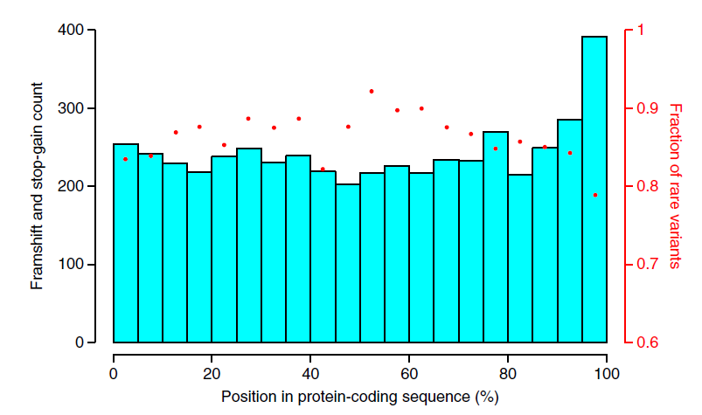
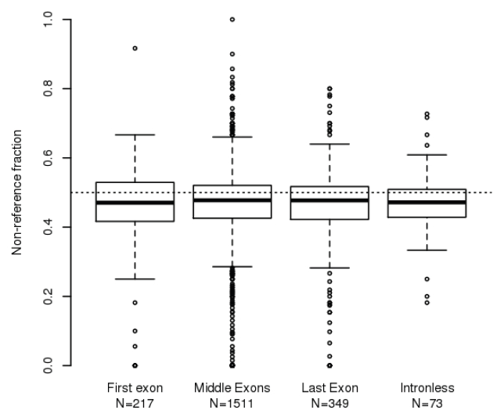
Results (6)
Figure 2
Supp. Figure 7
  Nonsense mediated decay of transcripts with premature stop codons
  Lowest FRV near C terminus of protein as strength of selection decreases
  Consistent with RNA-seq results: 0.36 (95% CI: 0.33-0.38)
Notes:
Stop gain mutations in the middle exons of genes have lower non reference allele fractions than stop gains in the first or last exon, in contrast to synonymous SNPs whose allele specific expression did not depend on the position of the variant
As the strength of negative selection increases, a greater FRV is expected

Slide 22
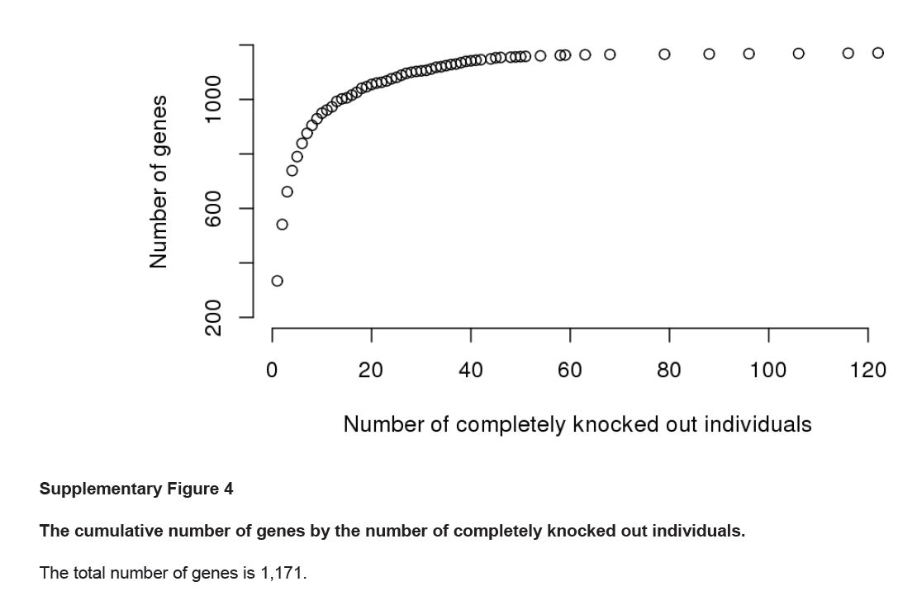
Results (7)
790
5
Notes:
They observed 5 or fewer complete knockouts for 790 of 1171

Slide 23
Results (8)
74.2% of LoF variants affected all transcripts of a gene
Indels overrepresented in LoF variant set
  7% (all sequence variants) to 41%
DHCR7 (c.964-1G>C) – splice acceptor variant
  ~19 homozygotes expected, 0 observed
  Smith-Lemli-Optiz syndrome
  Embryo loss or early death

Slide 24
(Their) Discussion
Observed deficit in double transmission
  Homozygotes are missing from the population
    Early death
  Homozygotes undersampled
    Illness/disability
Previous study by McArthur et al identified 253 complete knockouts
  Smaller sample size (n= 185, WGS at 2-4x)
Future work: follow up knockouts
  OTOP1 and LRIG3 knockouts

Slide 25
Conclusions
Massive dataset (n= 6795 LoF variants)
  Gudbjartsson et al, 2015, Scientific Data
Lots of potentially ‘knocked-out’ genes
  Reverse genetics approach
Genes highly expressed in brain seem to be (relatively) less ‘knocked-out’
Knockouts can reveal selective pressure on certain genes
  Least: Olfactory receptors, Keratin genes
  Most: embryo/foetal loss and early-onset diseases

Slide 26
(My) Discussion
By far the largest (published) study to date on human knockouts and provides a valuable resource in the discovery of the role of complete human knockouts in general populations
Although the study was performed on a genetic isolate, some of its results seem to be generalisable; for example, the tendency of knockout events to affect olfactory genes
Particularly the step from knowing the sequence in 2600 individuals to expanding this to more than 100,000 individuals is where the real power of this publication lies
Really impressive considering Iceland’s population (~320k)

Slide 27
(My) Discussion
As the study cohort was mixed, their impressive list of 1171 genes with biallelic LoF variants should not be interpreted as a list of genes that do not cause disease in humans
  LRIG3 and OTOP1 – auditory evaluation to assess for hearing loss
Different from MacArthur et al and Alsalem et al (n= 77, WES) as their cohorts were selected such that severe Mendelian diseases (casual variants) were excluded
  Common variants (most with MAF>2%)

Slide 28
(My) Discussion
Data provided allows stratifying by ‘offspring death before age 15’ – allowing observation of genes which cause early-death when knocked out (≥1 copy)
  BRF2 (splice-site donor, c.214+1G>A)
    Expected 7, observed 1
Genes that are NEVER seen as homozygotes even though we would expect several individuals
  ATP5F1 (p.Arg185*)
    Expected 11 homozygotes, observed 0
  KIAA0020 (p.Lys87Ilefs*12)
    Expected 5, observed 0

Slide 29
(My) Discussion
Large-scale whole-genome sequencing of the Icelandic population, Gudbjartsson et al, 2015, Nat Genet
  MYL4 (p.Cys78Trpfs*29) causes early-onset atrial fibrillation
  ABCB4 (several frameshifting indels found) increases risk of liver diseases
  GNAS (intronic variant) associated with increased thyroid-stimulating hormone levels when maternally inherited
    Not in dataset

Slide 30
(My) Discussion
BRCA2 and APC are well established (dominant) disease genes for breast/ovarian cancer and colon cancer, respectively.
  Human knockouts for BRCA2 (primordial dwarfism) and APC (severe limb malformation) have astonishingly different phenotypes from those of the established dominant phenotype in haploinsufficient individuals

Slide 31
(My) Discussion
Single/few instances of highly penetrant mutations can inform public based studies
  Familial hypercholesterolemia (LDLR gene)
    Develop coronary heart disease by the time they’re 55
  PCSK9 knockouts protect individuals from cholesterol-driven cardiovascular diseases
Analbuminaemia
  Metabolic defect characterised by an impaired synthesis of serum albumin
  Albumin is the most common serum protein (ALB gene)
  Benign condition
SNPs falling near Mendelian forms of some diseases
  Nephrotic syndrome
    Monogenic
    Multifactorial complex

Slide 32
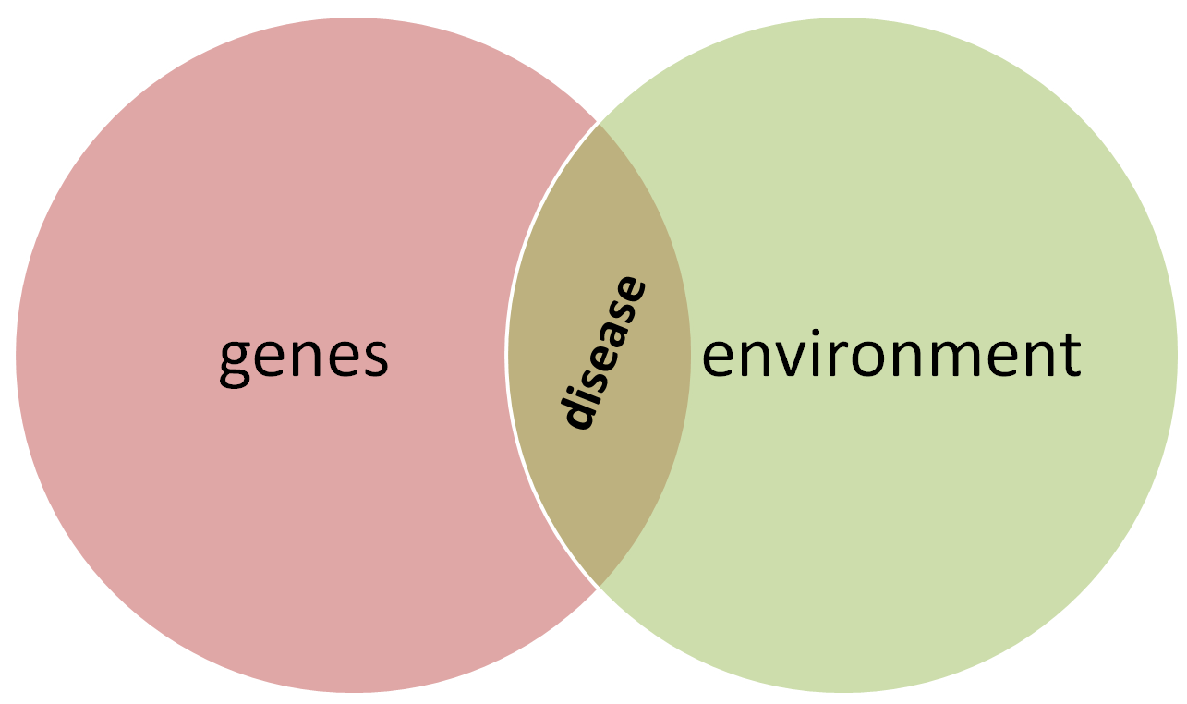
(My) Discussion
Environmental factors can also be important determinants
  FUT2 knockout may lead to clinically consequential B12 deficiency only in nutrition deficiency states

Slide 33
(My) Discussion
“LoF” mutations?
  Not much functional analysis to support their claims
‘Predicted high impact’ (PHI, Φ) mutations
  Rare stopgains, frameshifting indels, missense, splice-site acceptor/donor variants, start loss
Residual Variation Intolerance Score (RVIS)
Data is available for filtering according to our own definitions

Slide 34
Maybe of interest…
GPR126 (p.Ser1140X)
MYPN (p.Pro87LeufsX19)
MAPT (p.Arg448X)
MICB (p.Arg193X) – homozygote
MICA (p.Val300CysfsX86) – homozygotes
BTN2A1 (p.Asp196ThrfsX10) - homozygotes
HLA-DQB1 (splice-site acc/don) – homozyg.
ENSA (p.Gln101X)
TAP2 (p.Arg449X) - homozygote

