Slide 1
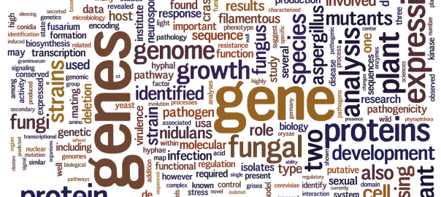
Identifying disease causal variants
Mendelian disorders
A. Mesut Erzurumluoglu
epmmee@bristol.ac.uk
Notes:
Good morning.
Just to introduce myself, I’m Mesut.
So this hour’s talk is about Identifying Mendelian disease causal variants.
I’ll talk for around 30 mins before we try out what we’ve learned in a practical.
If you’ll have any urgent questions, please ask them as we go along; but if they’re not urgent since we’ll have a lot of time at the end for a practical I’ll come around and answer your questions that way.
Question: Ice-breaker – Difference between Mendelian and complex disorder?

Slide 2
Contents
Whole process
Data formats
Identifying candidate genes
Analysis
  Finding candidate regions
    Consanguineous
  Finding causal variant
Practical
Notes:
I don’t like putting up a slide for contents but as you’re on the fourth day – you must have a lot of information in your head that’s not fully connected yet. So I don’t want this lecture to be just another one where I just spurt out some information and expect you to make sense of everything.

Slide 3
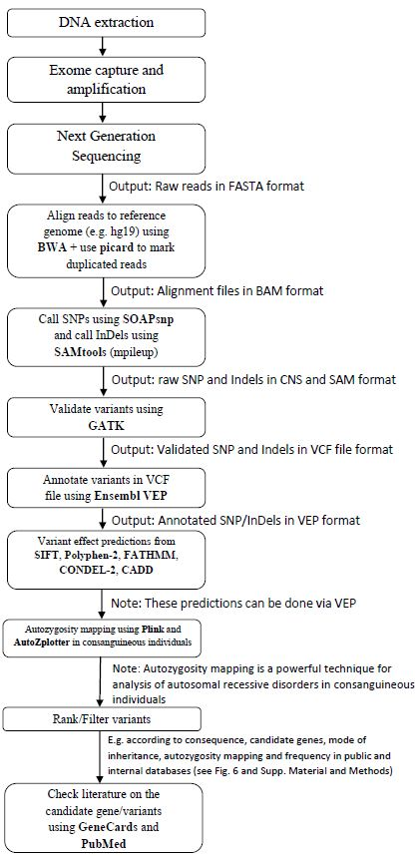
Whole process
Denis (Day 3)
Hash (Day 3)
Me
Notes:
So kick off I’ve put this slide is here to put things into context so that you know which talks to connect. As you can see my talk is located towards the end of the process when analysing Mendelian disorders.

Slide 4
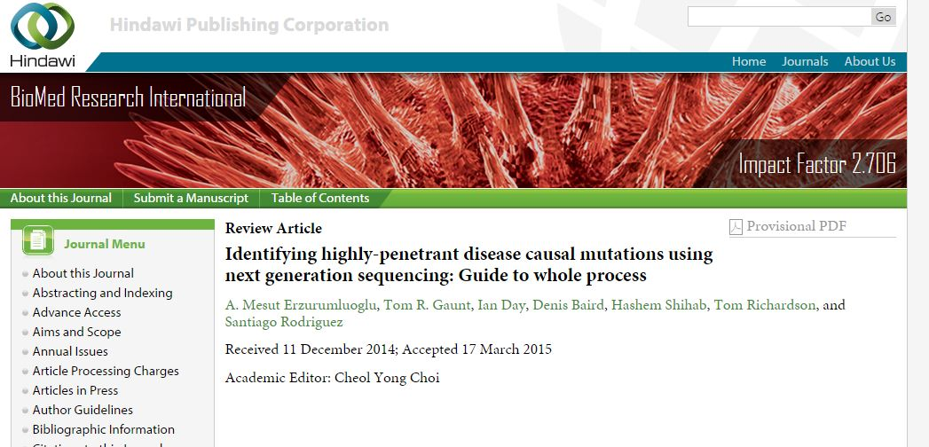
Published review
Erzurumluoglu et al. Mar 2015.
  BioMed Research International

Slide 5
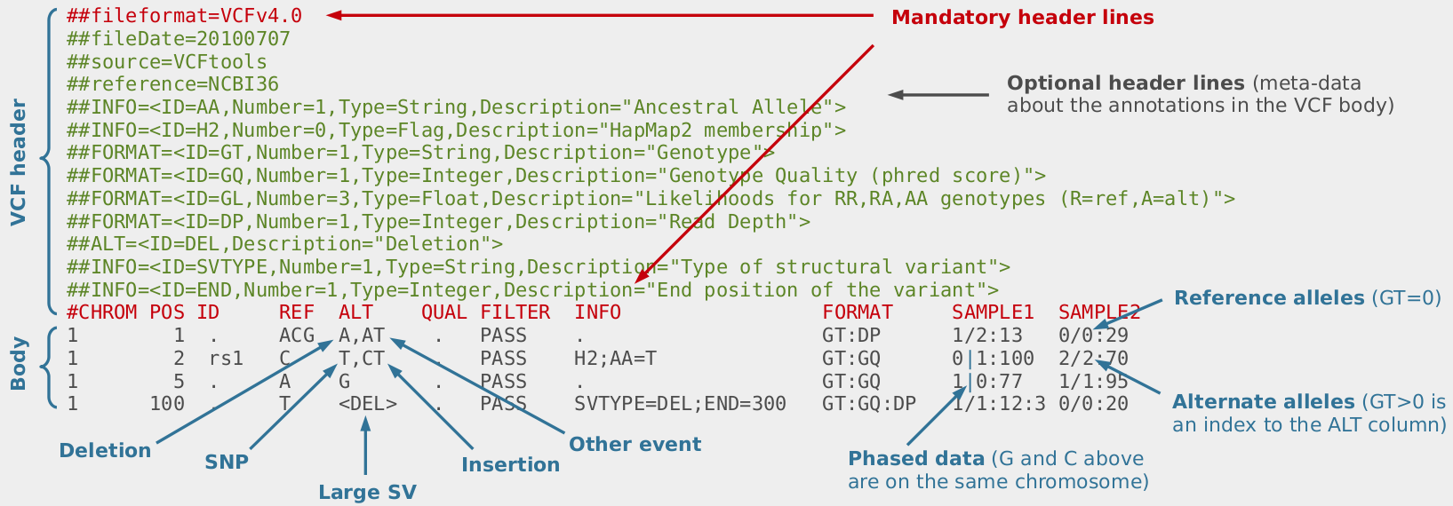
VCF file
FASTA file
  We are 99.9% similar
Only variants with relation to a reference genome (e.g. hg19, hg38) are included
Link: http://bioinf.comav.upv.es/courses/sequence_analysis/
Notes:
So I’ll take a couple steps back and remind you a few things about VCF files – which you must have seen in Denis’ talk

Slide 6
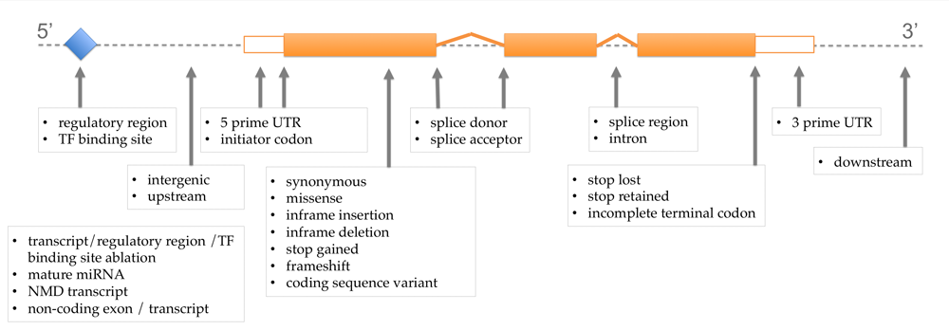
VEP annotated data
Consequences of variants
See link for meaning of each SO term: http://www.ensembl.org/info/genome/variation/predicted_data.html
Notes:
Once you have a vcf file, you’d then want to get some annotations for the variants in the vcf file – in Bristol we usually use Ensembl’s VEP annotations. Hopefully Hash will have said a few things about VEP.

Slide 7
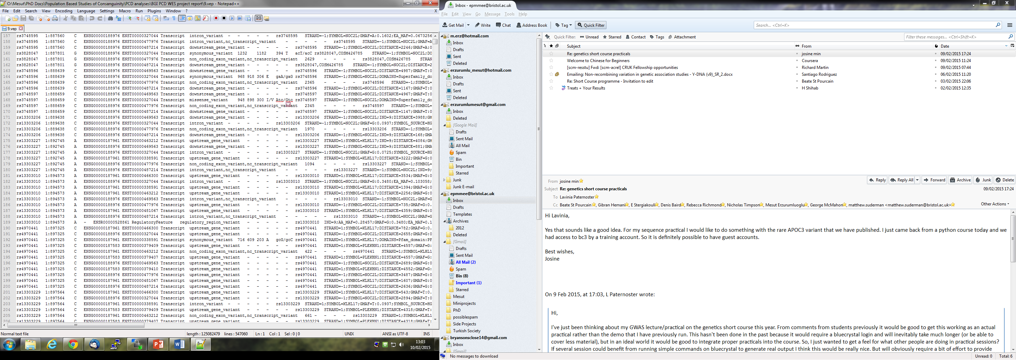
Several consequences for one mutation?
?
?
See link for annotation options: http://www.ensembl.org/info/docs/tools/vep/script/vep_options.html
Notes:
In a vep file, just like in this example here, you’ll see several consequences for the same mutation. So here you see 4 different consequences for this SNP here. Why?
Because this gene has three transcripts! And therefore, there has to be a consequence for each transcript
Things will be clearer in the next slide

Slide 8
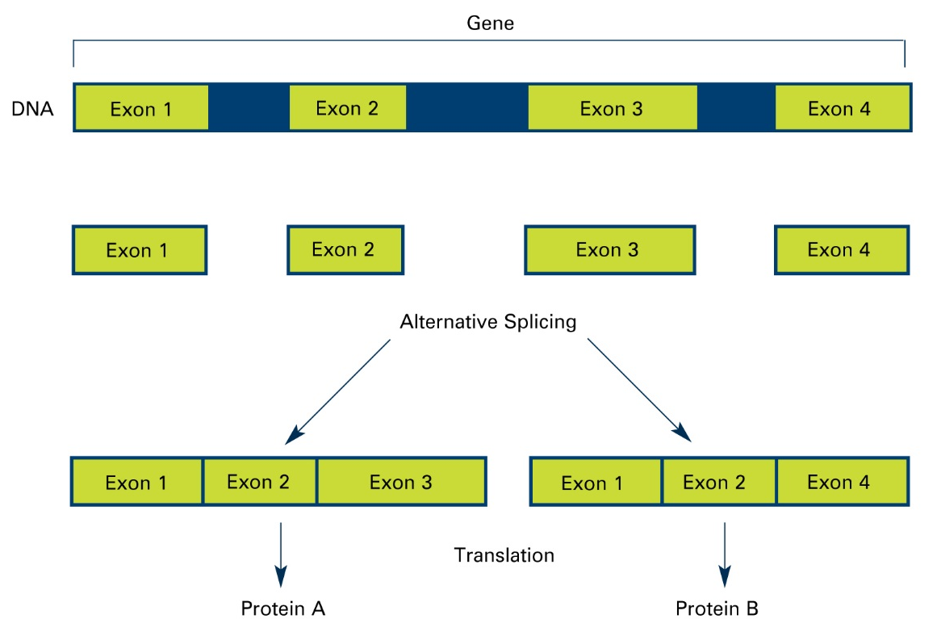
Alternative splicing
X
Transcript 1
Transcript 2
X
Source URL: www.pandasthumb.org/
Notes:
So by now you should have heard of something called alternative splicing which is the reason why there can be several transcripts of a gene. And if our mutation falls into exon 3 as in this example here, then the mutation will have an impact on the transcript which codes for transcript 1 but not for transcript 2.
As a side note: apart from alternative splicing, there could be another reason why the same mutation could have more than one effect on the genome. Can anybody think of it?
Mention: Overlapping genes!

Slide 9
Different Transcripts
Same mutation, different effect
‘Canonical’ transcript
  Longest transcript
  Will be fine to use for most genes
Reporting variants:
  See HGVS nomenclature guidelines
  Transcript ID:Nucleotide change:Protein change
  e.g. NM_024763.4:c.2525C>T:p.(S842F)
  Check using Mutalyzer
    Position converter (example: chr1:g.12345A>T)
    Name Checker
Notes:
So hopefully this has made things clear. That’s the main thing which confuses people when they look at a vep annotated file.
So now we know why there could be many annotations for the same variant and therefore why there can be different effects of the same variant.
Nowadays the main problem with data is that they’re too large for one to analyse. So to make analyses simpler, people like me usually analyse what is called the canonical transcript for each gene.
Return to previous slide to explain why using only canonical transcript can be a problem

Slide 10
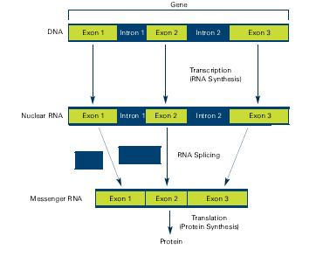
Canonical transcript – for most genes…
Source URL: www.pandasthumb.org/

Slide 11
Understand your disease!
Mode of inheritance
  Autosomal recessive
  Autosomal dominant
  X-linked
Prevalence
Known genes/variants
Any complications?
  Genetic heterogeneity
  Incomplete penetrance
  Pleiotropy
Notes:
Usually looking for one causal variant – unlike in complex disorders

Slide 12
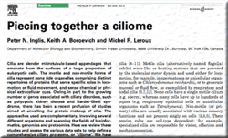

*Candidate genes
Literature
  e.g. Latest review on disorder
Disease specific databases
  e.g. Ciliome database
  LOVD
List 1
List 2
Notes:
After understanding what your disease is like, you’d want to create a list of candidate genes. I usually make two lists. One which contains all known genes and another which contains all suspected candidate genes. Of course the first one enables me to screen for known variants as this is the first thing we should all do when analysing sequencing data. Once you’re happy that your data doesn’t contain any of the known variants, then you can be excited about finding something novel.
So how do you create these lists?
* Means show them how to find them – open pubmed and enter appropriate keywords – Bardet-Biedl syndrome, ciliome database and cancer database

Slide 13
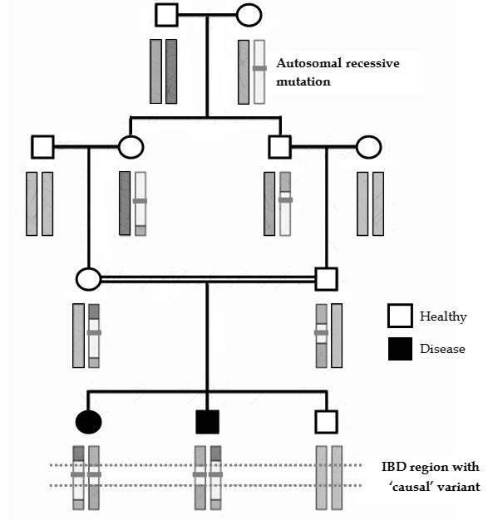
Filtering - Autozygosity
Consanguineous individuals
  Mostly first cousins
  Elevated risk of AR diseases
Autozygous regions
  Long runs of homozygosity
This slide is relevant to data obtained from consanguineous individuals only!
Notes:
Once you’re happy with your candidate gene lists, we can now move onto the filtering stage. So we have our vep annotated file but it’ll have tens of thousands of variants if you’re working with WES data. And millions, if you’re working with whole-genome data.
How you analyse your data will depend on the type of individual you’re analysing. Clinically relevant Mendelian disorders are usually rare due to natural selection as they affect the fertility of the affected individuals. Thus the variants which cause them are also rare.
However autosomal recessive disorders are even rarer as they require both the mother and father to be carriers. Therefore clinically relevant AR disorders in outbred populations is extremely rare. However the probability of an AR disorder is inflated in consanguineous individuals. The reason behind this is simply explained in this diagram here. So this cuts down the part of the genome we need to analyse by approx. 15/16.
I guess Santi had said a few things about this on the first day

Slide 14
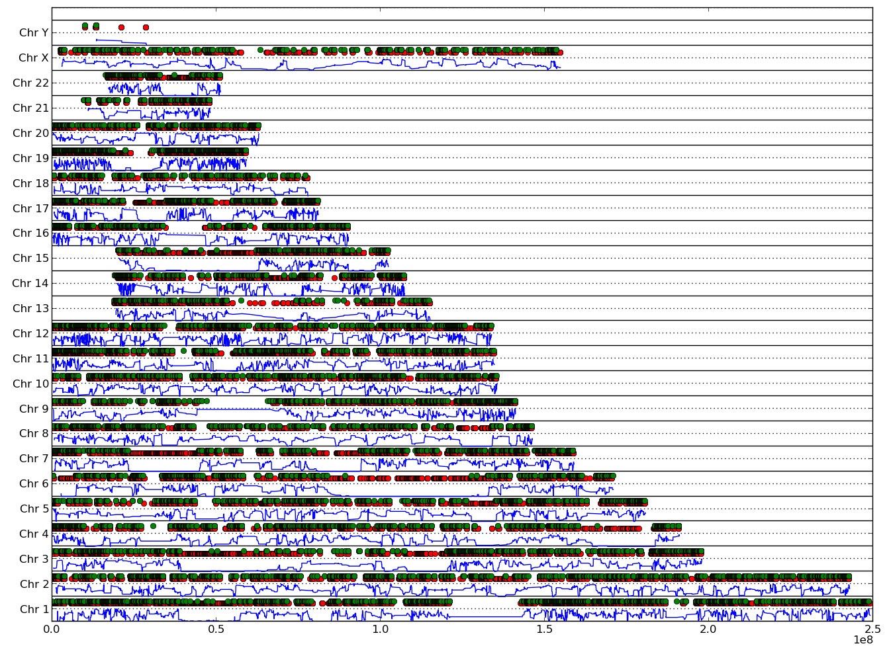
AutoZplotter
Homozygous
Heterozygous
Erzurumluoglu et al., 2015. BioMed Research International
Notes:
To help you with this, we’ve made available an easy to use plotter which plots the heterozygosity/homozygosity status of all the variants in a vcf file

Slide 15
Filtering – Variant status
Autosomal recessive
  Consanguineous: check autozygous regions (IBD)
  Unrelated (could be IBD or IBS)
Autosomal dominant
  Inherited – affected parent has to possess variant
  De novo
X-linked
  Recessive
  Dominant
Notes:
So the previous slide applied only to data from consanguineous individuals. The next three slides apply to all data types – both consang and outbred. So you would first be looking to think through which variants fit the mode of inheritance of your disease. So to use an example: a variant causal of an autosomal recessive disease has to be homozygous in the affected individuals and not in the unaffected ones.

Slide 16

Filtering - MAF
Calculating your threshold
  HWE: p2 + 2pq + q2 = 1 (where p + q = 1)
    q: frequency of disease causal mutation
    e.g. if AR disease is 1 in million, then q is 0.001
  Disease causal mutation cannot be common!
1000 Genomes Project
  1092 samples (Phase I)
  Incorporated by VEP
Exome variant server (EVS)
  6503 samples
  Incorporated by VEP
ExAC
  60,706 samples
  Download via FTP
Notes:
We’ve come across the HWE in my lecture in the previous shortcourse.

Slide 17
Filtering – Consequence to protein
Not predicted to be high impact mutations:
  Coding
    Synonymous
  Noncoding
    Upstream and Downstream of genes
    Intron
    5’ and 3’ UTRs
Notes:
Another pragmatic bit of filtering would be to filter out all variants which are not predicted to have a high impact such as synonymous mutations and non coding variants.

Slide 18
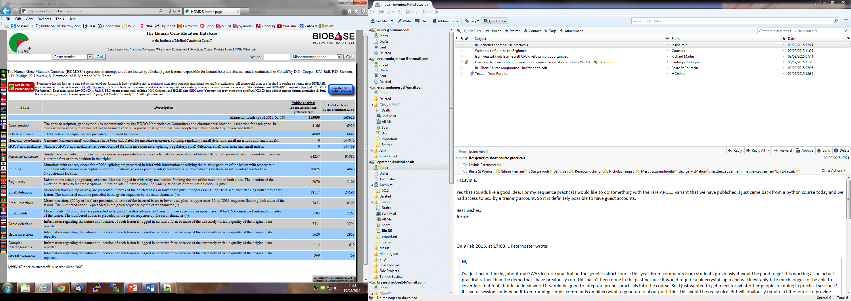
*Building Evidence – Known variants
OMIM – Mendelian diseases
HGMD
  Public – All reported mutations but 3 years behind
    Incorporated by VEP
    Variant position
  Paid – All mutations
ClinVar
  All clinically relevant mutations
  Download from FTP link
Notes:
So hopefully once you’ve applied these filtering steps you should be left with a variants to follow up. So you return to the literature to see whether any of them were already reported previously. You can check this by using these databases.
* Open OMIM and HGMD and show how to use – HGMD466448, BBS2 gene

Slide 19
*Building Evidence – Mutation effect prediction
Most probably ‘loss of function’ mutations:
  start losses
  splice acceptor/donor
  stop gains (especially NMD)
  frameshifting indels
  missense mutations
Predicting effect of Missense mutations:
  FATHMM-MKL & CADD (all variants, including non-coding)
  SIFT & Polyphen-2
(General)
Probability of being functionally disruptive
Notes:
OK so you’ve checked the databases and found that your variants are absent indicating that you’ve potentially identified a novel variant and/or gene. I would be very happy if I saw a start loss, a splice site acceptor/donor variant or a stop gain in the list as they are likely to be functionally disruptive. If I only have missense mutations, I would then look to predict the effect of these mutations using software such as FATHMM, CADD and the famous ones SIFT and PolyPhen2.
*Show order of vep’s severity

Slide 20
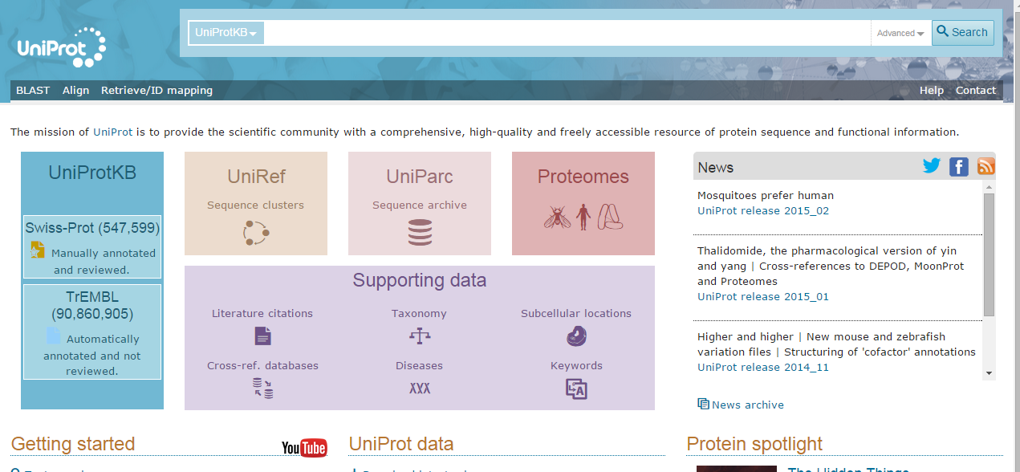
*Building Evidence - Conservation
GERP++
  Download ‘Tracks Data’ - Elements (hg19)
Local sequence alignment
  UniProt
    BLAST
    Align
Notes:
You would then look to see if your variant resides in a conserved region and whether the variant itself is conserved.
*Show GERP++ site and UniProt site, DNAAF3, P residue after two T’s

Slide 21
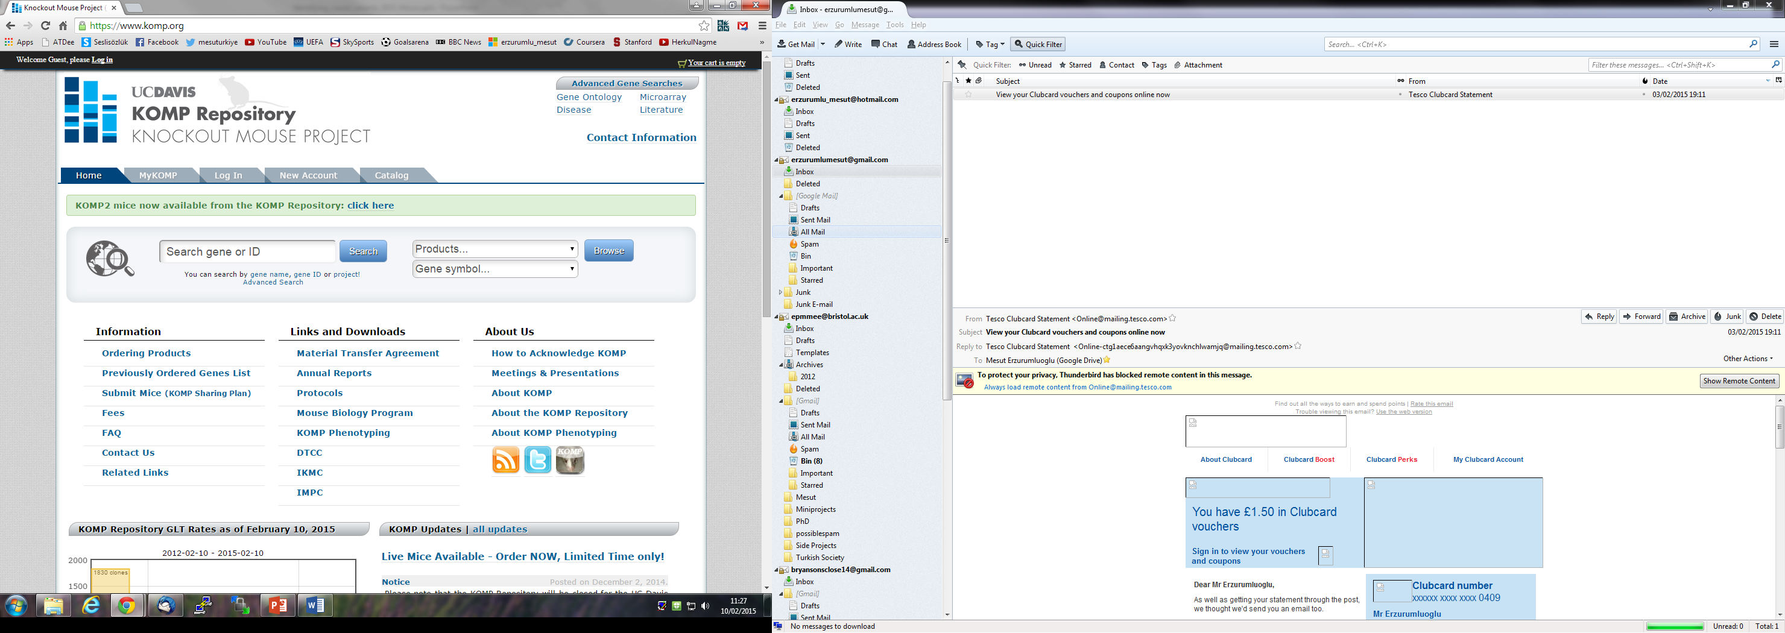
Building Evidence – Animal models
Check literature
Mouse knockouts
  Other model organisms
Functional studies
  In vitro
  In vivo
Notes:
If you have a variant in a novel gene, then the best bit of evidence would be find a study where they’ve knocked the gene out in a model organism.

Slide 22
Building Evidence – Gene expression
Which tissues is the protein expressed in?
ENCODE data
  Tonnes of expression data for tens of cell lines
  Load track via UCSC Genome browser
  Ensembl Genome browser
GeneCards
  Integrative webpage
Notes:
It’s important to check which tissues your gene is expressed because if you think you’ve founf a gene which causes intellectual disability but you find that it’s only expressed in the foot then it’s gonna be pretty hard to sell that to a journal.

Slide 23
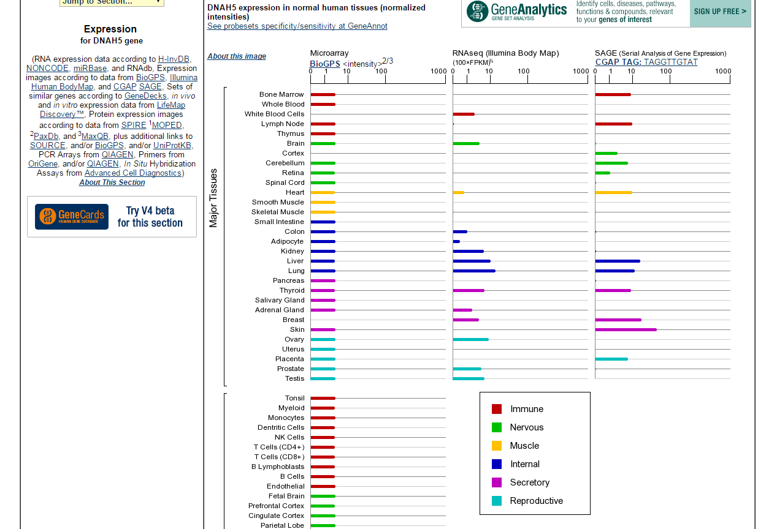
*GeneCards
Notes:
DNAH5 causes PCD which is a respiratory disease. So you’d expect the gene to be expressed in the lungs and as you can see it is.

Slide 24
Building Evidence – Replication
  Gold standard but not always possible
  Traditional: LOD score of 3 (p≤ 0.001)
Very rare disorders
  Parents and unaffected siblings
  Other affected siblings/cousins
  Check in other affected families
  Genotype variant in local population
Notes:
As you will have heard multiple times in the previous lectures, replicating your result is the best way to build evidence for your variant. However as Mendelian disorders are likely to be rare, this may not be always possible. Therefore it is essential to collect as much data as possible from the affected family.

Slide 25
Simple analysis pipeline
Create files:
  PHI_SO_terms.txt
    List of ‘most probably’ causal consequences
  Candidate_genes.txt
    List of candidate genes
  Example:
    grep -f PHI_SO_terms.txt file.vep | grep -f Candidate_genes.txt | grep CANONICAL | grep HOM | grep _[A-Z]/ | cat | less -S
Severe consequences
Candidate genes
Canonical transcripts
Homozygous variants
Rare variants
(absent in 1000GP)
Notes:
So we’ve talked about the theory behind the filtering steps we’d usually apply. This slide shows how you would apply the filters quite easily using UNIX commands. So if you remember, I talked about creating a list of candidate genes. I also talked about filtering mutations which we think wouldn’t have a high impact on the function of the gene. So I’d create another list containing the sequence ontology terms for the high impact consequences. You’ll see an example in the next slide. Once we have made these two files, we can then just grep out all the variants which are located in our candidate genes…

Slide 26
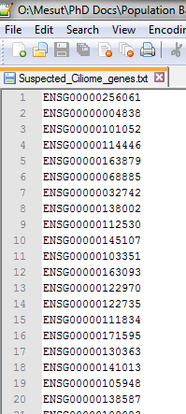
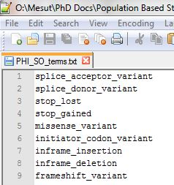

Slide 27
VEP annotated data
Consequences of variants
See link for meaning of each SO term: http://www.ensembl.org/info/genome/variation/predicted_data.html
Notes:
So we got these terms from the ensemble VEP website – we saw before in slide 6

Slide 28
Learning objectives
Making sense of VEP annotated data
  Different transcripts and mutation effects
How to create and use candidate list(s)
How to look for causal variants
  Filtering
  Setting threshold for MAF
Building evidence for variants
Reporting variants (e.g. for papers, databases)
Notes:
So this is my final slide before we move onto the practical. So hopefully now you can make sense of a vep annotated data when you see one…

Slide 29
Thank You
Any questions?
Please look back at the slides again once you complete the short-course(s)

Slide 30
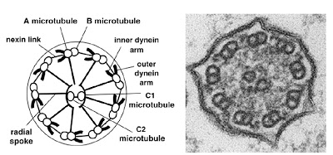
Practical
Proband is affected by Primary ciliary dyskinesia
  Hint 1: Autosomal recessive
  Hint 2: Prevalence is ~ 1 in 20000
  Hint 3: Genetically heterogeneous
PCD is characterised by abnormal cilia function and/or structure which consequently leads to chronic sino-pulmonary infections

Slide 31
Exercise
1- Create list of candidate genes (max: 15 mins)
  Ensembl IDs in txt file
2- Find causal variant (in Practical_file_Mesut.txt)
3- Backup variant with evidence
  Conservation
  ‘Model’ organisms
  Literature
4- Report causal variant in HGVS format

Slide 32

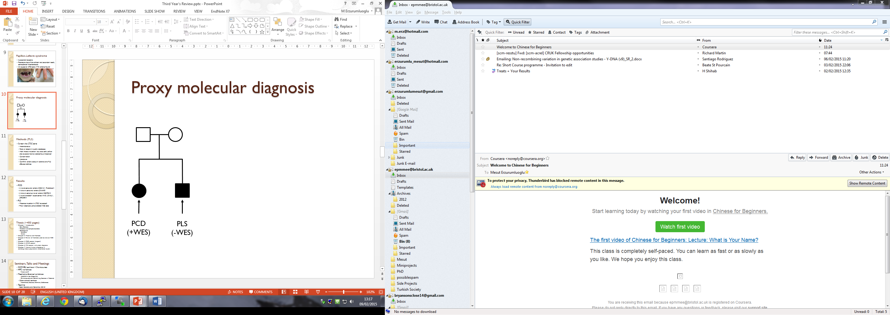
Additional exercise
A sibling of PCD proband is diagnosed with Papillon-Lefevre syndrome (PLS)
  Hint 1: PLS is autosomal recessive
  Hint 2: PCD affected sibling is not affected by PLS
1- Find causal variant
2- Build-up evidence for causal variant
3- Report causal variant in HGVS format

Slide 33
To-do list
Create PCD candidate gene list
Find PCD causal variant in file
Backup variant with evidence
Report variant in HGVS format
Find PLS causal variant in file
Backup variant with evidence
Report variant in HGVS format

Slide 34
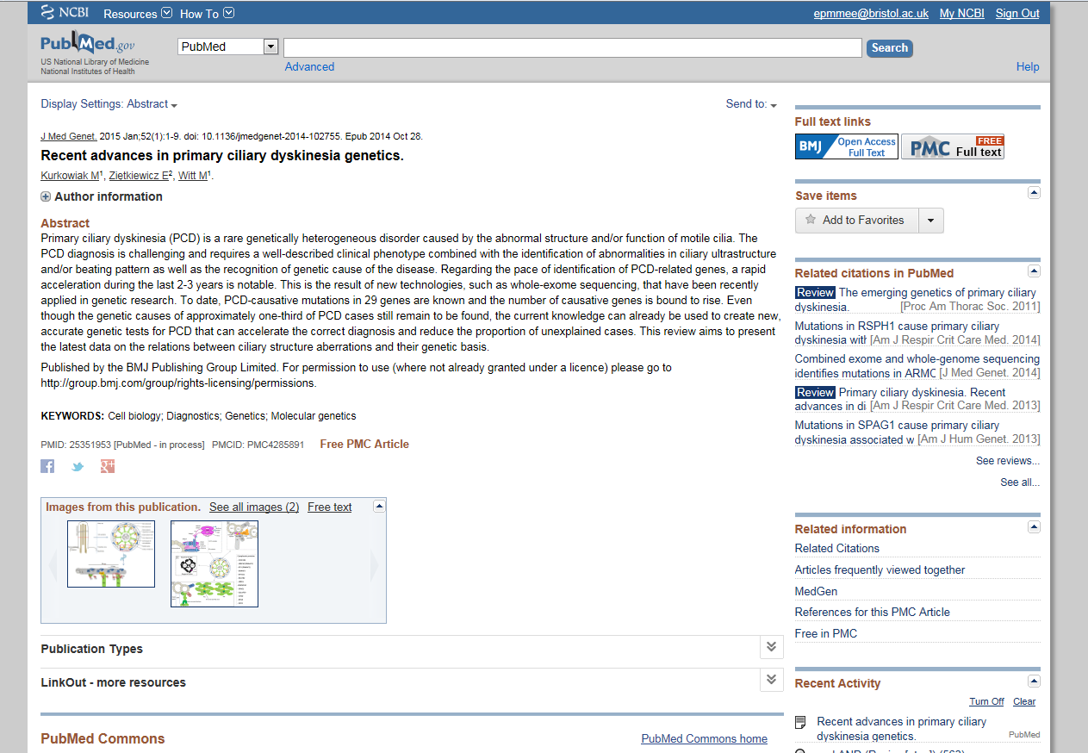
Answers – Known PCD causal genes

Slide 35
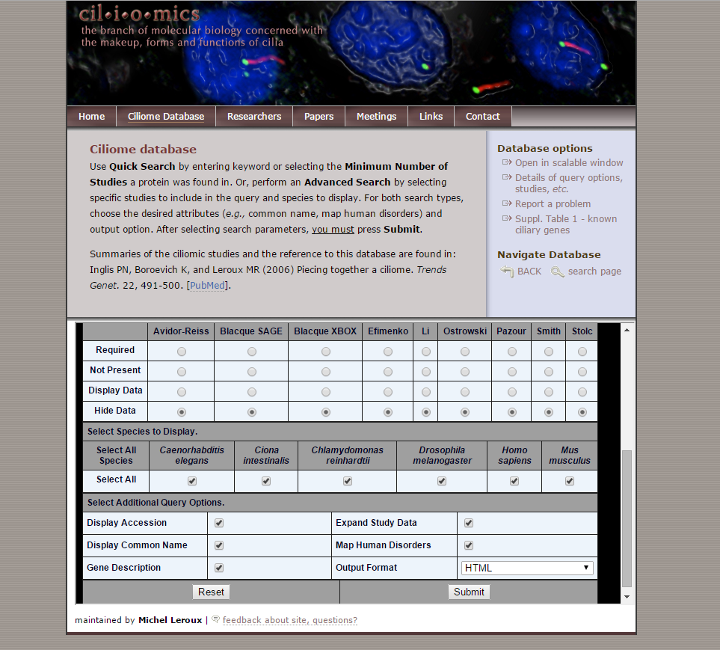
PCD candidate genes
http://www.sfu.ca/~leroux/ciliome_database.htm

Slide 36
Answers – PCD causal variant
Autosomal recessive
  Filter sex chromosome variants
Autosomal recessive
  Filter heterozygous variants
PCD is rare (~1/20000)
  Filter common variants (GMAF ≥ 1%)
Screen known PCD causal genes
Answer: 19_11537002_C/A
Notes:
Sqrroot of 1/20000 = 0.007 so filter variants with MAF over 1%

Slide 37
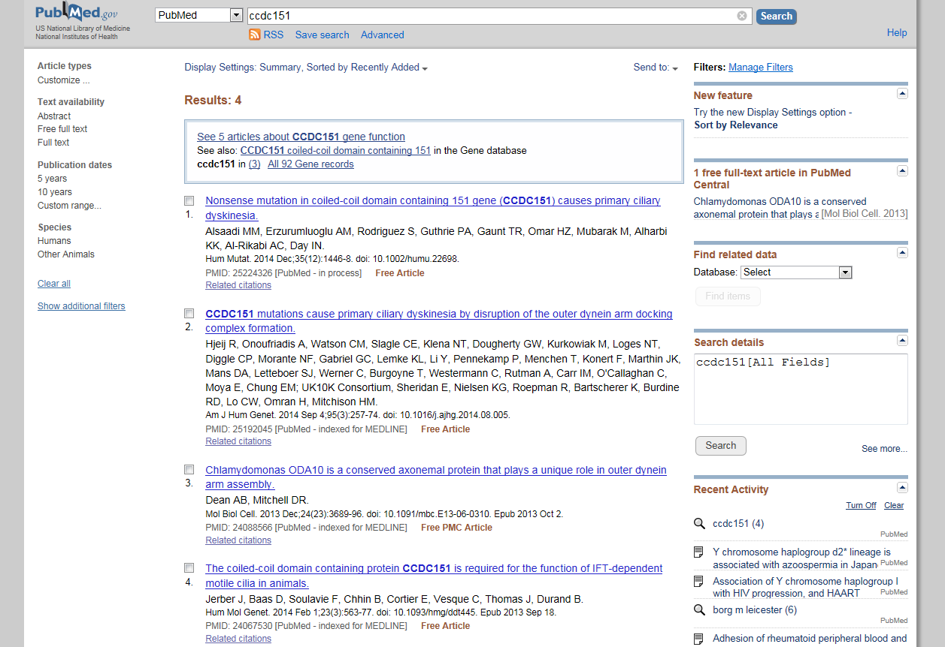
Building evidence for PCD causal variant

Slide 38
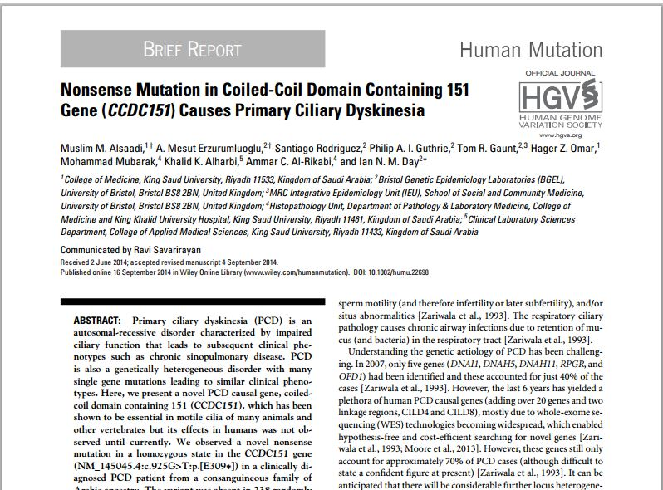

Slide 39
Building evidence for PCD causal variant
Already identified gene and variant
  Alsaadi and Erzurumluoglu et al, 2014. Hum Mut.
  Highly conserved (e.g. GERP score, see paper)
  Concrete evidence!
Animal models link CCDC151 to PCD
  Jerber et al, 2013. Hum Mol Genet.
HGVS Answer: NM_145045.4:c.925G>T:p.(E309*)

Slide 40
Answers – PLS causal variant
There is 50% probability that the PCD affected sibling will be a carrier for the PLS causal variant
PLS is caused by mutations in CTSC gene
PLS is rare
Answer: 11_88027667_C/T
Answer: NM_001814.4:c.899G>A:p.(G300D)

Slide 41
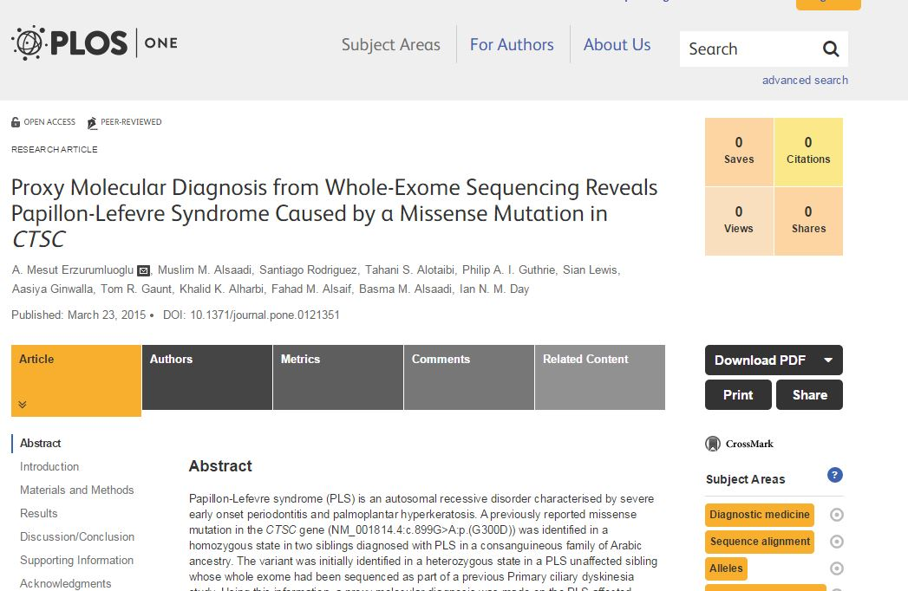
Building evidence for PLS causal variant

