Slide 1
Versatility and meeting deadlines in data science
A. Mesut Erzurumluoglu
09/05/18

Slide 2
My approach to getting things done
I think about the problem at hand, then look for ways to solve it myself.
Solving it in R is first-priority for me but time is precious
  So if I can’t find the solution within an hour, I look to do it using Python and/or UNIX commands first
  Then Excel, Stata, Photoshop, PowerPoint and/or other bioinformatics/online tools
If I have to do the same job >2 times within a month, then I definitely document everything I’ve done and try to automate everything as much as I can
  Rationale: Datasets utilised are always updated – so can’t use last year’s scripts anyway

Slide 3
Python scripting examples:
1st Problem
I want to go through one very large file (millions of lines long) and output all lines that match the words in another large file (>100k lines long)
Possible UNIX command:
  grep -wf large_file.txt very_large_file.txt > large_file_clean.txt
  Error: “Memory exhausted”
Couldn’t write it in R in 1 hour so I moved to Python

Slide 4



Files
Python script:
  Grep_-f_large_file_in_Python.py
Input files:
  lines_to_be_kept.txt
  very_large_data_file.txt
Output file:
  large_data_file_clean.txt
Notes:
Click on files to download them

Slide 5

2nd Problem
I want to download all RefSeq’s ‘gene function’ summaries and put it in a nice readable format
  Poorly structured data by RefSeq (next slide)
  Example input: refseqgene.21.genomic.gbff.gz
    Original file is >20 million lines long
  Example output: RefSeq_Chr_21_gene_summary.txt
Notes:
For an example input file, download “refseqgene.21.genomic.gbff.gz” from http://mirror.ufs.ac.za/datasets/ncbi/refseq/H_sapiens/RefSeqGene/

Slide 6
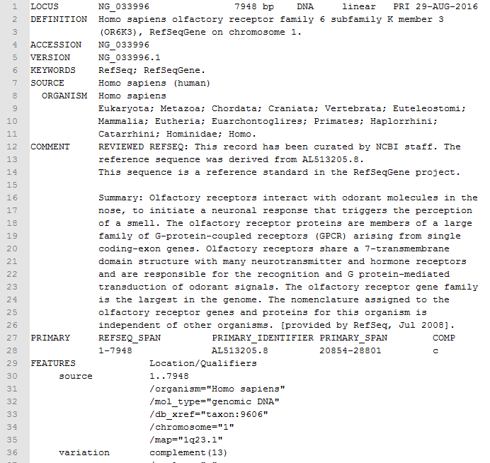

Slide 7

Files
Python script:
  Refseq_gene_summary_retriever.py
  Try writing your own script in R
Input file:
  refseqgene.21.genomic.gbff.gz
Output file:
  RefSeq_Chr_21_gene_summary.txt
Notes:
For an example input file, download “refseqgene.21.genomic.gbff.gz” from http://mirror.ufs.ac.za/datasets/ncbi/refseq/H_sapiens/RefSeqGene/

