Slide 1

Genetic effects on gene expression across human tissues
GTEx Consortium, Oct 2017
Features:
(i) Identifying SNPs affecting gene expression in cis and/or trans in 44 tissues (with partial replication)
(ii) GWAS SNP-eSNP colocalisation
Further reading:
1- ‘The Genotype-Tissue Expression (GTEx) project’ paper (2013). Nature Genetics
2- eGTEX Project (2017) paper. Nature Genetics
3- ‘A Statistical Search for Genomic Truths’. Quanta Magazine (2018)
Journal club: 11/07/18
Mesut Erzurumluoglu
Notes:
eGTEx: additional intermediate molecular measurements on the same tissues
Interviewing Dr. Barbara Engelhardt

Slide 2
Contents
Intro (8 slides)
  Why?
  RNA-Seq & RPKM (How?)
  GTEx & other studies
  Terminology
Methods
Results (12 slides)
Future work

Slide 3
Why?
GWAS: SNP association with trait/disease
Many ‘sentinel’ SNPs from GWASs do not point to an apparent causal gene - most sentinels are noncoding and/or intergenic
GTEx study: SNP association with gene expression in 44 tissues
Integrating GWASs and eQTL studies can elucidate mechanism of non-coding variants on diseases
Variant effect prediction
Other -omics studies
Druggability
Protein-Protein interactions
Fine mapping
Causal SNP(s) Target Gene(s) Relevant Tissue(s) Pathways
Trans-ethnic GWAS
eQTL studies
eQTL studies
Pathway enrichment

Slide 4
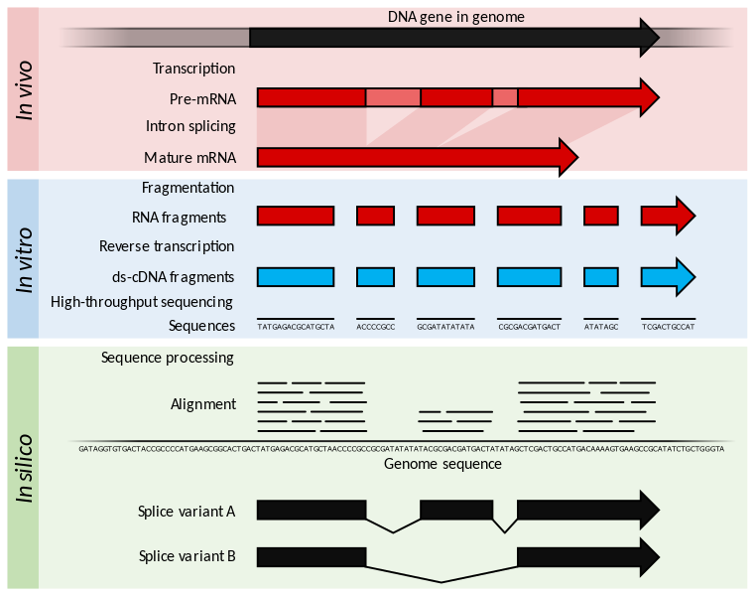
RNA-seq
Exon 1
Exon 2
Exon 3
en.wikipedia.org/wiki/RNA-Seq

Slide 5
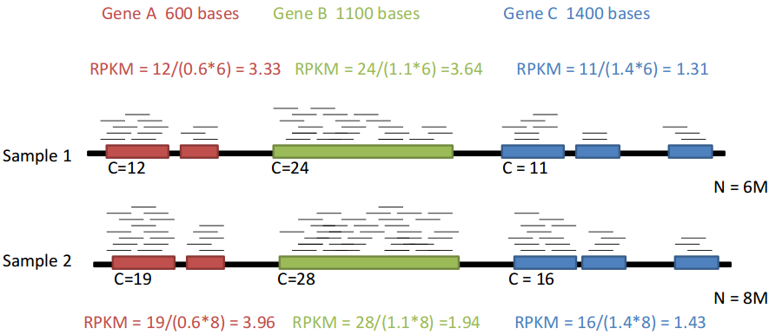
RPKM
Reads Per Kilobase of transcript per Million mapped reads
RPKM= C/(L*M)
  C: no of mappable reads per gene
  L: length of the gene in kb
  M: total no of mappable reads per sample in millions
Source: izabelcavassim.wordpress.com

Slide 6
GTEx V6p (patch)
449 human donors
44 tissues (42 distinct)
Genotype, gene expression, histological and clinical data for all donors
‘Healthy’ tissues from post-mortem samples
12.5M variants incl. X chr (2.2M genotyped)
  Reference panel: 1000 Genomes v3
All donors whole-exome sequenced (80x)
  148 whole-genome sequenced (30x)
n≥70 for all tissues (7,051 samples in total)
Latest GTEx version: V7 (n=620; 48 tissues)
Notes:
Patched after GENCODE update – provide high quality reference gene annotation and experimental validation for human and mouse genomes

Slide 7



Other studies
ENCODE
  Identify all functional elements in the human genome
  147 different cell types (at tiers 1-3)
RoadMap Epigenome
  111 clinically relevant tissues
    Stem cells
    Differentiated cells from healthy and diseased donors (e.g. cancer, neurodegenerative, autoimmune)
MuTHER (Multiple Tissue Human Expression Resource)
  856 UK twins (1/3 monozygotic)
  LCLs, subcutaneous fat, and muscle and skin
International Human Epigenome Consortium (ongoing)
  >1,000 reference epigenomes from healthy and diseased human cells
  Model organisms relevant to specific human diseases
Limitations
  Small sample sizes
  Conducted in limited, accessible cell types
    Limited utility when informing regulatory biology and human health
Notes:
e.g. DNase HS, Histone modifications, methylation patterns
See DeepSEA Journal Club (23/08/17)

Slide 8
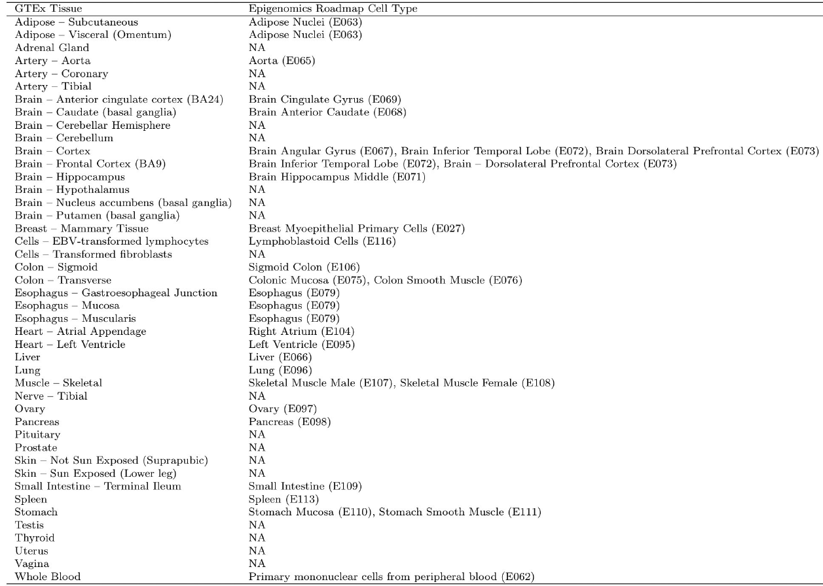
Extended Data Table 4

Slide 9
Terminology
cis-eQTL: eSNP within 1Mb of target gene’s transcription start site (TSS)
  After 1Mb from TSS, cis-regulation seems to fall below background levels
  Any eSNP >1Mb away is called “trans-eQTL”
lincRNA: long intergenic noncoding RNA
  lincRNA genes code for mRNA longer than 200bp
Allele-specific expression (next slide)
Notes:
ASE aka allelic imbalance

Slide 10
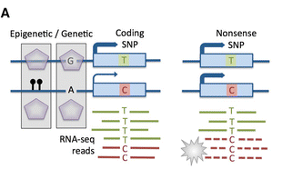
Allele-specific expression
ASE (aka allelic imbalance): variation in expression between two haplotypes distinguished by heterozygous sites
Castel et al, 2015
Causes
Genetic: Regulatory variants, NMD
Epigenetic: Random monoallelic expression, imprinting, chrX inactivation
Technical: Genotyping error, Mapping bias

Slide 11
Methods
Criteria: 5% FDR for cis-eQTLs and 10% for trans-eQTLs
Linear regression with top 3 PCs, sex, genotyping platform and latent factors (PEER method) included as covariates
Exclusions: diseased tissues
Replication: 4 tissues from TwinsUK cohort
Randomisation: order of sample processing for library prep and sequencing was randomised to avoid batch effects
Notes:
PEER (Probabilistic Estimation of Expression Residuals) by Stegle et al, 2012 was used to control for hidden batch effects and other potential confounders in the gene expression data: donor death, ischemic time, RNA integrity number (RIN), and sequencing quality control metrics, Nucleic acid isolation, library construction batches and total sequencing depth
4 tissues: blood, subcutaneous adipose, LCL, sun-protected skin

Slide 12
Results
152,869 cis-eQTLs for 19,725 genes => 50.3% of all (known) lincRNA genes and 86.1% of all (protein-coding) genes
  Additional 24,886 secondary signals with 24.8% of lincRNA eGenes and 41.2% of eGenes having >1 eSNPs in ≥1 tissue
673 trans-eQTLs for 93 genes (18 tissues)
Median of 2,816 autosomal eGenes or lincRNA eGenes within each tissue
Protein-coding genes without a cis-eQTL were likely to be expressed at low levels or loss-of-function intolerant and were enriched for development and environmental response
lincRNAs (probably) have a limited role in common disease pathogenesis

Slide 13
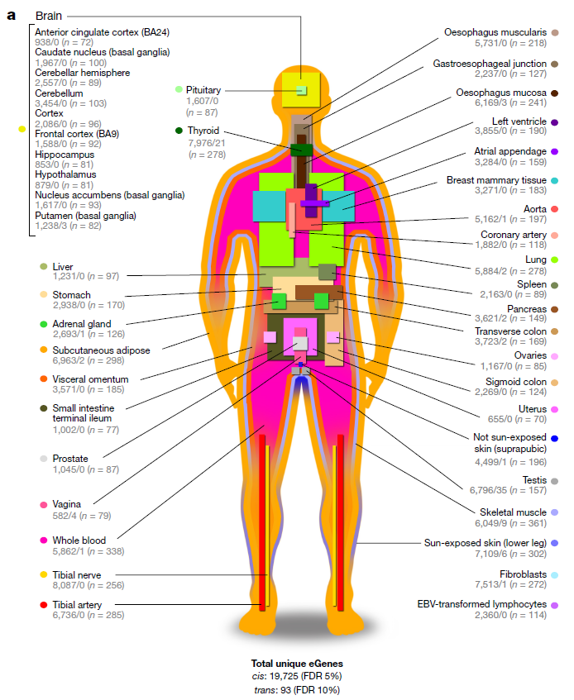
Fig. 1
Most
trans-eGenes
& elevated no of expressed genes (n=16,853)
Most
cis-eGenes
Notes:
V7 Muscle skeletal n=491

Slide 14
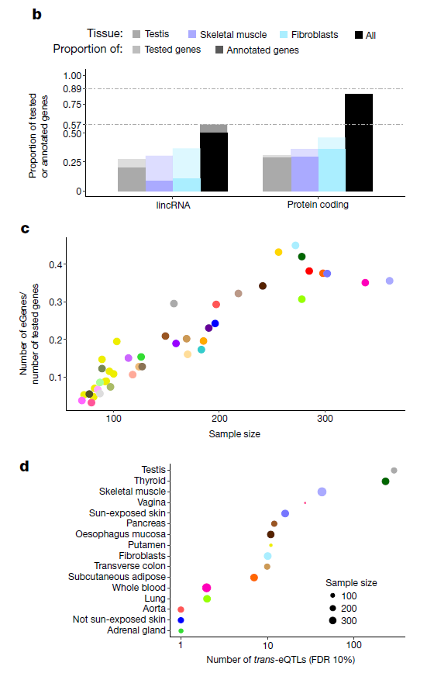
Majority (86.1%) of human genes are eGenes: 19,725
Increased sample size -> discovery of eGenes
Increase sample size rather than add more tissues
(Ext. Data Fig. 5c)
Testis (n=157) had the most trans-eGenes: 35
Fig. 1

Slide 15
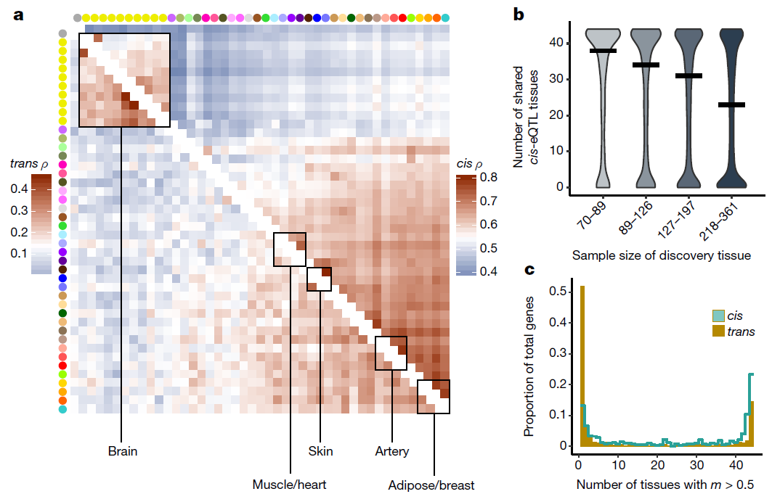
Fig. 2
Trans and cis effects are similar in related tissues (e.g. brain, muscle)
cis-eQTLs showed bimodal pattern of tissue sharing – either shared my most tissues or a few (2c)
trans-eQTLs showed higher tissue specificity (2c)
m: the probability that effect is shared in each tissue

Slide 16
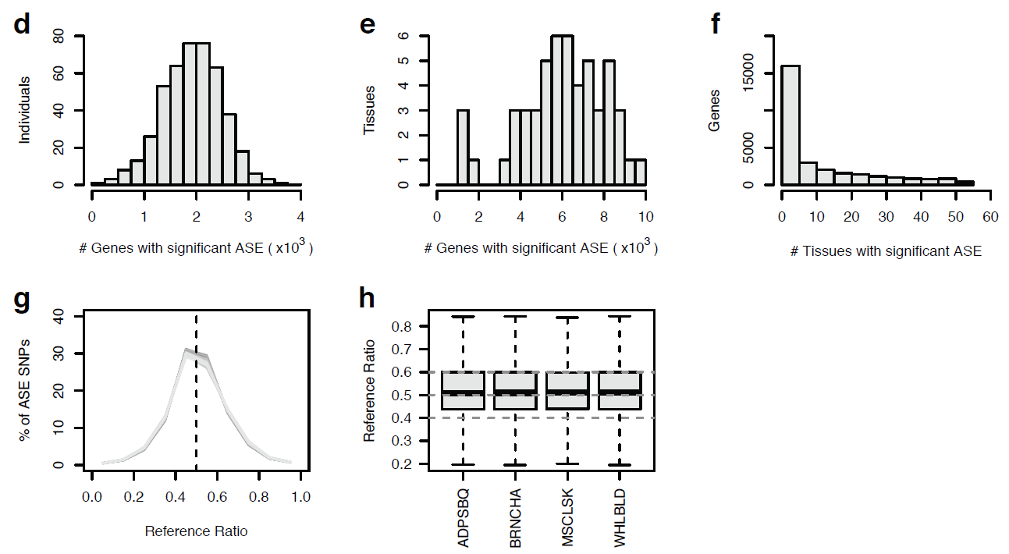
Allele-specific expression
Widespread
1,963 genes had significant allelic imbalance in ≥1 tissue
  With a median of 570 genes where donor was not heterozygous for top eSNP – suggesting more complex or rarer regulatory effects at these loci
Supp. Fig 16
Notes:
ASE provides an independent measure of a cis-eQTLs’ effect size

Slide 17
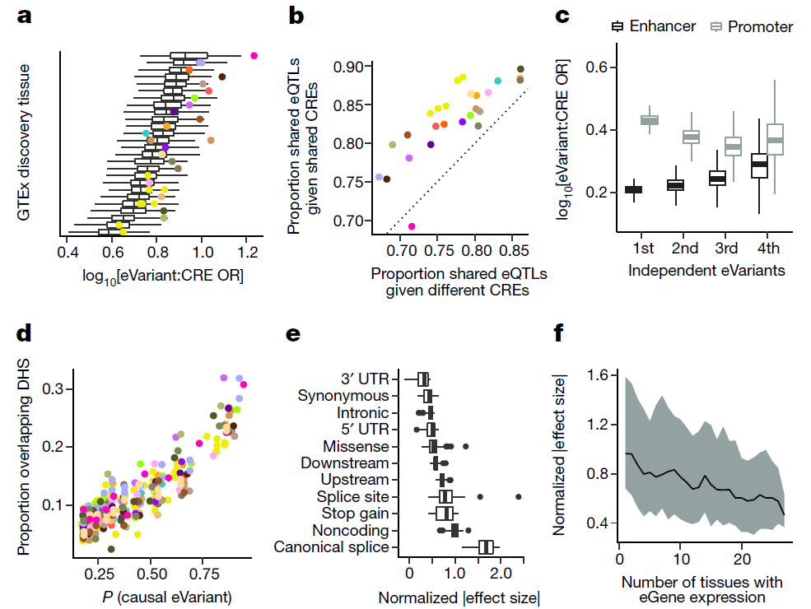
CRE: cis-regulatory elements e.g. enhancers, promoters
Fig. 3
Cis-eQTLs at canonical splice sites (GT–AG intron/exon boundaries) exhibited strongest effects
Notes:
3a: OR 2.5 to 16 eSNPs enriched in CREs;
3b: eQTL more likely to be shared across pairs of tissues when the eVariant overlaps the same chromatin state in both tissues
3c: primary eSNPs more enriched in promoters
P= causal probability (>0.8)
3f: indicates genes expressed in greater numbers of tissues are less likely to have eQTLs with large regulatory effects

Slide 18
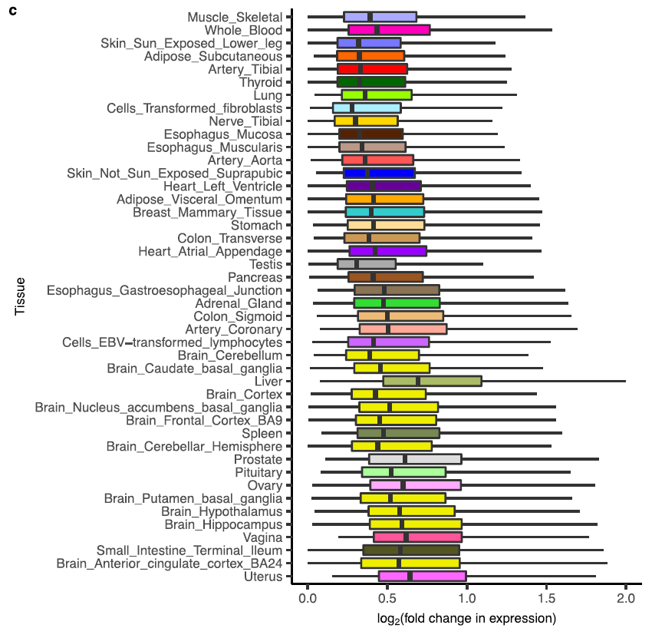
Extended Data Fig. 11c
17.4% of eGenes had cis-eQTLs with median effect sizes of at least twofold across tissues

Slide 19
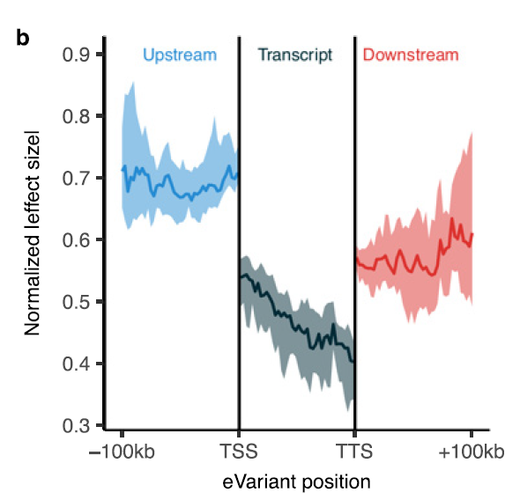
Extended Data Fig. 11b
(also see Fig. 3e)
cis-eQTLs upstream of TSSs had the strongest effect and those within transcripts had the smallest
  Suggests eQTLs affecting transcription have stronger effects than eQTLs that affect post-transcriptional regulation of mRNA levels
Notes:
Post-transcriptional regulation e.g. miRNA (micro RNA)

Slide 20
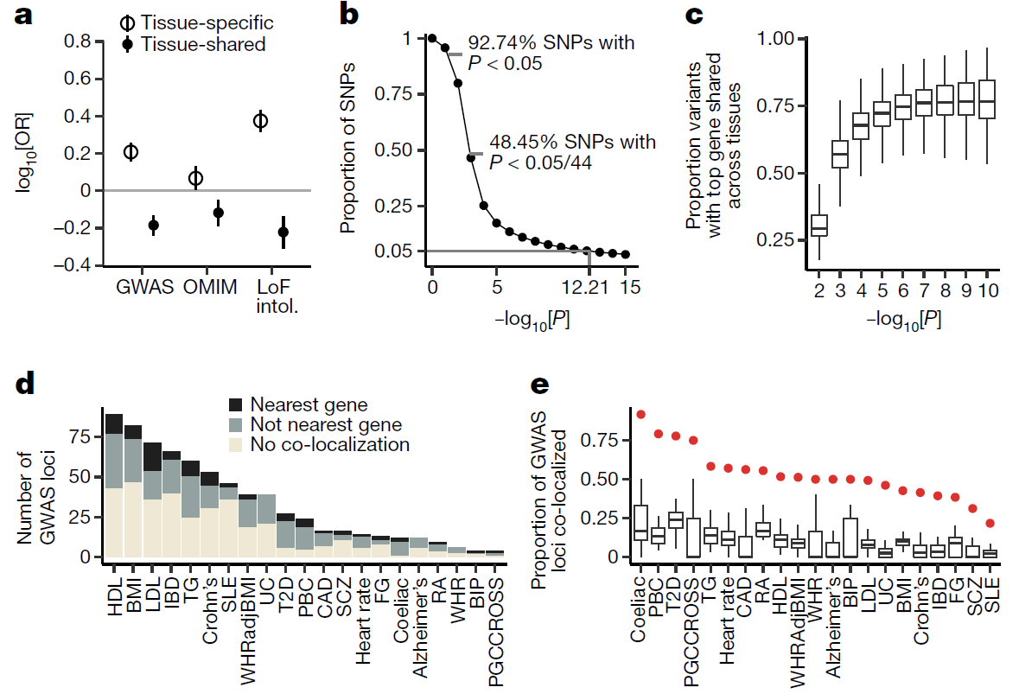
Fig. 5
Tissue shared eGenes are less likely to be loss-of-function mutation intolerant and associated with disease
  Consistent with purifying selection removing large-effect regulatory variants that involve many tissues
Notes:
5b: 50% of SNPs are significant when correcting for the number of tissues tested
5e: GWAS-eSNP colocalisation across 21 traits (each tissue). Red dots: union of all tissues

Slide 21
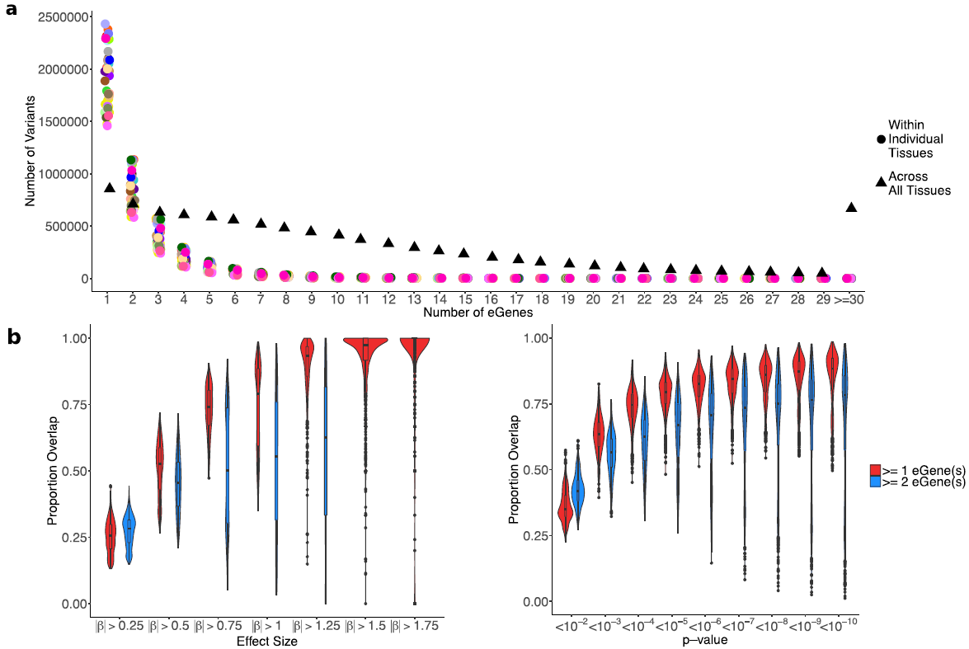
GWAS-eQTL integration (caution!)
Extended Data Fig. 15
  (a) Many eSNPs associated with >30 eGenes
    (c) Gene with the strongest association vary across tissues for these eSNPs

Slide 22
Anecdote from Barbara Engelhardt: the need to sift through “noise” in the data to uncover interesting information
“One trans-eQTL signal was strong: an exciting thyroid association, in which a mutation appeared to distally regulate two different genes. We asked ourselves: How is this mutation affecting expression levels in a completely different part of the genome? We looked near the mutation on the genome and found a gene called FOXE1, for a transcription factor that regulates the transcription of genes all over the genome. The FOXE1 gene is only expressed in thyroid tissues, which was interesting. But we saw no association between the mutant genotype and the expression levels of FOXE1. So we had to look at the components of the original signal we’d removed before — everything that had appeared to be a technical artifact — to see if we could detect the effects of the FOXE1 protein broadly on the genome. We found a huge impact of FOXE1 in the technical artifacts we’d removed. FOXE1, it seems, regulates a large number of genes only in the thyroid. Its variation is driven by the mutant genotype we found. And that genotype is also associated with thyroid cancer risk. We went back to the thyroid cancer samples — we had about 500 from the Cancer Genome Atlas — and replicated the distal association signal. These things tell a compelling story, but we wouldn’t have learned it unless we had tried to understand the signal that we’d removed. The signal from broad-effect transcription factors like FOXE1 actually looks a lot like the effects we typically remove as part of the noise: population structure, or the batches the samples were run in, or the effects of age or sex. A lot of those technical influences are going to affect approximately similar numbers of genes — around 10 percent — in a similar way. That’s why we usually remove signals that have that pattern. In this case, though, we had to understand the domain we were working in. As scientists, we looked through all the signals we’d gotten rid of, and this allowed us to find the effects of FOXE1 showing up so strongly in there. It involved manual labour and insights from a biological background, but we’re thinking about how to develop methods to do it in a more automated way.”
A Statistical Search for Genomic Truths (Quanta Magazine)

Slide 23
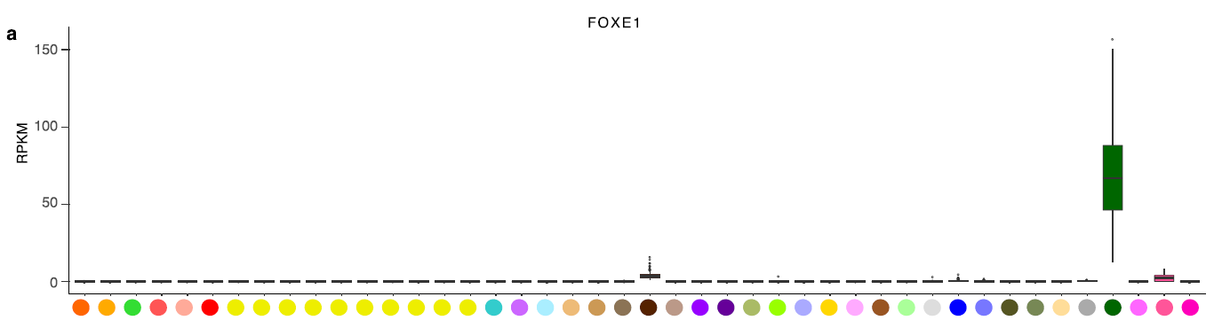
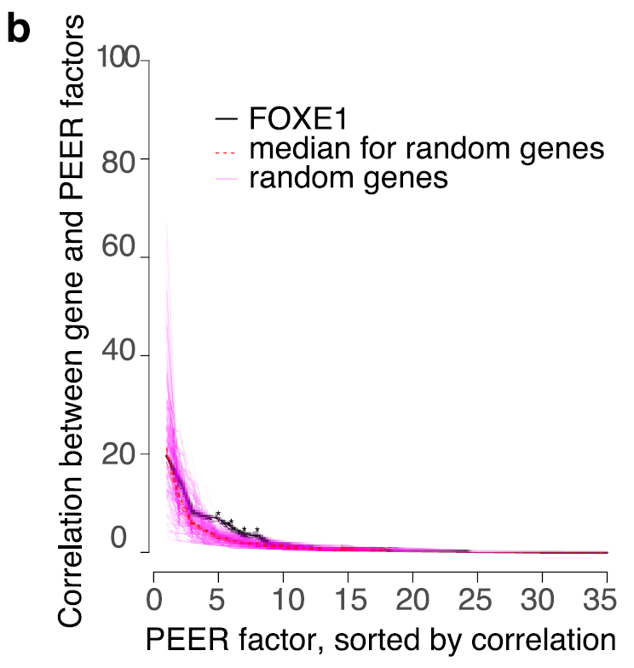
Thyroid
Extended Data Fig. 16
Correlation of FOXE1 expression levels and 5, 6, and 7th PEER factors was significantly higher than the correlation of random genes’ expression levels at those rank ordered PEER factors

Slide 24
Future work
More sample size needed, especially to detect trans-eQTLs
  Final aim: 1000 donors & 53 tissues
  Probably find that all genes are eGenes
Current QC methods are too strict
Large-scale single-cell sequencing studies
  Will (probably) supersede GTEx if done properly

Slide 25
Extra slides

Slide 26
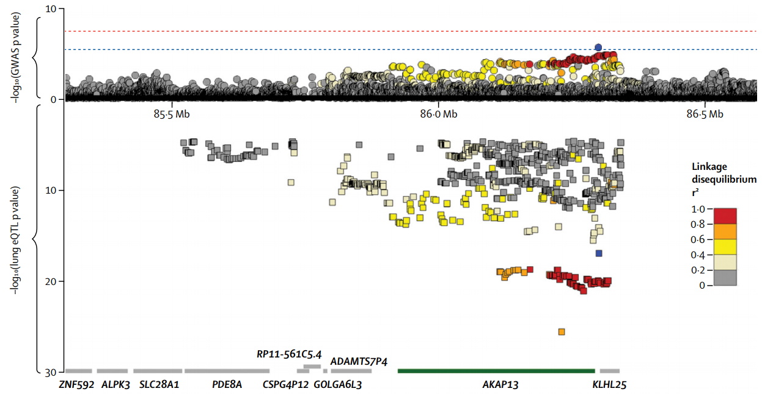
GWAS-eQTL signal colocalisation methods
Same causal variant(s) or not?
Allen et al, 2017

Slide 27
What we want to see
Lung Function GWAS
Causality
Transcription
Disease
Causal variant
Transcription (eQTL)
Pleiotropy
Transcription
Disease
Causal variant
Genotype
AA
Aa
aa
Linkage
Transcription
Disease
(Non-coding) Causal variant
Causal variant 1
Causal variant 2
What we’ll often see

Slide 28
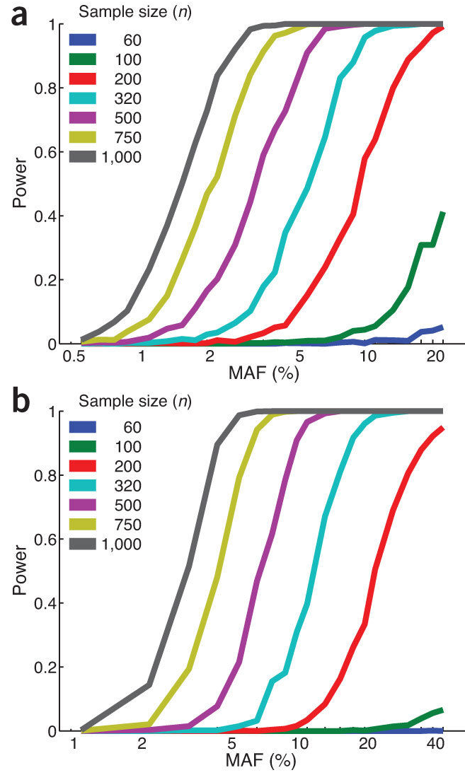
(a) Power for cis-eQTL analysis in which we assume α = 0.05/200,000, reflecting Bonferroni correction for 200,000 hypotheses based on 20,000 genes and an average of 10 non-redundant SNPs in the region ±100 kb of each gene. (b) Power for trans-eQTL analysis in which we test 20,000 genes against 5 million SNPs in a total of 10¹¹ tests with α=5×10⁻¹³
Fig. 1 from GTEx Consortium 2013, Nat Genet
Notes:
A final GTEx resource of 900 or more donors would realistically yield ∼750 samples of any given tissue, as not all organs are available for collection from each donor. At an effective sample size of 750, we would have 80% power to detect cis eQTLs with MAF as low as 2% and trans eQTLs with MAF as low as 4%. Statistical power may be higher using methods that leverage the fact that multiple tissues are collected and analyzed for each donor

