Slide 1
Ingiltere’de akademik kariyer serisi (‘Academic career in the UK’ series) – part 1
Genel olarak doktora sürecinde nelere dikkat etmeliyim? (General comments on doing a PhD)
  Advanced postgraduate review (APG)
  Sunum yaparken dikkat edilecekler (How to do presentations?)
Tez yazarken dikkat edilecekler (Writing a PhD thesis)
Makale yazarken dikkat edilecekler ve prosedür (Writing and publishing papers)
Akademik kariyer (a career in academia)
  Postdoc
  Lectureship ya da fellowship
CV düzenleme ve geliştirme (structuring your academic CV)
Personal statement yazma (writing a personal statement)
Pre-, intra- (during) & post-interview
Hocanızla ilişkiniz nasıl olmalı? (dealing with your supervisor)
  Ingiliz kültürüyle ilgili gozlemlerim (my views on British culture)
Spesifik problemler
  Mental wellbeing
Time management
  Akademik/entelektuel olarak kendini geliştirme (developing yourself as an academic/intellectual)
  Coursera/MOOCs
  Social media
19/07/18
A. Mesut Erzurumluoglu

Slide 2
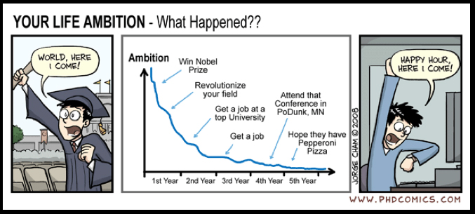

Intra- and Post-PhD
My general comments on doing a PhD and being a Postdoc
Finding a postdoc job
  Application process
  Interview – my experiences
Transition to (hopefully successful!) Postdoc
Fellowships/grants
Search for “postdoc life” in Google Images
19/07/18
A. Mesut Erzurumluoglu
Notes:
Getir yaninda: CV, Personal Statement

Slide 3
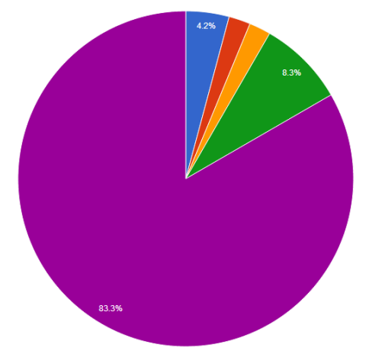
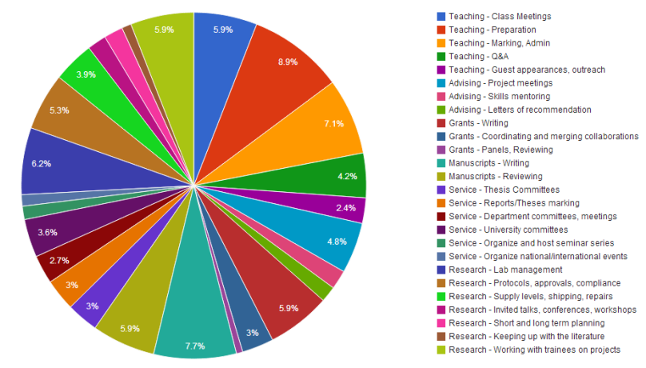
PhD
Analysis
PhD: Improve yourself and make a small contribution after 3-4 years. Expected: 1-2 papers submitted/published
Reports/Writing
Reading/training
Pie charts for time spent on different tasks
Higher expectations & limited time
Trying stuff out (flexible)
Dr. title
Postdoc: do a lot of analyses and produce results timely. Expected: a paper per year + input to 2-3 side-projects
Postdoc
Extras
Senior Academic post
Reading
Trying stuff out
Developing pipelines and analysis (getting ‘jobs’ done on time)
Source URL for bottom two (adapted) figures: http://www.vandermeerlab.org/MvdM_SoYouWantToBeAnAcademic.pdf
Notes:
Main difference: higher expectations (cutting edge science, more thorough, perfectly carry out commands, then develop own ideas) and take less time to do stuff. One example: if they say do a “quick and dirty GWAS” – that means do a ‘good quality’ GWAS within a week (e.g. check your results using Manhattan plots, QQ-plots, replicate previously reported SNPs?, read up on some of the genes that came out, clear analysis schema to show exactly what you’ve done)
PhD -> main focus is YOU
Postdoc -> main focus is the project
As a PhD student, if your pie chart looks like the bottom left one, then you’ve essentially worked as a cheap postdoc – avoid!

Slide 4
General comments on PhD life
Make full use of Coursera and MOOCs (esp. Medical Statistics, UNIX, R and Python Programming)
Be grateful. You’re not just doing a PhD – a fully-funded PhD at a top university. Very prestigious!
Don’t forget that you’re doing a PhD – the top academic degree! Be cognisant of this and don’t be shy or think that you don’t deserve to be here – you all do! Show that (i) you have the potential to be an expert in the field and have the skills to work at a top research group, (ii) can get the job done, (iii) you’re willing to learn, and (iv) without being cynical or a total sceptic, you can be a critical reader. I think these the best skills you can gain from doing a PhD.
Try to know everything that goes on in your specific field. Read papers and reviews but also follow blogs and twitter accounts that make this easier for you. If you’re saying “there’s too much to read!” then you don’t know what your “specific field” is. But in case someone points out a paper that you haven’t read, don’t say “I haven’t seen it”. Say “I’ve printed it and didn’t get a chance to read it but it’s the first thing I’ll read when I get back to the office”
Make time to attend seminars and watch people give talks:
  Posture (eye contact?)
  How many slides?
  Contents of slides – figures?
  Q&A style
Listen to people from different fields; sometimes not even vaguely related. Gives you a sense of what the world needs and where it’s going.
Read before viva: 'It's a PhD, not a Nobel prize': how experienced examiners assess research theses
“First impression is last impression” applies to everything. Try to make your first 2-3 sentences in every section, and the (whole) abstract and discussion sections perfect. Pay attention to the preface of your thesis also – both aesthetically and grammatically.
Have a very good relationship with your PhD supervisor(s) – will need their reference for a long time
26/07/18
A. Mesut Erzurumluoglu
Notes:
Geriye donup baktigimda “iyiki bunlari yapmisim” dedigim seyler
Link to paper: https://pdfs.semanticscholar.org/555a/7e7198c9faca2656451c05bc1d51d55cb7cc.pdf

Slide 5
Ingiltere’de akademik kariyer serisi – part 2
Genel olarak doktora sürecinde nelere dikkat etmeliyim?
  APG
  Sunum yaparken dikkat edilecekler
Tez yazarken dikkat edilecekler
Makale yazarken dikkat edilecekler ve prosedür
Akademik kariyer
  Postdoc
  Lectureship ya da fellowship
CV düzenleme ve geliştirme
Personal statement yazma
Pre-, intra- (during) & post-interview
Hocanızla ilişkiniz nasıl olmalı?
  Ingiliz kültürüyle ilgili gozlemlerim
Spesifik problemler
  Mental wellbeing
Time management
  Akademik/entelektuel olarak kendini geliştirme
  Coursera/MOOCs
  Social media
27/07/18
A. Mesut Erzurumluoglu

Slide 6
Career progression – what’s next?
Start thinking about what you want to do a year before submission date: postdoc or industry or something else
  Read Wellcome Trust Basic Science Career Tracker (2013) & check MRC Interactive career framework
  Talk to your supervisors/senior friends about prospects
  Look at fellowship calls and deadlines
    Fellowship (and grant) applications: I did one grant (rejected after 2nd round) and one fellowship application (pending) and learned a lot from the process (e.g. priorities, structure, content)
    Fellowship application takes >1 month to prepare and very tough to get
      Grant applications take much longer and even more competitive
Notes:
Wellcome Trust fellowships URL: https://wellcome.ac.uk/funding/scheme-finder?field_scheme_type_tid=91&field_grant_type_tid_selective=1103
MRC fellowships URL: https://mrc.ukri.org/skills-careers/fellowships/skills-development-fellowships/
MRC Interactive career framework URL: https://mrc.ukri.org/skills-careers/interactive-career-framework/

Slide 7
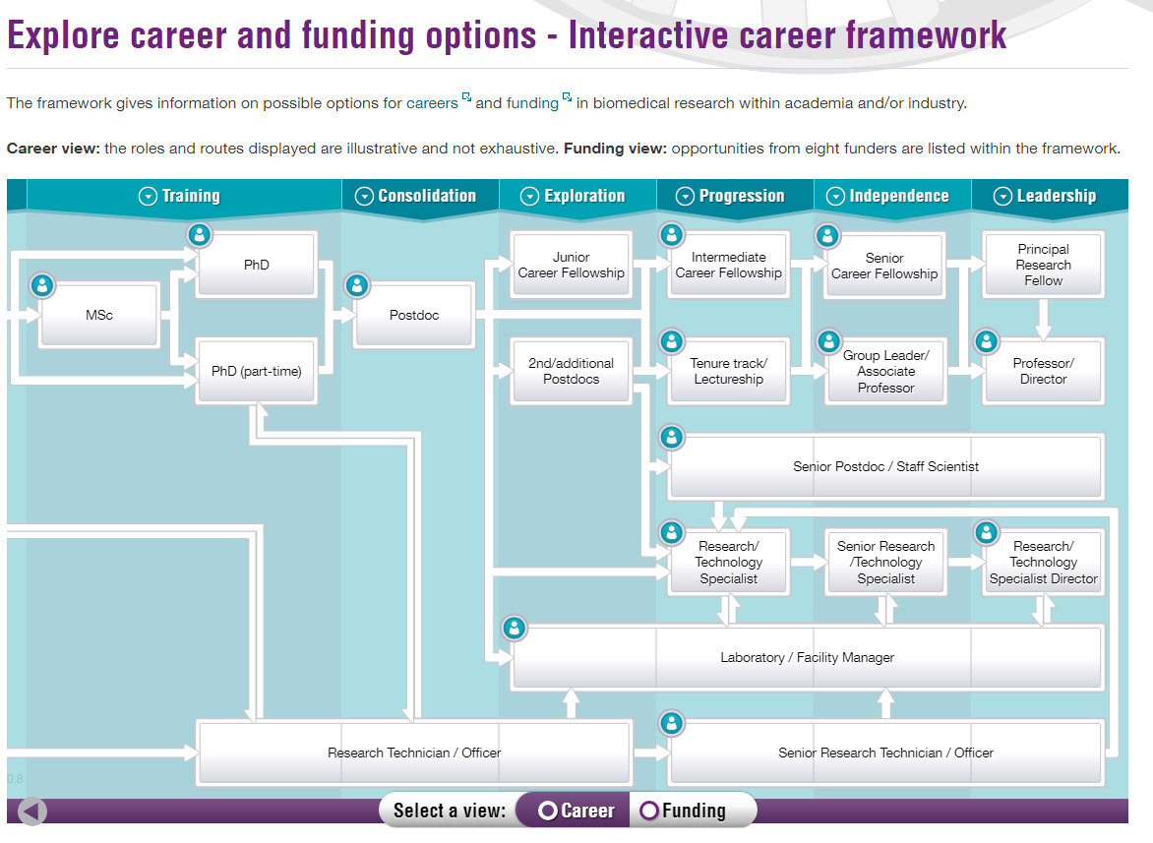
URL: https://mrc.ukri.org/skills-careers/interactive-career-framework/

Slide 8
Applying for Postdocs
Where to look?
  Dept. emails, Twitter, Findapostdoc.com, jobs.ac.uk
When to look?
  Start applying ~3 months before submission date
  Submission date is the crucial date for employers
Which job?
  Matches skill set (but with training opportunities)
  ≥2 year contract
  Good “salary to cost of living” ratio
    £30k is very good in Leicester but not in London – definitely not in Manhattan!
  Interesting project? Nice city? Group size?
Apply to as many jobs as possible
  Can reject them afterwards if several acceptances

Slide 9
CV and Personal Statement
Show CV and personal statement to PhD Supervisor and/or senior peers
Publications are key – have them on CV as early as possible
  Include a short summary of what your role(s) was and make them sound impressive
Fill CV with relevant and concrete extras
  conferences/talks, skills gained from projects, reviewing, little grants here and there (e.g. mobility grants), courses/workshops attended (espec. statistical, programming related), teaching, supervision, membership to academic groups (e.g. Community Genetics Network), collaborations initiated, grant applications, awards
Be bold in the personal statement: “I can manage, analyse and interpret results from large-scale datasets (as evidenced by xyz et al).” Do not sound like: “I have a lot of skills; might come in handy…”
  They’ll at least invite you to an interview
  Pre-application email: “Dear Prof/Dr. Xyz; I’m very interested in the post but was wondering (i) whether there were any training opportunities and (ii) how collaborative the group is. My CV and personal statement are attached. Kind regards.

Slide 10
Ingiltere’de akademik kariyer serisi – part 3
Genel olarak doktora sürecinde nelere dikkat etmeliyim?
  APG
  Sunum yaparken dikkat edilecekler
Tez yazarken dikkat edilecekler
Makale yazarken dikkat edilecekler ve prosedür
Akademik kariyer
  Postdoc
  Lectureship ya da fellowship
CV düzenleme ve geliştirme
Personal statement yazma
Pre-, intra- (during) & post-interview
Hocanızla ilişkiniz nasıl olmalı?
  Ingiliz kültürüyle ilgili gozlemlerim
Spesifik problemler
  Mental wellbeing
Time management
  Akademik/entelektuel olarak kendini geliştirme
  Coursera/MOOCs
  Social media
10/08/18
A. Mesut Erzurumluoglu

Slide 11
CV and Personal statement tips
See my CV as a template:
  leicester.academia.edu/AMesutErzurumluoglu/CurriculumVitae
1-page ‘Personal statement’:
  A paragraph on “why you’ve chosen this field”
  A couple of paragraphs on “the skills you’d like to underline and why they’re relevant”
  A paragraph on what sets you apart from others
    Writing high-quality papers? Wet-lab skills? Leadership?
  Final paragraph on “why you chose this group and project” – praise

Slide 12
Job interview
“First impression is last impression” – always think of this.
If you’re giving a talk try to keep the introductions as short as possible and move onto the stuff you’ve done. Because they’re interested in the stuff you’re doing and not what others have done.
Never mention weaknesses or any problems you had with your supervisor – even if they ask nicely or act sincere…
Prepare diplomatic answers to questions like (Reviewer 3!):
  Where do you see yourself in 5 years?
  What do you expect from your supervisor?
  What’s the thing you least look forward to in your workplace?
  Didn’t you even have a little problem with your supervisor?
Always underline relevant skills (what they’re looking for – see appendix)
  Programming in R (or Python)
  Statistical knowledge
  Data QC experience
  Genetic/biomedical knowledge
  Wet-lab skills? Knowing how data is created…
Dish out some praise - why I chose to apply?
  “I read your papers…” – show that you know what they’re working on
  “I want to be involved in cutting-edge projects…”
  Importance of trait/disease
  Impact (e.g. clinical trials)
  Training opportunities
Notes:
One possible answer for 1st question: “My main focus will be to do my best in the current job (if I get it) and publish papers of the highest quality. As time passes I will be looking to apply for fellowships/grants and contribute to the group financially.”
Look genuinely enthusiastic – you want this job
How would you start an analysis?
If you don’t get the job, ask yourself: they must have see something in the other candidate that they haven’t seen in you. It may be that you couldn’t do anything about it (e.g. the other candidate was already working there)

Slide 13
What they’re looking for(?)
Essential: Strong programming skills
Essential: Use bioinformatics tools
Essential: Solid statistical background
Essential: Genetic knowledge
Essential: Write papers/grants
Essential: Present results/attend conferences/Public engagement
Desirable: Epidemiology knowledge
Desirable: Supervise and teach

Slide 14



Relevant skills, achievements and experiences - Background
BSc in Biological Sciences – Genetics (2007-2011)
PhD in Genetic Epidemiology (Feb 2012-Nov 2015)
Epidemiology, Statistics, Python Programming, Bioinformatics, Rare disease genetics, Teaching, Supervision
Postdoc as Computational Biologist (Nov 2015-?)
R Programming, Medical Statistics, GWAS & follow-up, Respiratory genetics, Teaching

Slide 15
Relevant Skills
Data analysis/management
  Strong Python and R programming skills
  Experienced Bioinformatician
    UNIX/Shell scripts
  Genotyping data
    GWAS array
      Deodorant-use GWAS (n=10k)
      Population genetics/haplogroups – below
    Exome-chip – rare coding variants (Erzurumluoglu et al, 2018)
      Four smoking behaviour-related traits (n= up to 620k)
  NGS data
    Whole-exome sequencing
      Primary ciliary dyskinesia (Alsaadi & Erzurumluoglu et al, 2014)
      Papillon-Lefevre syndrome (Erzurumluoglu et al, 2015)
Population genetics
  Haplotypes
    Fine-mapping method: HAPRAP (Zheng et al, 2017)
  Haplogroups
    Interaction between Y-DNA haplogroups & Psychiatric disorders
      Howe et al, 2017
    Interaction between Y-DNA haplogroups & obesity-associated SNPs
      Erzurumluoglu et al, 2018
1
2
1-4, 7
1-7
1-4
1-5, 7
Notes:
CV

Slide 16
Skills continued…
GWAS SNP follow-up (Wain et al, 2017)
  eQTL colocalisation (e.g. GTEx, Blood, Lung)
  Functional annotation and variant effect prediction
  Pathway enrichment analyses
  ‘Druggability’
Genetic correlation (Zheng et al, 2017)
  Automated bivariate LD score regression server: LD Hub
Presenting results
  Manhattan & Circos plots
Wet-lab skills
Notes:
Other follow-up: pQTL, mouse knockouts, protein-protein interactions, pleiotropy, Polygenic Risk Score, metabolites, capture Hi-C, PheWAS

Slide 17
Increasing citation
Before publication:
  Cite papers in your field
  Preprint
  Conferences
After publication:
  Open access
  Present in conferences & meetings
  Share on social media
  Peer-review other papers in field
  Collaborate

Slide 18
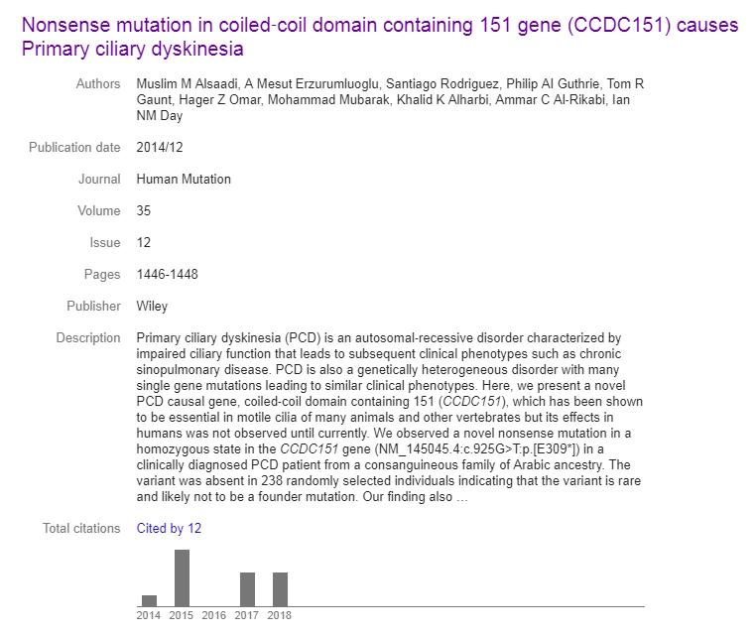
Comment on PubPeer
Notes:
Comment URL: https://pubpeer.com/publications/CB50609AEB0312AD7C418B4C89260C

Slide 19
Ingiltere’de akademik kariyer serisi – part 4
Genel olarak doktora sürecinde nelere dikkat etmeliyim?
  APG
  Sunum yaparken dikkat edilecekler
Tez yazarken dikkat edilecekler
Makale yazarken dikkat edilecekler ve prosedür
Akademik kariyer
  Postdoc
  Lectureship ya da fellowship
CV düzenleme ve geliştirme
Personal statement yazma
Pre-, intra- (during) & post-interview
Hocanızla ilişkiniz nasıl olmalı?
  Ingiliz kültürüyle ilgili gozlemlerim
Spesifik problemler
  Mental wellbeing
Time management
  Akademik/entelektuel olarak kendini geliştirme
  Coursera/MOOCs
  Social media
17/08/18
A. Mesut Erzurumluoglu

Slide 20
Guidance for authors
Introductory guide for authors
  http://publishingsupport.iopscience.iop.org/wp-content/uploads/2018/05/Author-Guide-V9.pdf
Introductory guide for reviewers
  http://publishingsupport.iopscience.iop.org/wp-content/uploads/2018/05/Reviewer-guide-V11.pdf
    http://blogs.nature.com/ofschemesandmemes/2018/09/11/peer-review-week-2018-creating-equal-opportunities-for-peer-reviewers-through-training

Slide 21
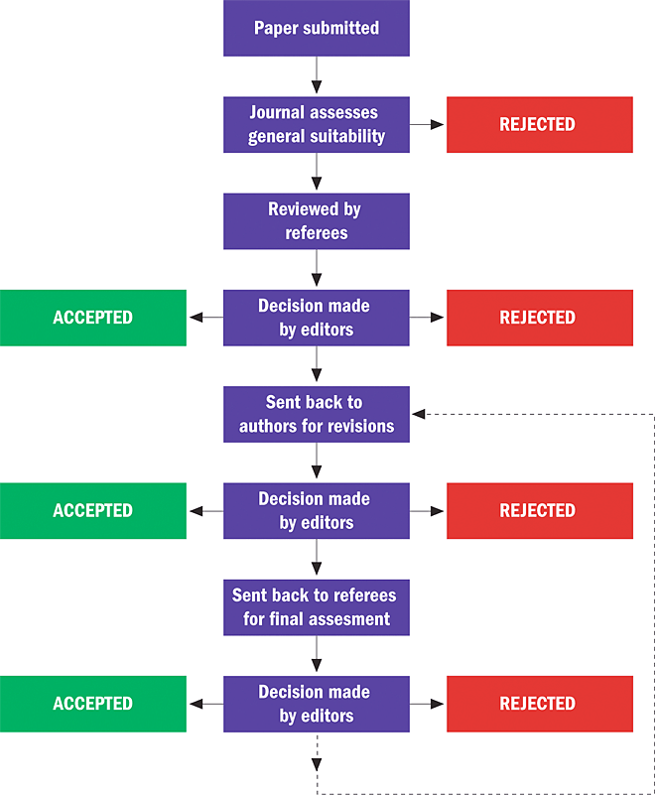
Peer-review process

Slide 22
Prestige as a Postdoc candidate
No of ‘average’ papers
Always aim for a high-impact paper!
  If not lucky enough, then try publishing 1-2 ‘average’ papers before finishing your PhD
    Shows that you can write papers but also ‘start-and-finish’ a project (very important skill!)
    But don’t over-do it! It’ll give the impression that you’re an ‘average’ scientist and you’re happy to be one

Slide 23
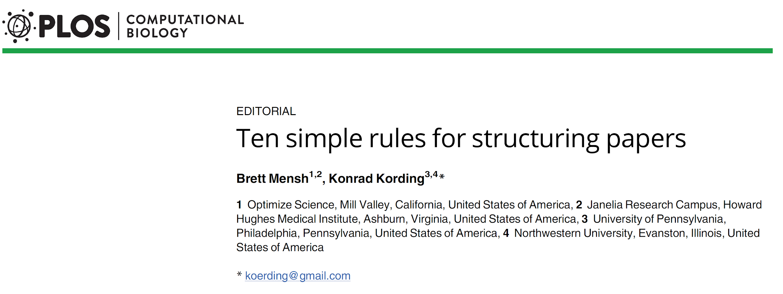
Rules 1-4
principles that apply to all parts of a paper (grants or posters)
Rules 5-8
apply to the main components of a paper
Rules 9-10
provide guidance on the process itself

Slide 24
Rules 1-4 (Principles)
Rule 1: Focus your paper on a central contribution, which you communicate in the title
First element the reader encounters
Focus on single message
Thinking about the title early can help in designing experiments, developing theories and writing the paper
Rule 2: Write for flesh-and-blood human beings who do not know your work
Think like a naive reader
Define technical terms clearly, avoid abbreviations and acronyms
Minimize the number of loose threads that the reader has to keep in mind at any one time

Slide 25
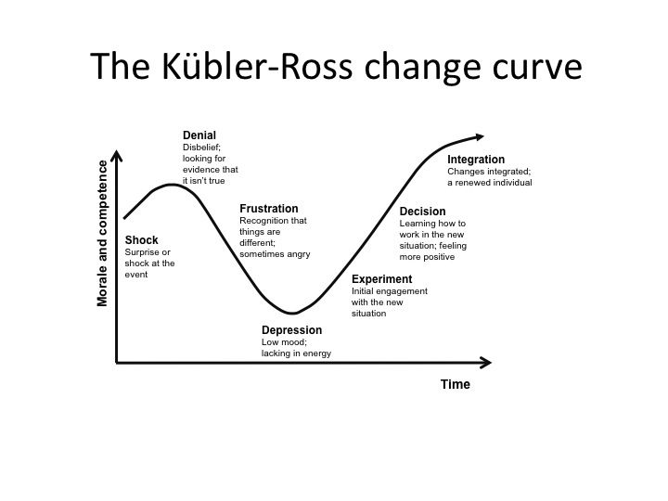

Slide 26
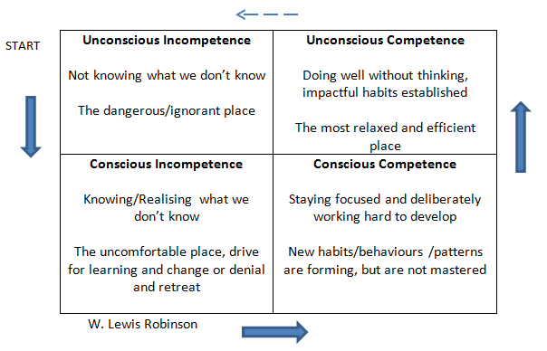

Slide 27
Rules 1-4 (Principles)
Rule 3: Stick to the context-content-conclusion (C-C-C) scheme
C-C-C as a default for scientific story structure (other structures are used in different contexts, e.g. newspaper articles)
it applies at different scales:
  whole-paper scale - introduction, results, discussion
  paragraph scale - context, novel content, conclusion to be remembered
reader interested in the ultimate claim and the logic supporting it - no need to follow the chronology of the experiments/analyses
Rule 4: Optimize your logical flow by avoiding zig-zag and using parallelism
minimise the number of subject changes - only the central idea of the paper should be touched upon multiple times
related sentences or paragraphs should be strung together
for example, if we have three independent reasons why we prefer one interpretation of a result over another, it is helpful to communicate them with the same syntax
there is nothing wrong with using the same word multiple times in a sentence or paragraph

Slide 28
Rules 5-8 (Components)
Rule 5: Tell a complete story in the abstract
in many case it is the only part of the paper that will be read - must convey message effectively
follow C-C-C rule:
  context - what gap the paper fills and why it matters
  content - describe novel method/approach used; summarise results
  conclusion - uses the results to answer the question described in the context ; may end with a broader conclusion (how this moves the field forward)
Rule 6: Communicate why the paper matters in the introduction
it highlights the existing gap and why it is important
set of progressively more specific paragraphs
no broad literature review beyond the motivation of the paper
summarise results in the last paragraph

Slide 29
Rules 5-8 (Components)
Rule 7: Deliver the results as a sequence of statements, supported by figures, that connect logically to support the central contribution
needs to convince the reader that the central claim is supported by data and logic
sketch out the logical structure of how your results support your claim and convert this into a sequence of declarative statements that become the headers of subsections within the results section (and/or the titles of figures)
title of the figure should communicate the conclusion of the analysis, and the legend should explain how it was done
use C-C-C structure for each paragraph/piece of evidence
Rule 8: Discuss how the gap was filled, the limitations of the interpretation, and the relevance to the field
recapitulate the results
discuss the limitations
reveal how the central contribution may catalyze future progress
the first discussion paragraph is special in that it generally summarizes the important findings from the results section
weakness/strength of the paper

Slide 30
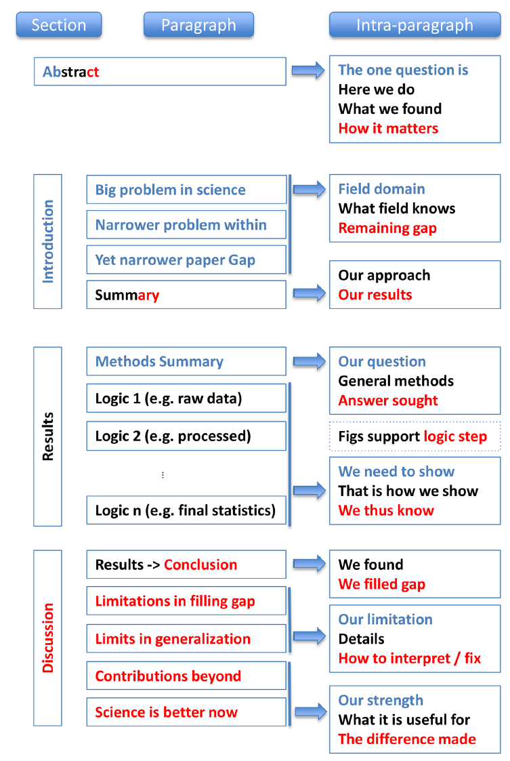

Slide 31
Rules 9-10 (Process)
Rule 9: Allocate time where it matters: Title, abstract, figures, and outlining
useful to formalize the logic of ongoing experimental efforts (e.g., during lab meetings) into an evolving document of some sort that will ultimately steer the outline of the paper
spend more time on sections read by most readers (title, abstract, figures…)
make an outline of the paper/individuals section
Rule 10: Get feedback to reduce, reuse, and recycle the story
it is important not to get too attached to one's writing - rewriting may be faster than reworking at times
Because input from others is essential, a network of helpful colleagues is fundamental to making a story memorable. To keep this network working, make sure to pay back your colleagues by reading their manuscripts

Slide 32
Five common writing mistakes new scientists make
[https://contemplativemammoth.com/2018/08/21/five-common-writing-mistakes-new-scientists-make/]
The passive voice is being used
It is entirely likely that your prose is padded with extraneous, superfluous, or otherwise unnecessary additions; furthermore, the utilization of such redundant verbiage is arguably obfuscating your points (thus, in order to improve the clarity of your writing, it is highly recommended that you eschew such stylistic choices, including run-on sentences filled with fluff, padding, and filler).
Your prose is redundant. You keep making the same point over and over again
This use of unclear antecedents is inappropriate.
I love cake. Your paragraph needs a topic sentence.
Bonus #1: You changed tenses mid-paragraph, and/or your methods are written in the present tense. Repeat after me: methods will be written in the past tense.
Bonus #2: You’re not following SI conventions.
Ever written. Ever written badly. No matter. Write again. Write poorly again. Write better

Slide 33
From Dr. Chiara Batini (Univ. of Leicester)
read a lot of papers, understand what makes a paper a good paper (easy to read, solid scientific explanations, ….), try and use that strategy for your papers too
make it a good story to read - as much as possible
read it, do something else for a few hours (or a day if possible), read it again, edit accordingly and then ask someone else to read it; incorporate feedback, read it again
if the blank page is scary and you are stuck - try and change the section you are working on
if starting from scratch, I would usually go in this order: Table and Figures, Material and Methods, Results, Discussion, Introduction

Slide 34
Ingiltere’de akademik kariyer serisi – part 5
Genel olarak doktora sürecinde nelere dikkat etmeliyim?
  APG
  Sunum yaparken dikkat edilecekler
Tez yazarken dikkat edilecekler
Makale yazarken dikkat edilecekler ve prosedür
Akademik kariyer
  Postdoc
  Lectureship ya da fellowship
CV düzenleme ve geliştirme
Personal statement yazma
Pre-, intra- (during) & post-interview
Hocanızla ilişkiniz nasıl olmalı?
  Ingiliz kültürüyle ilgili gozlemlerim
Spesifik problemler
  Mental wellbeing
Time management
  Akademik/entelektuel olarak kendini geliştirme
  Coursera/MOOCs
  Social media
17/08/18
A. Mesut Erzurumluoglu
Notes:
Coursera seminars
Twitter, LinkedIn, Scholar, Academia.edu (CV)
Ingiliz kulturu blog yazim

Slide 35
*Your ‘worth’ as a early career researcher
1st author papers in top journals
Directly applicable
h-index
Prestige of university
Desirable
Funded PhD
Skills
CV
You/me
Fellowship or (small) grant
References
Knowledge
Directly applicable
Other
Supervision
Conferences
Presentable
Teaching
English level
Female/BME
*from funder/expert panel/PI’s view
Notes:
From funder/expert panel/PI’s view

Slide 36
Summary of key messages
You’re a fully funded PhD student at a top university
Don’t work like a postdoc. Take time to improve yourself (e.g. via MOOCs, blogs, papers)
  Concentrate on transferable skills: mathematics/statistics, data analysis/programming, writing, speaking
  Take time out to think about what you’re doing, what sets you apart
First impression is last impression’
  Whatever people see first (e.g. you in an interview, title/abstract in a paper, type your name on Google), make those bits perfect!
Collaborate with people with different expertise
  Learn from others’ experiences
‘Submitted’ paper is much better than ‘in progress’
‘Back your claims up with concrete stuff (e.g. papers, conferences, teaching)
Notes:
Bad email example: turkishgangster123@gmail.com
Photo on Google – make more professional

