Slide 1

‘Smoking exome chip’ project
A Human-Exome chip meta-analysis exploring the genetic architecture of four smoking behaviour-related traits
Combination of three large consortia:
Consortium for the Genetics of Smoking Behaviour (CGSB) – Leicester, UK
CHDExome+ – Cambridge, UK
GSCAN – Colorado & Michigan, USA
Four smoking-behaviour related traits:
Cigarettes per day (CPD): 53 cohorts
Pack years (PY): 49 cohorts
Smoking initiation (SI): 55 cohorts
Smoking cessation (SC): 42 cohorts
Total: 58 different cohorts/datasets
A. Mesut Erzurumluoglu (Genetic Epidemiology group)
11th May 2017

Slide 2
Contents
Intro to Genetic Epidemiology (GE) terminology
  Slides 3-10
Intro to Smoking and genetic association studies on Smoking behaviour related traits
  Slides 11-13
‘Smoking exome chip’ project
  Current sample sizes – slide 14
  Quality control steps – slides 15-20
  Results and follow-up studies – slides 21-28
  Next steps – slide 29
Notes:
Quality control steps are there to hopefully prevent GIGO (garbage in

Slide 3
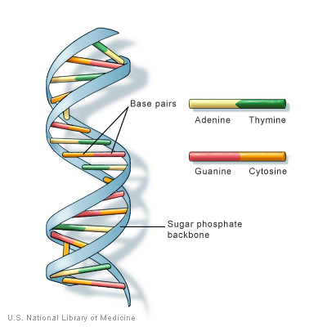
Our genome
3 billion base-pairs long
  Made up of Adenine (A), Guanine (G), Cytosine (C) & Thymine (T)
Inherit a copy each from our parents
  99.9% similar
Some differences (variants) are widespread in the population
Base pairs
Sugar backbone
Notes:
Our genome is 3bn base pairs, made up of 4 bases: Adenine, Guanine, Cytosine and Thymine. We inherit a copy from our mothers, and a copy from our fathers. If we were to compare the corresponding positions between the two, they would be same ~99.9% of the time. Every now and then, around every 1000 bases they’re going to be different. If we move away from the family and extend these comparisons to the population, we’ll see that some of them – which we call SNPs – are quite common in the population.

Slide 4
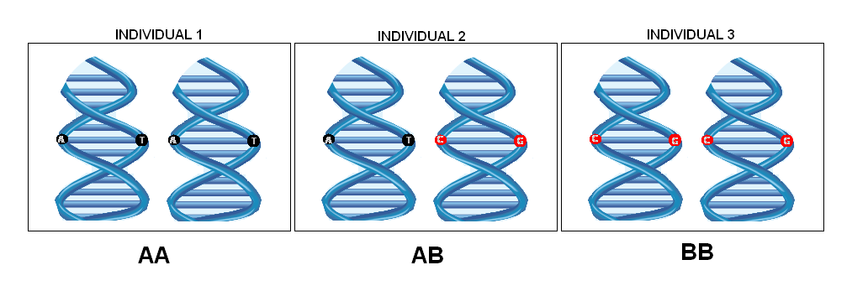
GE terminology – SNP
Single nucleotide polymorphism: Single base change in a specific position of the genome where different individuals (in a certain population) have different alleles (i.e. polymorphic) and therefore different genotypes
Alleles
SNP
A
A
A
G
G
G
T
T
T
T
T
T
AA
AG
GG
Genotypes
GE: Genetic Epidemiology

Slide 5
GE terminology – Association study
A
A
A
G
G
G
AA
AG
GG
Does not smoke
Smokes
Smokes a lot
  Is SNP (or genotype) associated with disease/trait?
    Analyse (hundreds of thousands) SNPs from across the genome, in a large number of individuals (usually tens of thousands) = genome-wide association study (GWAS)
  SNPs identified through GWASs may improve our biological understanding of disease with ultimate aim of prevention, improvement in diagnostics and treatment (e.g. drug targets)
Notes:
Another example:
AA: poor lung function, AG: normal lung function, GG: good lung function

Slide 6
GE terminology – Rare/Common?
  Rare SNP: variant with minor allele frequency<1%
Genotypes for 100 individuals at SNP 1
Genotypes for 100 individuals at SNP 2
A/A A/A A/G A/A A/A A/A A/A A/G G/G A/A A/G A/A A/G A/A A/G A/A A/G A/A A/A A/A A/A A/G A/G A/G A/A A/A A/G A/A A/A A/G A/A A/G A/A A/A A/G A/A A/A A/A A/A A/A A/A A/G G/G A/A A/A A/A A/G A/A A/G A/A A/A A/A A/G A/A A/A A/A A/A A/G G/G A/A A/G A/A A/G A/A A/G A/A A/G A/A A/A A/A A/A A/G A/G A/G A/A A/A A/G A/A A/A A/G A/A A/G A/A A/A A/G A/A A/A A/A A/A A/A A/A A/G G/G A/A A/A A/A A/G A/A A/G A/A
C/C C/C C/T C/C C/C C/C C/C C/C C/C C/C C/C C/C C/C C/C C/C C/C C/C C/C C/C C/C C/C C/C C/C C/C C/C C/C C/C C/C C/C C/C C/C C/C C/C C/C C/C C/C C/C C/C C/C C/C C/C C/C C/C C/C C/C C/C C/C C/C C/C C/C C/C C/C C/C C/C C/C C/C C/C C/C C/C C/C C/C C/C C/C C/C C/C C/C C/C C/C C/C C/C C/C C/C C/C C/C C/C C/C C/C C/C C/C C/C C/C C/C C/C C/C C/C C/C C/C C/C C/C C/C C/C C/C C/C C/C C/C C/C C/C C/C C/C C/C
Genotype counts:
A/A=64, A/G=32, G/G=4
Minor allele = G
Minor allele count (MAC)
= 2*4 (G/G) + 32 (A/G) = 40
Minor allele frequency (MAF)
= MAC / (2 chr × 100 indiv)
= 40 / 200 = 20%
G allele at SNP 1 is a
Common variant (>1%)
Genotype counts:
C/C=99, C/T=1, T/T=0
Minor allele = T
Minor allele count (MAC)
= 2*0 (T/T) + 1 (C/T) = 1
Minor allele frequency (MAF)
= MAC / (2 chr × 100 indiv)
= 1 / 200 = 0.5%
T allele at SNP 2 is a
Rare variant (<1%)

Slide 7
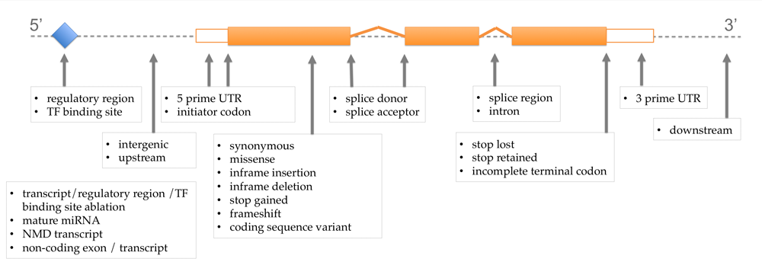
Human-Exome chip
Genome: complete set of DNA we receive from our parents
  Exome: subset of the genome formed by exons (~1%) – see image below (filled in orange)
Genotyping arrays are often called a ‘chip’ as they resemble a computer chip
  Not for DNA sequencing, but genotyping certain alleles
  Human-Exome chip is designed to predominantly harbour rare putatively functional variants – thus much larger sample sizes needed
    ~250,000 variants (in up to 286,425 individuals in our project)
  UK Biobank Axiom array, designed mostly for GWAS (MAF>1%) purposes
    ~820,000 variants (in a subset of the total, up to 112,811 individuals in our project)
Gene
Exon 1
Exon 2
Exon 3
Image from Ensembl VEP

Slide 8
Genetic association study
Linear regression model: trait ~ SNP + covs + e
  Covariates: Age, sex and principal components (≥3, up to 10 PCs)
Significance threshold: P<5x10⁻⁷ for Human-Exome chip variants and P<5x10⁻⁸ for GWAS chip variants
Quality control (QC) parameters
  At study-level: Hardy-Weinberg equilibrium p-value threshold of 10⁻⁵ and call rate threshold of >95% for each genotyped SNP
    To identify poor quality SNPs and genotyping errors
  At meta-analysis level: we excluded datasets where the effects sizes were non-normally distributed and/or the genomic inflation factor (λ) was very low (<0.80)
    Deflated λ can occur due to phenotypically discordant samples
Call rate Fraction of called SNPs per sample over the total number of SNPs in the dataset
Notes:
HWE P-value rationale: We expect SNPs to obey certain rules in a randomly mating population
Causes of λ inflation are technical batch effects, population stratification, cryptic relatedness between samples, DNA sample quality

Slide 9
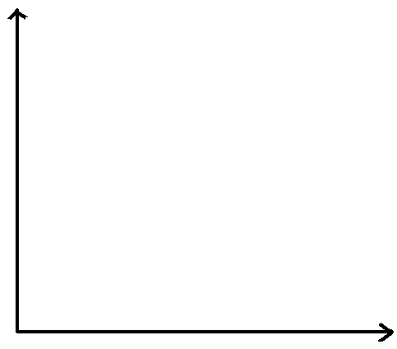
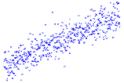
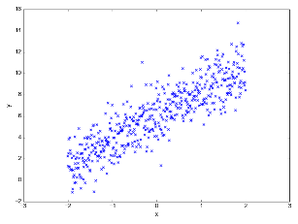
Additive model
Additive model assumes:
  ∆Trait value/risk ∝ no of ‘risk’ alleles inherited
Value
β
Quantitative trait e.g. height
β
0/0
0/1
1/1
Genotype
(risk allele coded as 1)
β: effect size
Notes:
No of risk alleles: 0, 1, 2. In slide 5, ‘risk’ allele would be G as G is the allele that is associated with increased smoking

Slide 10
Meta-analysis of GWAS
Analysis plan developed
(instructions for trait-specific association studies)
Study 1
Study 6
Study 2
Study 5
Study 3
Study 4
RESULTS in RAREMETALWORKER output format
Meta-analysis using RAREMETAL
GWAS: Genome-wide association studies
Associated SNPs
Notes:
RAREMETAL utilises the Cochran-Mantel-Haenszel method, assuming additive genetic effect. CMH is a technique that generates an estimate of an association between an exposure and an outcome after adjusting for confounding.

Slide 11
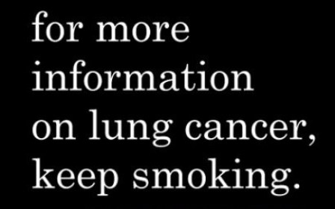
Introduction to Smoking
Smoking is a major risk factor for many diseases, including many common diseases
  e.g. lung cancer and chronic obstructive pulmonary disease (COPD)
It is thought to be the cause of 1 in 10 deaths worldwide
  Thus, there is a special interest in understanding the genetic aetiology of smoking behaviour and whether certain individuals are more likely to start or stop smoking – or smoke heavily after starting
References:
Wain LV et al. 2017. Genome-wide association analyses for lung function and chronic obstructive pulmonary disease identify new loci and potential druggable targets. Nature genetics; 49(3): 416-425
Reitsma et al. 2017. Smoking prevalence and attributable disease burden in 195 countries and territories, 1990-2015: a systematic analysis from the Global Burden of Disease Study 2015. The Lancet.

Slide 12

Traits analysed
Smoking behaviour related traits
  Smoking initiation (SI, binary trait)
    Ever vs Never smokers. Ever smokers were defined as individuals who have smoked >99 cigarettes in their lifetime.
  Smoking cessation (SC, binary trait)
    Ex vs Current Smokers
  Cigarettes per day (CPD, quantitative trait)
    Inverse-normalised
  Pack years (PY, quantitative trait)
    Packs per day x Years smoked, inverse-normalised
Notes:
Pack: 20 cigarettes

Slide 13
Previous studies
Previous GWASs have been successful in identifying 13 common SNPs associated with smoking behaviour related traits
  Including the 15q25 (CHRNA3) region, which yield the largest effects (explaining ~1% of phenotypic variance)
  However the identified loci explain only a small amount of the estimated genetic heritability of smoking behaviour (between 2% and 3%), which is thought to be around 40-60%
  Thus there is a need for alternative approaches to elucidate further the genetic architecture of smoking behaviour
CHRN: Cholinergic receptor nicotinic
Notes:
Common: with minor allele frequency, MAF>1%

Slide 14
Current sample sizes
SI: n=286,425 (UK Biobank + UK BiLEVE n=112,811)
SC: n=98,977 (UK Biobank + UK BiLEVE n=51,043)
CGSB Cohort | SI
AIRWAVE | 1905
ASCOT SC | 2461
ASCOT UK | 3243
B58C | 5537
BRIGHT | 851
DIABNORD | 397
EFSOCH | 1389
EGCUT – BMI CASES | 926
EGCUT – CONTROLS | 767
EGCUT – T2D CASES | 836
EGCUT – CoreExome | 4642
EMBRACE | 604
FENLAND | 1333
FIA3 | 2387
GEN SCOT | 9810
GLACIER | 928
GO DARTS | 4447
KORA | 2843
KORC | 836
LBC21 | 503
LBC36 | 983
LOLIPOP HE | 1664
LOLIPOP OE | 977
LRGP | 2070
OXBB | 4301
SEARCH – Breast | 3465
SEARCH - Control | 1810
SEARCH - Ovarian | 723
SHIP | 7396
SIBS | 878
UKHLS | 9176
PY: n=108,397 (UK Biobank + UK BiLEVE n=40,624)
CPD: n=109,323 (UK Biobank + UK BiLEVE n=40,882)
GSCAN Cohort | SI
ARIC | 8970
FINNTWIN | 1467
FUSION | 1153
GECCO | 6459
HRS | 6393
ID1000 | 803
MEC | 1903
METSIM | 8146
MHI | 6820
NAGOZALC | 1038
NESCOG | 486
SARDINA | 5069
TWINSUK | 878
UK BIOBANK | 73331
UK BILEVE | 39480
GFG | 2994
CHDExome+ Cohort | SI
BRAVE | 5543
CCHS | 6287
CGPS | 11781
CIHDS | 3434
PROSPER | 1279
EPIC-CVD | 21475
INTERVAL | ?
PROMIS | 9005
UK BiLEVE: UK Biobank Lung Exome Variant Evaluation
Red: Relatively large sample sizes (n>5k)

Slide 15
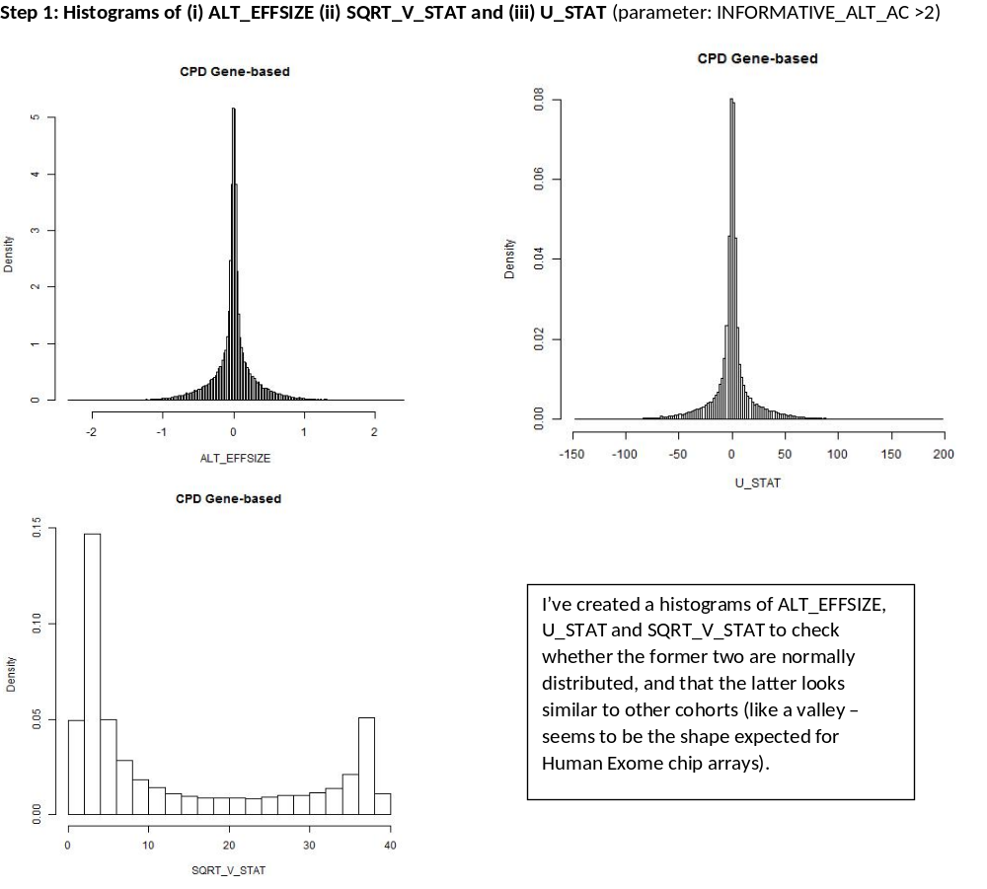
Quality Control (QC) steps – within studies
U-statistics
summarize the genomic similarity between pair of individuals and link this similarity to phenotype similarity
Notes:
We QC all of the results we receive from each of the analysts

Slide 16
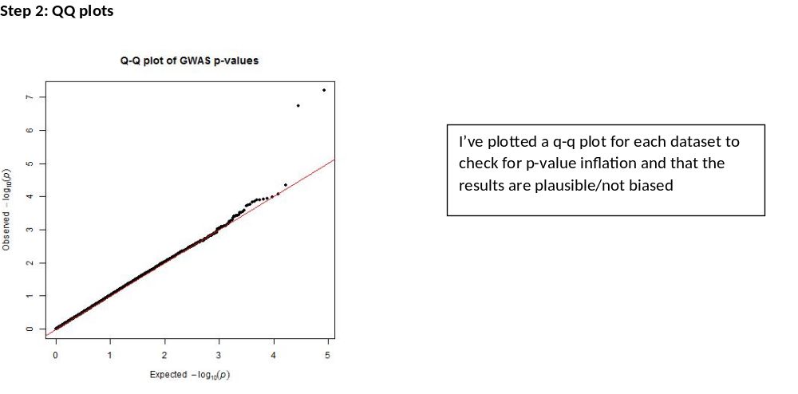
QC steps – within studies
(a simple way to observe confounding effects)
Quantile-Quantile plots show the expected distribution of association test statistics across the hundreds of thousands of SNPs compared to the observed values. Any deviation from the X=Y line implies a consistent difference between cases and controls across the genome.
Notes:
A nice QQ plot should show a solid line matching X=Y until it sharply curves at the end (representing the small number of true associations among thousands of unassociated SNPs)

Slide 17
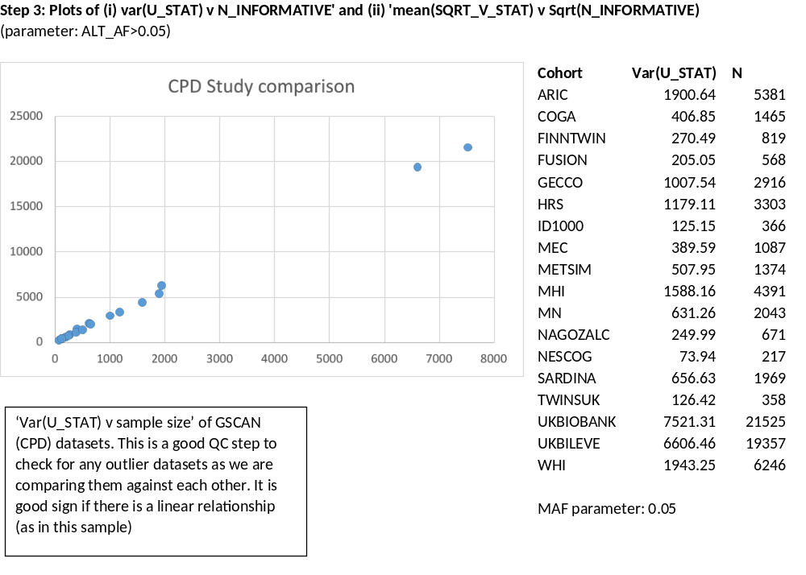
QC steps – across studies

Slide 18
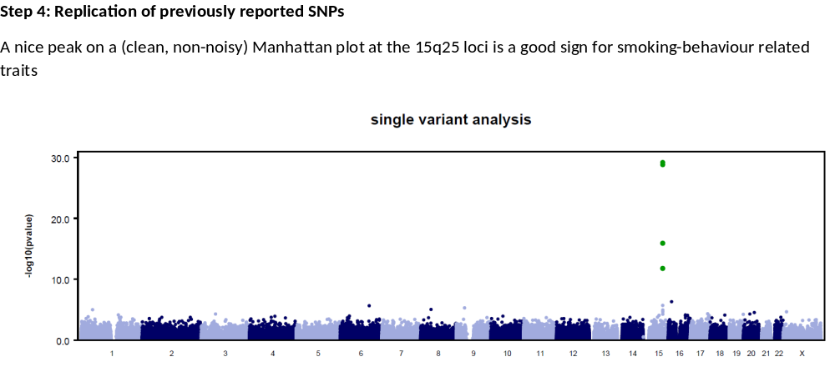
QC steps – positive controls
The y-axis shows the −log₁₀ P values of ~1,000,000 SNPs, and the x-axis shows their chromosomal positions. SNPs with P<5e-8 are highlighted in green.

Slide 19
Excluded datasets & reasons
 | SI | SC | CPD | PY
BRAVE | South Asian sample & Non-normally distributed β | South Asian sample & Non-normally distributed β | South Asian sample | South Asian sample
PROMIS | South Asian sample | South Asian sample & Non-normally distributed β | South Asian sample | South Asian sample
INTERVAL | Missing many RAREMETAL columns & Very low lambda (0.068) | Missing many RAREMETAL columns & Very low lambda (0.21) | Missing many RAREMETAL columns & Very low lambda (0.042) | Missing many RAREMETAL columns & Very low lambda (0.047)
LRGP | Non-normally distributed β | Non-normally distributed β |  | Non-normally distributed β
PROSPER | Non-normally distributed β
CCHS |  | Non-normally distributed β
EPIC |  | Very low lambda (0.17)
TOTAL | 50 cohorts (n=286425) | 36 cohorts (n=98977) | 50 cohorts (n=109323) | 45 cohorts (n=108397)

Slide 20
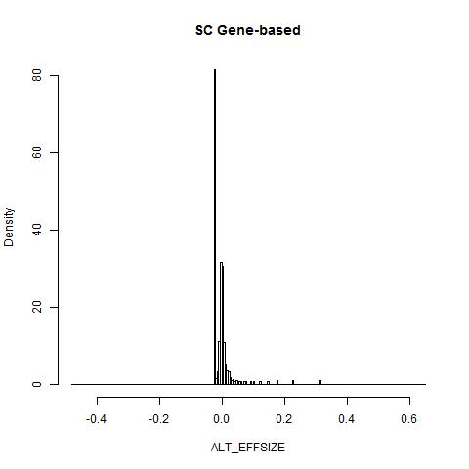

Problematic datasets
  CCHS – SC dataset (n=4021)
Parameter: MAC≥3
Notes:
Maybe trait residuals are not standardised – non-normally distributed

Slide 21
Results: Previous signals
Loci | Trait | Reported SNP (UK BiLEVE) | Proxy Chr:Pos | Proxy Ref:Alt | Proxy Beta | P value | R2
15q25 (CHRNA3) | CPD | rs1051730 (rs71448806) | 15:78894339 (rs1051730) | G>A | 0.08 | 1.99e-30 | 0.99
7p14 (PDE1C) | CPD (PY) | rs215605 (rs215600) | 7:32338337 (rs215607) | G>A | -0.01 | 0.027 (1.69e-07) | 0.30
8p11 (CHRNB3) | CPD | rs13280604 | 8:42559586 (rs13280604) | G>T | -0.027 | 5.68e-10 | 1
LOC100188947 | CPD | rs1329650 | 10:93348120 (rs1329650) | G>T | -0.005 | 0.04 | 1
EGLN2 | CPD | rs3733829 | NA | NA | NA | NA | NA
19q13 (RAB4B) | CPD | rs7937 | 19:41310571 (rs3733829) | A>G | 0.005 | 0.005 | 0.34
DBH | SC | rs3025343 (rs111280114) | 9:136478355 (rs3025343) | G>A | -0.021 | 2.64e-05 | 1
BDNF | SI | rs6265 (rs2049045) | 11:27679916 (rs6265) | C>T | -0.01 | 1.63e-06 | 1
NCAM1 | SI | (rs4466874) | 11:112866456 (rs4144892) (non H-Ex) | C>T | 0.055 | 4.73e-10 | 1
TEX41/PABPC1P2 | SI | (rs10193706) | 2:146125523 (rs10427255) | C>T | -0.014 | 1.74e-13 | 0.49
LPPR5 | SI | (rs61784651) | 1:99445471 (non H-Ex) | C>T | 0.044 | 0.0001 | 1
DNAH8 | SI | (rs10807199) | NA | NA | NA | NA | NA
NOL4L | SI | (rs143125561;rs57342388) | NA | NA | NA | NA | NA
*r2 value between proxy SNP in Human-exome chip and previously reported SNP is presented in final column
Notes:
To test the reliability of the samples and methods used, we assessed evidence for associations in our data for previously reported signals for smoking behaviour. For this, we looked for proxies (r2>0.3, ±2Mb) in the human exome chip for each of these previously reported loci. Ten out of 13 had at least a single proxy (Supp. Table 3). Of these ten proxy SNPs, seven showed strong association (P<0.0001) in the meta-analysis of the trait it was reported for; and another three showed weak association (P<0.05) – although a couple of them (i.e. rs215607 and rs3733829) were very weak proxies for previously reported SNPs

Slide 22
Results: Novel signals for follow-up?
Loci | Trait | SNP ID | Chr:Pos | Ref:Alt | Beta | PooledMAF | P value (not λ corrected) | Consequence
GPR101 | CPD & PY | exm1659559 (rs1190736) | X:136113464 | C>A | -0.027 & -0.022 | 0.36 & 0.39 | 1.40e-11 & 4.98e-09 | missense
ATF6 | CPD | exm118559 (rs141611945) | 1:161771868 | A>G | 1.707 | MAC=9 (~113k) | 2.95e-07 | missense
CNNM2 | SI | exm-rs7914558 (rs7914558) | 10:104775908 | G>A | 0.0122 | 0.397 | 1.94e-10 | intronic
TMEM182-POU3F3 | SI | rs12616219 (non H-Ex) | 2:104352495 (rs9308868) | C>A | -0.046 | 0.194 | 5.49e-08 (4.9e-04) | intergenic
BCL11A | SI | rs11895381 (non H-Ex) | 2:60053727 | A>G | 0.05 | 0.29 | 5.62e-09 | intergenic
ZSCAN9 | SI | rs1150691 (non H-Ex) | 6:28168033 | A>G | -0.049 | 0.13 | 4.95e-08 | intergenic
REV3L | SI | rs462779 | 6:111695887 | G>A | -0.014 | 0.19 | 1.38e-08 | missense
GAPVD1 | SI | rs2841334 (non H-Ex) | 9:128122320 (rs534214) | G>A | -0.058 | 0.086 | 2.28e-08 (7.56e-04) | intronic
TNRC6A | SI | exm1227414 (rs11639856) | 16:24788645 | T>A | -0.014 | 0.191 | 1.26e-08 | missense
SMG6 | SI | exm1276230 (rs216195) | 17:2203167 | T>G | -0.013 | 0.272 | 8.25e-09 | missense
PJA1 | SI | exm1643833 (rs11539157) | X:68381264 | C>A | 0.017 | 0.165 | 1.39e-11 | missense
TEF-TOB2 | SC | rs202664 (non H-Ex) | 22:41813886 | T>C | -0.115 | 0.103 | 1.02e-08 | intergenic
Bold: P value <5e-8 even after excluding UK Biobank and BiLEVE samples. Red: Do not reach threshold when cohort-level GC correction applied
Call rate and HWE P-value thresholds were 99% and >5e-5 respectively
Notes:
Note:
No H-Ex: these SNPs are not found on the Human Exome chip (only on the UK Biobank and BiLEVE arrays)

Slide 23
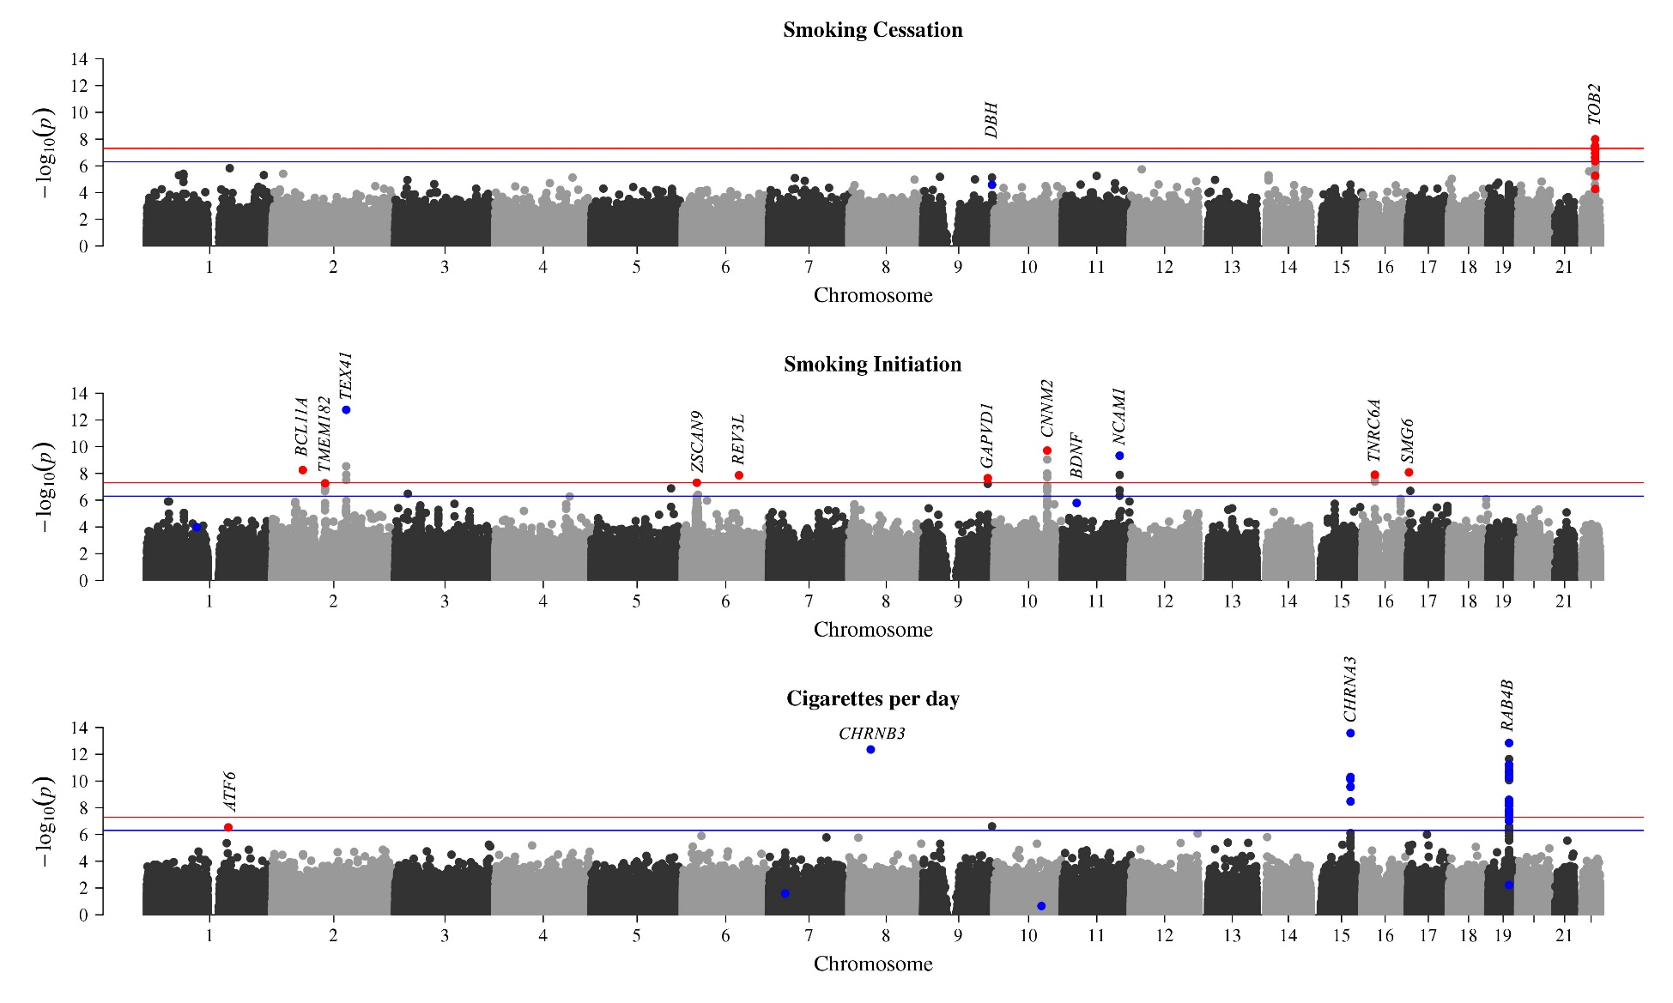
Manhattan plots
P-value threshold: 5e-7 for rare Human-Exome chip SNPs (dark blue line), 5e-8 for others (red line)
Only autosomes shown. PY omitted as there were no novel signals. Dark Blue: previous signals; Red; novel signals. Results capped at 14.

Slide 24
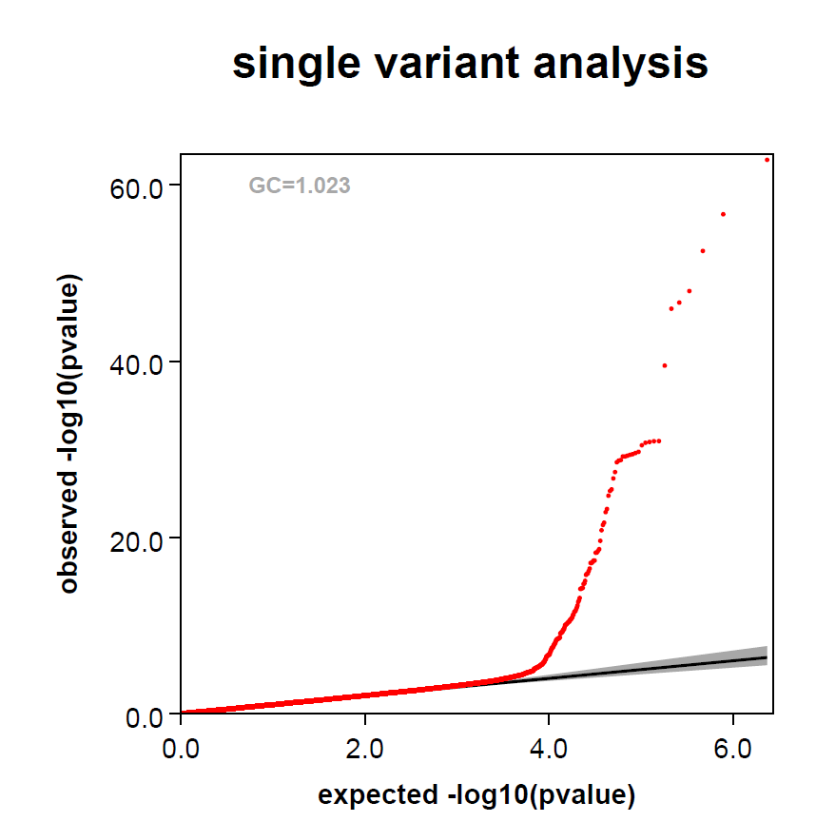
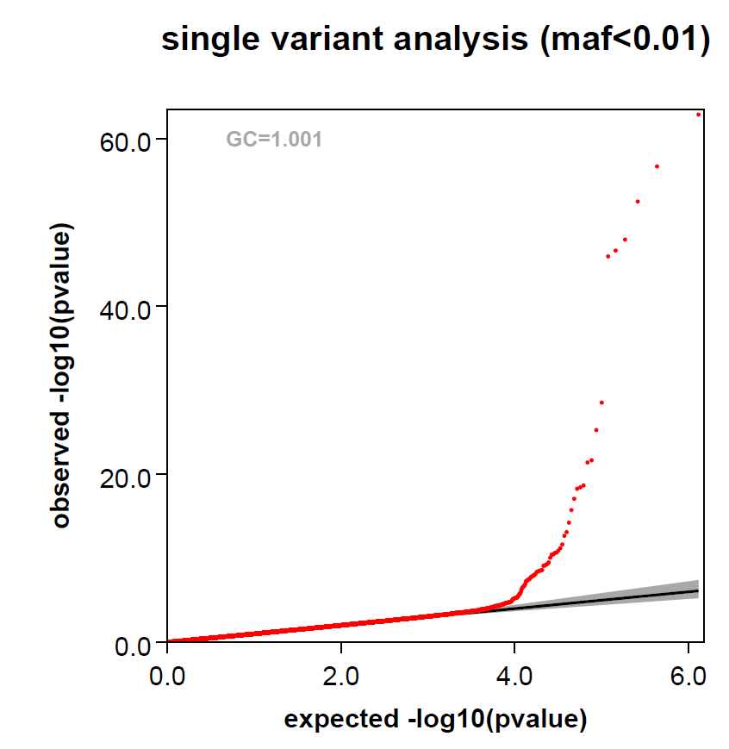
QQ plots – CPD
No SNP QC filters

Slide 25
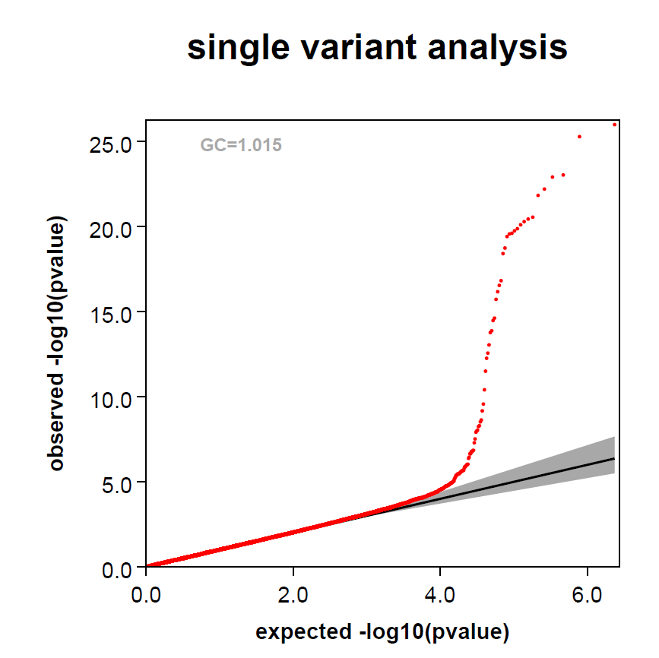
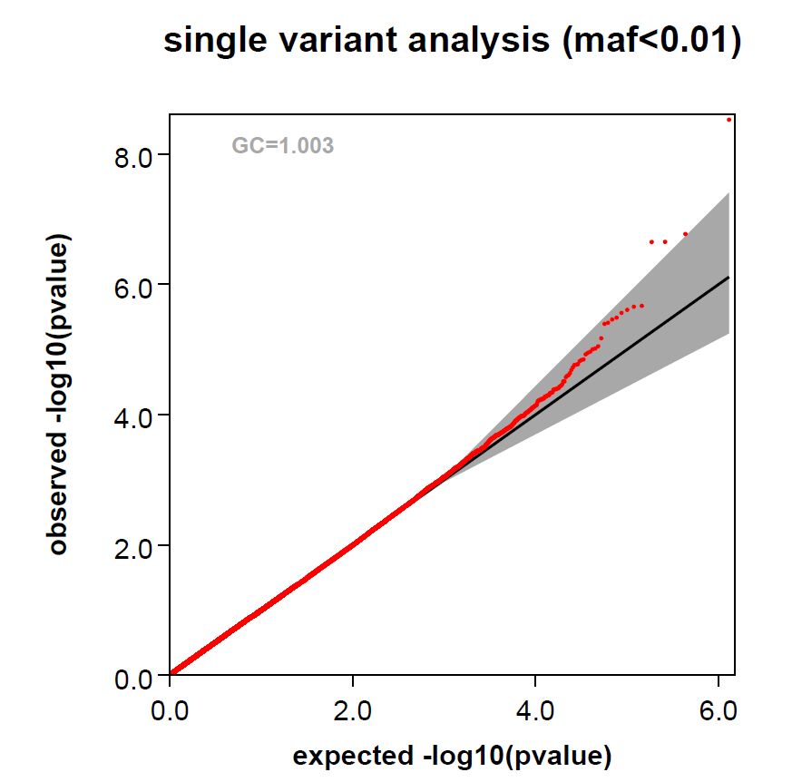
PY
No SNP QC filters

Slide 26
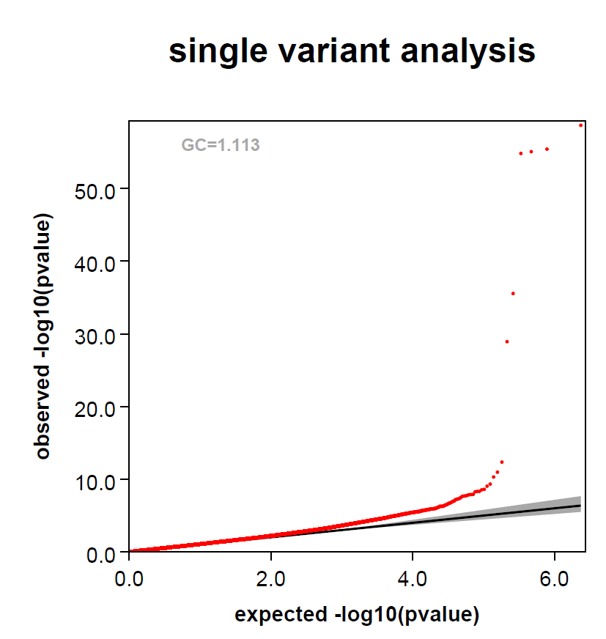
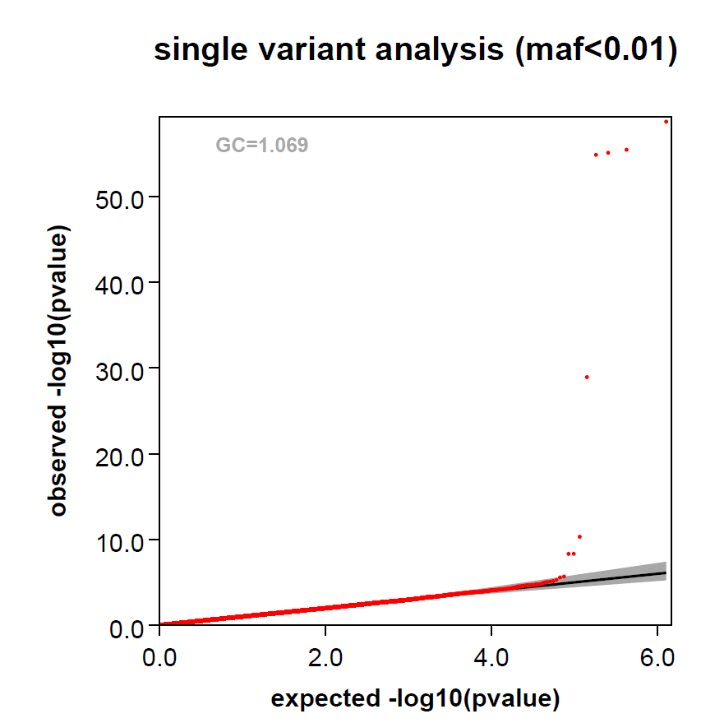
SI
No SNP QC filters

Slide 27
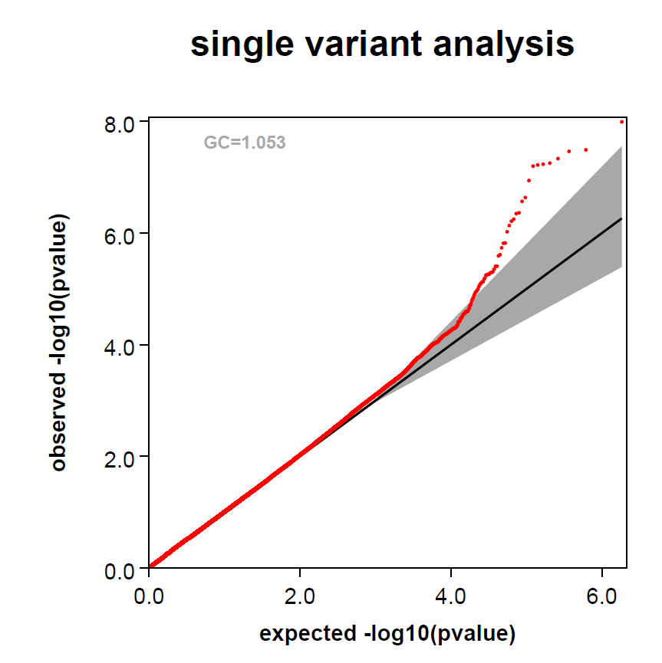
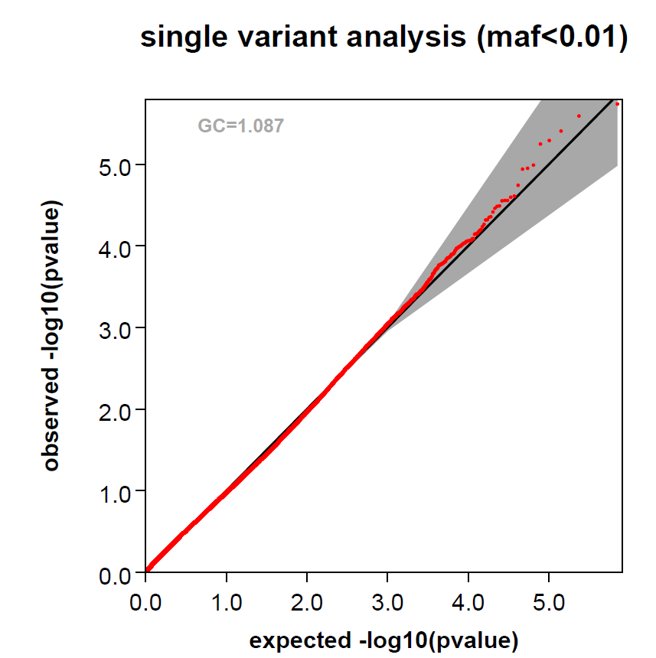
SC
No SNP QC filters

Slide 28
Consortium specific meta-analysis for top SNPs
CNNM2 (SI, P-value: 1.94e-10)
  CGSB P-value: 2.38e-05 (n=78,052) +
  GSCAN P-value: 2.02e-06 (n=165,387) +
  CHDExome+ P-value: 0.0087 (n=42,976) +
ATF6 (CPD, P-value: 2.95e-07)
  CGSB P-value: 0.00017 (n=26,506) +
  GSCAN P-value: 0.005 (n=69,695) +
  CHDExome+ P-value: 0.025 (n=7,364) +
REV3L (SI, P-value: 1.38e-08)
  CGSB P-value: 1.19e-05 (n=78,048) -
  GSCAN P-value: 0.0012 (n=165,368) -
  CHDExome+ P-value: 0.029 (n=42,976) -
GPR101 (CPD, P-value: 1.40e-11)
  CGSB P-value: 0.0010 (n=26,499) -
  GSCAN P-value: 3.41e-09 (n=51,050) -
  CHDExome+ P-value: NA
PJA1 (SI, P-value: 1.39e-11)
  CGSB P-value: 8.72e-07 (n=78,040) +
  GSCAN P-value: 3.09e-07 (n=108,512) +
  CHDExome+ P-value: NA
SMG6 (SI, P-value: 8.25e-09)
  CGSB P-value: 0.0013 (n=78,056) -
  GSCAN P-value: 2.04e-05 (n=154,822) -
  CHDExome+ P-value: 0.002 (n=42,359) -
TNRC6A (SI, P-value: 1.26e-08)
  CGSB P-value: 0.0009 (n=78,032) -
  GSCAN P-value: 1.61e-06 (n=165,386) -
  CHDExome+ P-value: 0.011 (n=42,976) -
Notes:
Note: See slide 20 for Ref & Alt alleles for each SNP

Slide 29
Next steps
Replication
  All sentinel SNPs except ATF6 SNP are on the UK Biobank custom (Axiom) array
  ATF6 SNP
    MAF in Africans (1.2%), Latinos (0.1%), Europeans (0.019%) and South Asians (0.003%) – MAFs from gnomAD
Other follow up studies: eQTL databases, biological pathway enrichment, literature review, druggability, pleiotropy

Slide 30

Acknowledgements
CGSB cohorts
  Airwave, ASCOT (Scotland and UK), 1958BC, BRIGHT, Croatia-KORCULA, DIABNORD, EFSOCH, EGCUT, EMBRACE, Fenland, FIA3, GS:SFHS, GLACIER, GoDARTS, KORA F4, LBC1921, LBC1936, Lifelines, LOLIPOP, LRGP, OxBB, SEARCH, SHIP, SIBS, UKHLS
Collaborators
  Colorado/Michigan
    Dajiang Liu & Mengzhen Liu
  Cambridge
    Jo Howson
Vicki/Martin/Louise/Nick
Carl – worked on the project before me

Slide 31
Appendices

Slide 32
Gene-based analyses
Parameters:
  Only Human-Exome chip SNPs
  SNPs with MAF<5%
  Annotations used: Nonsynonymous, Stop gain, Splice Site, Start Gain, Start Loss, Stop Loss and Synonymous variants.
Variant collapsing methods
  SKAT, Burden test, Variable threshold (VT), Madsen-Browning (MB) method

Slide 33
Gene-based analyses - Results
Not many novel genes to follow up
  Most are explained by one signal or a single strong signal amongst many variants
  CHRNA5 implicated by all three tests for CPD
  CRCP (calcitonin gene-related peptide (CGRP)-receptor component protein) implicated in MB and VT tests for CPD trait by three rare variants (P-values: 0.041, 0.004, 0.046)
  MMP17 implicated by VT (and Burden) test for PY (>10 variants)

Slide 34
Sensitivity analyses
SNP/Analysis | Primary analysis | -UKBiobank samples | I2 test for heterogeneity
CNNM2 | 1.94e-10 | 7.33e-08 | CGSB: 13.13%, Q-test P-value: 0.26; GSCAN: 7.05%, Q-test P-value: 0.37; CHDExome+: 0%, Q-test P-value: 0.83
REV3L | 1.38e-08 | 8.13e-07 | CGSB: 16.91%, Q-test P-value: 0.207; GSCAN: 31.33%, Q-test P-value: 0.12; CHDExome+: 4.03%, Q-test P-value: 0.37
TNRC6A | 1.26e-08 | 1.97e-06 | NA
SMG6 | 8.25e-09 | 1.35e-07 | NA
PJA1 | 1.39e-11 | 4.53e-09 | CGSB: 17.98%, Q-test P-value: 0.21; GSCAN: 30.07%, Q-test P-value: 0.18
GPR101 (CPD) | 1.40e-11 | 3.28e-07 | CGSB: 10.98%, Q-test P-value:; 0.31 GSCAN: 0.58%, Q-test P-value: 0.43
P-values obtained from each SI analysis is shown in the corresponding box (unless stated otherwise).
-UKBiobank: Both UK Biobank and UK BiLEVE samples are excluded from primary analysis.
Notes:
UK BiLEVE study ascertained on heavy smokers

