Slide 1
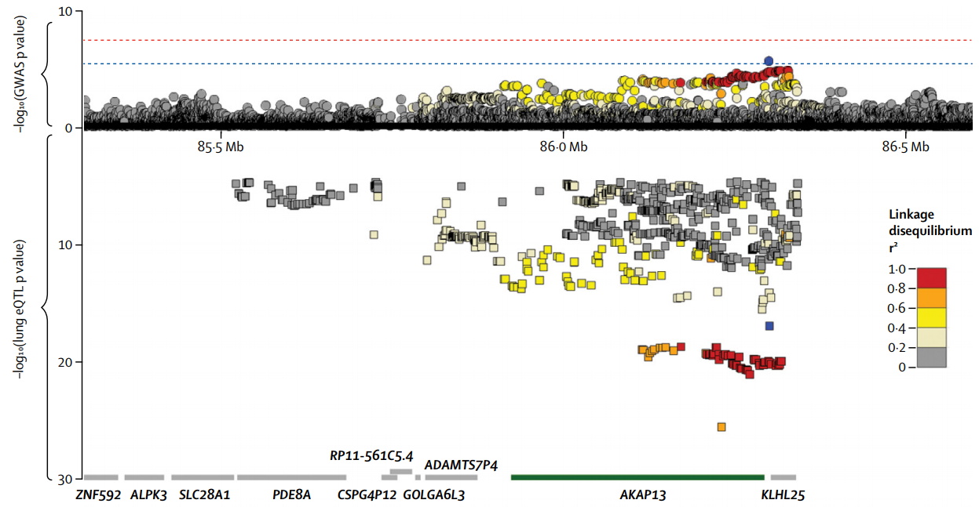
GWAS-eQTL signal colocalisation methods
Integrating GWASs and eQTL studies can elucidate mechanism of non-coding variants on diseases
  Challenging due to the uncertainty induced by (i) LD and (ii) allelic heterogeneity
Allen et al, 2017
Same causal variant(s) or not?

Slide 2
What we want to see
Lung Function GWAS
Causality
Transcription
Disease
Causal variant
Transcription (eQTL)
Pleiotropy
Transcription
Disease
Causal variant
Genotype
AA
Aa
aa
Linkage
Transcription
Disease
(Non-coding) Causal variant
Causal variant 1
Causal variant 2
What we’ll often see

Slide 3
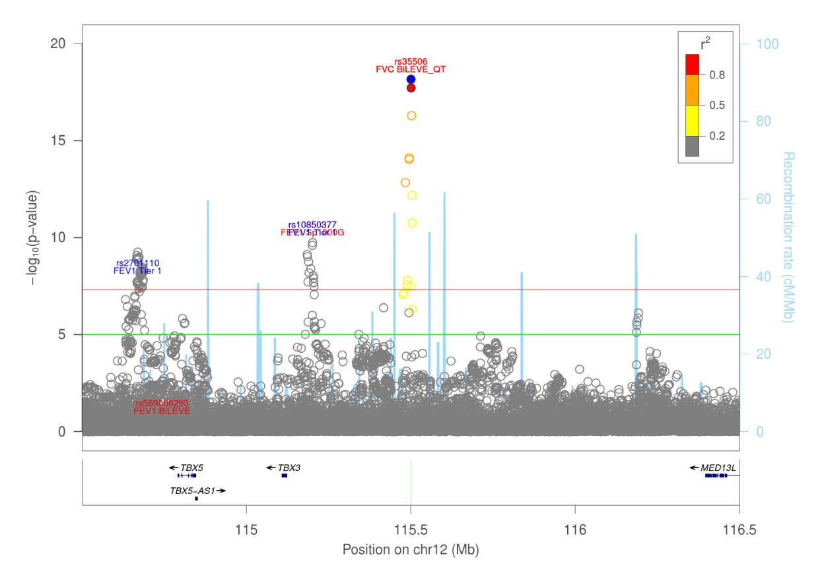
Current UK Biobank LF GWAS
If top eSNP for a gene is in our 99% credible set, then we inferred that both signals were colocalised
  Generally a strict approach
    Some credible sets have 1-2 SNPs (e.g. rs35506 below)
  Puts too much trust on the eQTL results
    Relatively small sample sizes & potential cell-type heterogeneity
    Strict thresholds applied as methods still work in progress
Shrine, Guyatt et al, 2018. BioRxiv
Notes:
Credible set: rs35506 & rs35505 (near TBX3)

Slide 4
eCAVIAR
Hormozdiari et al, 2017. AJHG
“State-of-the-art”
  Widely used since publication (>50 citations)
Probabilistic model for integrating GWAS and eQTL data to estimate the posterior probability of the same variant being causal in both GWAS and eQTL studies, while accounting for allelic heterogeneity and LD
  It can (i) quantify the strength between a ‘causal’ variant and its associated signals in both studies, and (ii) colocalize variants that pass the significance threshold in GWAS
  For any given peak variant identified in GWAS, eCAVIAR considers a collection of variants around that peak variant as one single locus
Notes:
eCAVIAR: eQTL and GWAS CAusal Variants Identification in Associated Regions

Slide 5
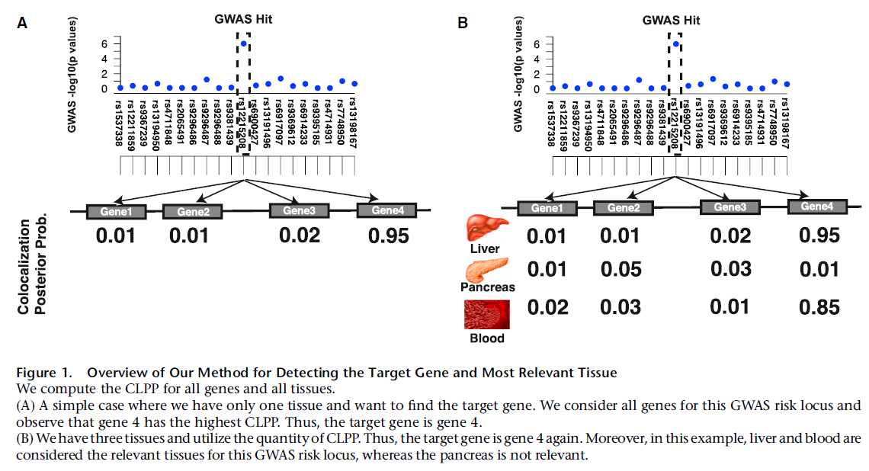
CLPP: colocalisation posterior probability –
probability that the same variant(s) is causal in both the GWAS and eQTL study
(Most likely) Causal SNP(s) Target Gene(s) Relevant Tissue(s)

Slide 6
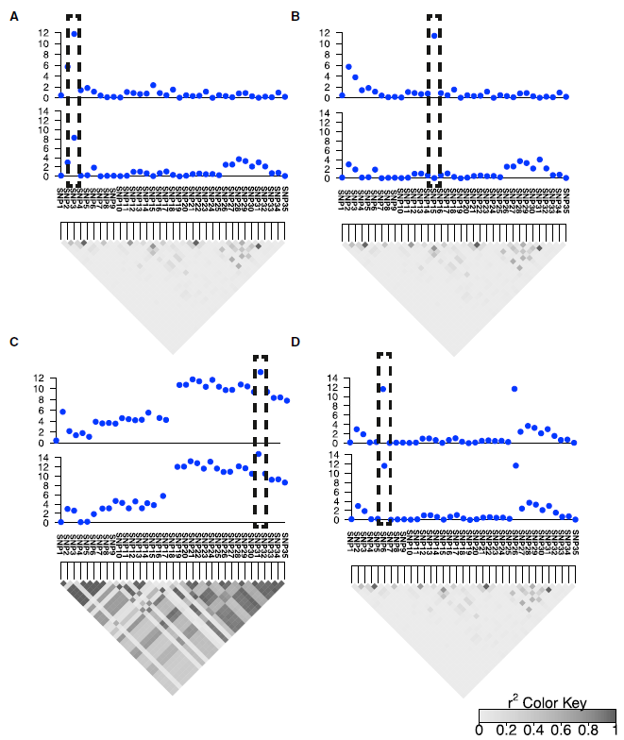
GWAS -log10(P)
CLPP is high
CLPP is low
eQTL -log10(P)
CLPP is low
CLPP is low (~0.25) if 1 causal variant specified. CLPP≈1 if >1 causal variant
CLPP: colocalisation posterior probability –
probability that the same variant(s) is causal in both the GWAS and eQTL study

Slide 7

Current analysis plan & results
MFAP2 region
FEV₁/FVC meta-analysis GWAS results +/-500kb around sentinel SNP and P<10⁻⁴
  output: 375 SNPs
GTEx Lung (full results) and Lung eQTL (FDR<5%)
  Input: 366 and 5 SNPs, respectively
Sakornsakolpat et al (BioRxiv) supplement p10: To determine whether these signals co-localized (rather than being related due to linkage disequilibrium), we performed colocalization analysis between our genomewide significant loci and mQTL using eCAVIAR [64]. We tested variants that were significant in both datasets, P<0.0027 in GWAS (equivalent to Z score>3, as recommended by the author [64]) and P<3.2x10-6 in mQTL [61] . We estimated the posterior probability of a variant being shared in both GWAS and mQTL, using a cut-off of 0.1 as previous demonstrated [64].
Notes:
Supp. Table 13
Z-score= 3.719

Slide 8
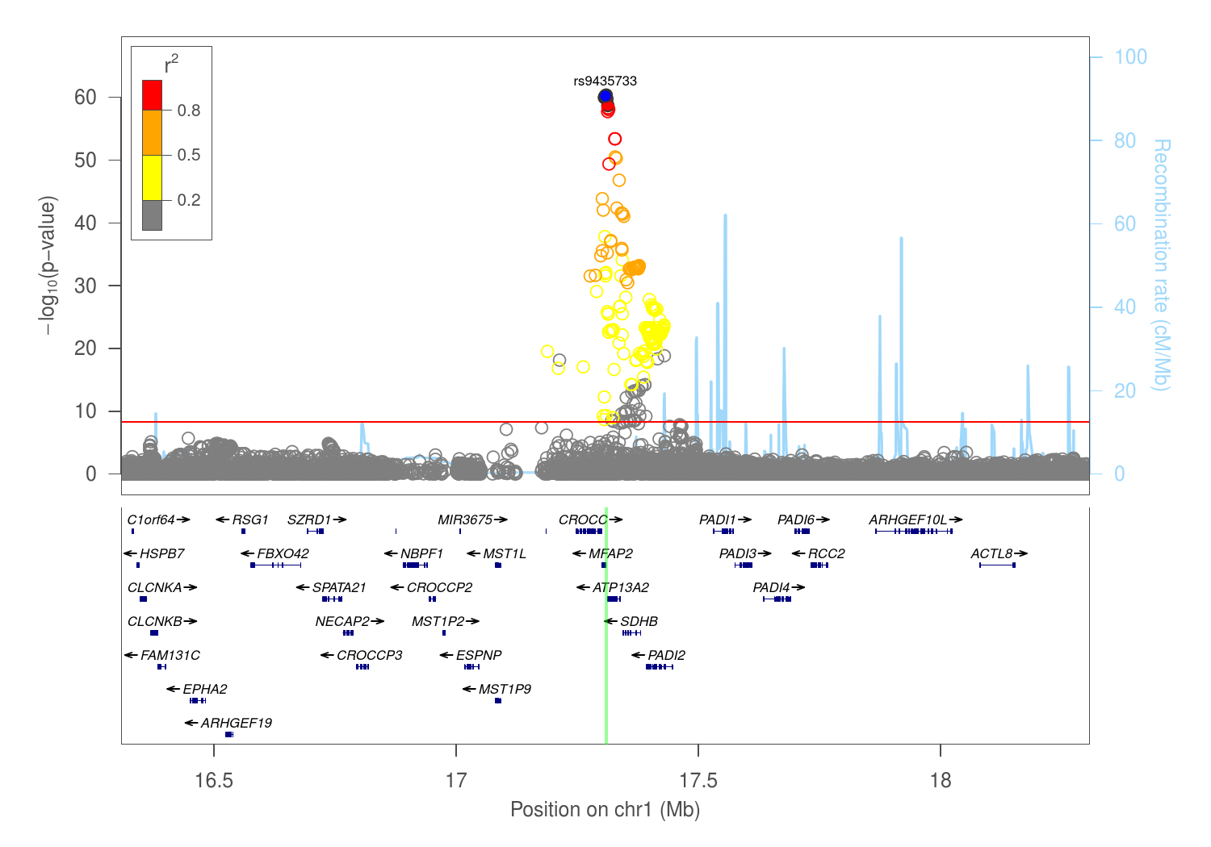
99% credible set has 5 SNPs (incl. rs9435733)
Shrine, Guyatt et al, 2018. BioRxiv

Slide 9
eCAVIAR outputs
*_col contains the colocalization posterior probability (CLPP). Last column is the CLPP score
*_post: contains the probability of each variant is causal in eQTL or GWAS. The last column is this quantity
*_set: is the credible set used for fine-mapping purpose
*_hist: the output of eCAVIAR when you set -f and if you set the maximum number of causal "-c " to X. Then you will have a *_hist file where you will have X+1 column in the output file as follows: First column is the probability that this locus has 0 causal variants; second column is the probability that this locus has 1 causal variant; X-th Column: is the probability that this locus has (X-1) causal variants
The files _1 and _2 refer to the GWAS and eQTL results, respectively

Slide 10
eCAVIAR paper discussion
Strong evidence in support of the idea that most GWAS loci are not strong eQTL loci and that the mechanism by which GWAS loci affect gene regulation is more complicated than expected
Possible explanations:
  GWAS loci in fact do affect expression but are secondary signals in comparison to the stronger associations found in current eQTL studies
    Heterogeneity of tissues could render it hard to detect eQTLs specific to a disease-relevant cell type that composes only a fraction of the tissue
  GWAS variants affect other aspects of gene regulation, such as splicing or regulation at a level other than transcription regulation
    Several studies have shown that alternative splicing could explain the causal mechanism of complex disease associations
  GWAS loci are eQTL loci only in certain conditions, such as development, where expression levels are not typically measured

Slide 11
Other colocalisation methods
RTC (regulatory trait concordance) method
  Requires individual level data for the eQTL datasets
  Conditions on the top GWAS signals and checks whether any eQTL signals are attenuated
COLOC/MOLOC
  Utilises an approximate Bayes factor to estimate the posterior probabilities that a variant is causal in both GWASs and eQTL studies
  Initially developed for checking colocalisation between a pair of GWAS using summary stats, then extended to >2 studies.
Sherlock
  Bayesian statistical framework that matches GWAS association signals with eQTL signals for a specific gene in order to detect whether the same variant is causal in both studies. Similar to RTC, Sherlock accounts for the uncertainty of LD
  Easy to use online server (http://sherlock.ucsf.edu)
Enloc
  Similar method to eCAVIAR but not cited much
Piccolo
  https://github.com/Ksieber/piccolo
Notes:
RTC: Nica et al, 2010. Candidate causal regulatory effects by integration of expression QTLs with complex trait genetic associations. PLoS Genet.
Enloc: Wen et al, 2017. Integrating molecular QTL data into genome-wide genetic association analysis: Probabilistic assessment of enrichment and colocalization. PLoS Genet
Sherlock: He et al, 2013. Sherlock: detecting gene-disease associations by matching patterns of expression QTL and GWAS. AJHG
COLOC: Giambartolomei et al, 2014. Bayesian Test for Colocalisation between Pairs of Genetic Association Studies Using Summary Statistics. PLoS Genet
MOLOC: Giambartolomei et al, 2018. A Bayesian Framework for Multiple Trait Colo-calization from Summary Association Statistics. Bioinformatics

Slide 12
To do/discuss
All SNPs and genes on Table 1?
  Automate pipeline
Request Lung eQTL results for all regions
P-value (0.0027 & 3.2x10-6) & cut-off (0.1) thresholds?
Other tissues?
  Blood eQTL?
  All GTEx tissues?

