Slide 1

GWAS of three molecular traits highlights core genes and pathways alongside a highly polygenic background
Sinnott-Armstrong et al, 2020
Take-home messages:
Genetic architecture of urate, IGF-1, and testosterone (x2)
  “biologically simpler than most diseases”
Few “core” genes but heritability mostly explained by polygenic background
“Omnigenic” model?
Genetics Forum: 14/05/20
A. Mesut Erzurumluoglu
@mesuturkiye
Notes:
- Appeared on BioRxiv on 22nd April – another omnigenic model paper. What I didn’t expect was how deeply they looked into the pathways involved. Although it’s a long paper, I really enjoyed reading it and wanted to share it with the group. I’ve published GWAS papers before but this paper has definitely given me ideas for future papers. In a nutshell, the paper contains 4 GWASs and then the authors try and make inferences about the genetic architecture of these traits and the pathways that influence them. They choose these traits because there’s already a lot of things known with regard to the core pathways and genes. Compared to schizophrenia which is poorly understood at the molecular level or height where we understand more of the underlying biology, but for which a large number of different biological processes contribute variance
the top hits contribute only a small fraction of the total heritability

Slide 2
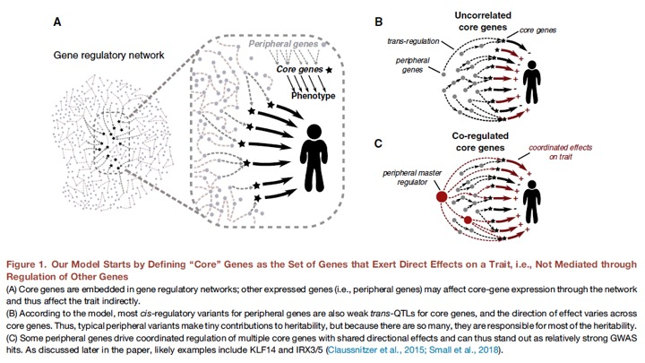
Notes:
Omnigenic model: for common complex diseases - Core genes: which have direct effect on the trait that is not mediated through regulation of other genes.
Lots of other “peripheral” genes that are expressed in trait-relevant cell types and can influence the trait if they affect the expression of core genes - huge numbers of weak trans-regulatory effects from SNPs at peripheral genes
-?the distribution of peripheral gene effect sizes would be centered on zero, and in practice not all genes have regulatory variants?
-Omnigenic extreme
-endophenotypes
Genetics journal – they explained many things
They finally conclude that these traits are good examples of the omnigenic model.
Commands: GWAS (plink), LD Score regression, epistasis (plink2), causal snp simulations (gcta)

Slide 3
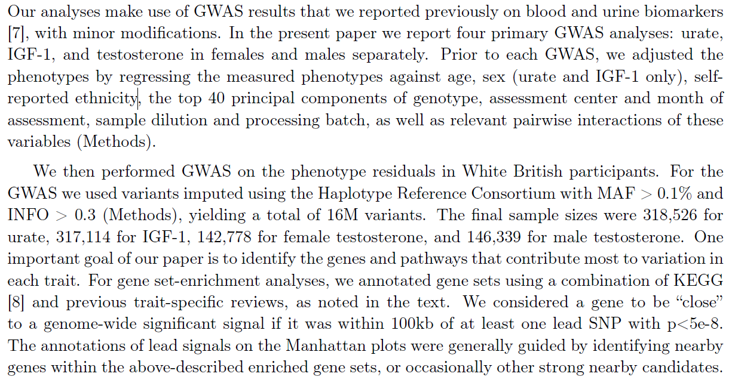

Notes:
Ali G ☺
Sample sizes small?

Slide 4
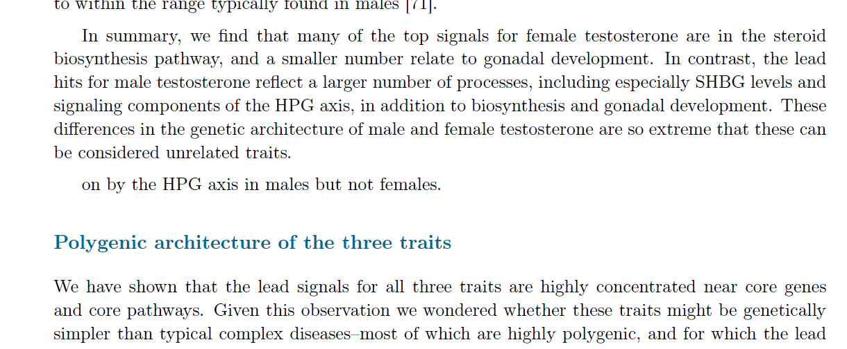

Slide 5
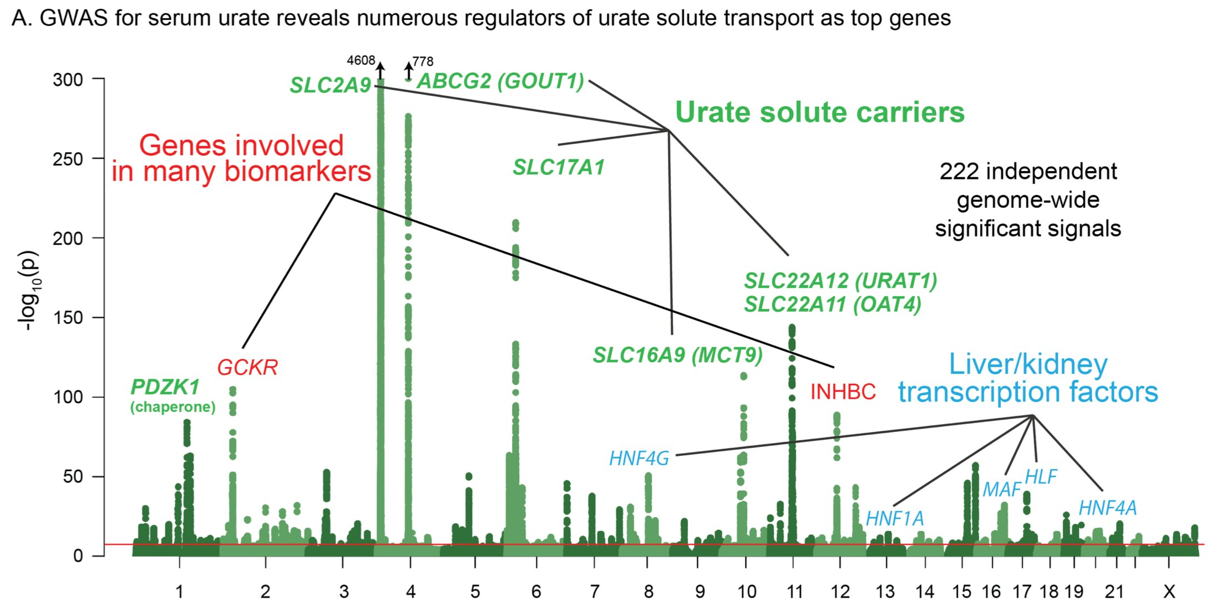
Urate GWAS
Notes:
-log10(P)<1000
The top hits are near kidney transporter genes - six of the top ten signals are located within 100kb of a urate solute transport gene
GCKR: glucose-enzyme regulator

Slide 6
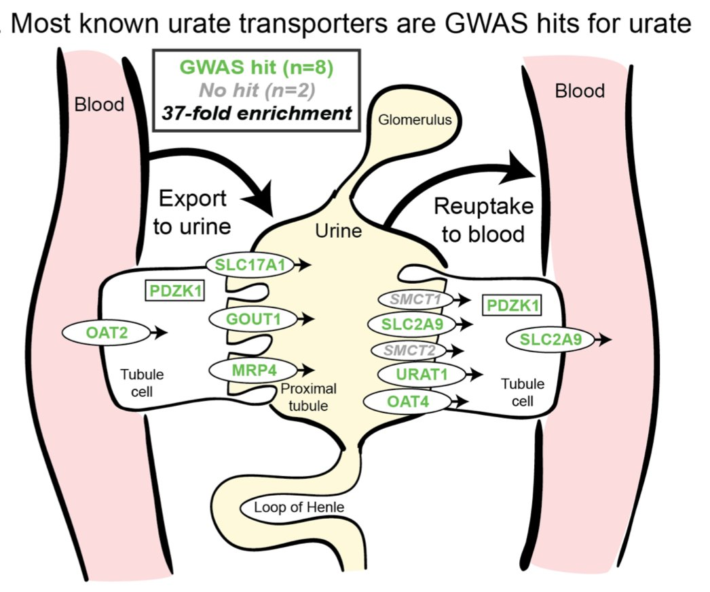
Notes:
I really liked these hand-drawn figures using Adobe Illustrator (KEGG: manually curated by Kyoto University)
Urate heritability (secretion pathway) is highly enriched in kidney regulatory regions compared to the genome-wide background (analysis using stratified LD Score regression). Other tissues show little or no enrichment after removing regions that are active in kidney

Slide 7
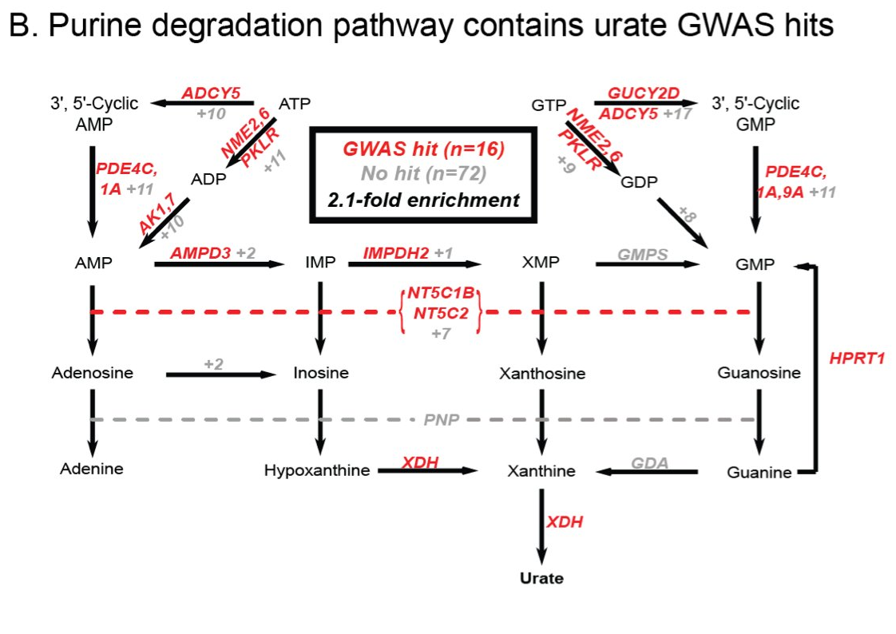
Notes:
Urate biosynthesis pathway which produces urate as a byproduct shows relatively modest enrichment - suggesting that
synthesis, while it plays a role in the genetic basis of urate levels, is secondary to the core regulatory functions provided by the secretion pathway

Slide 8
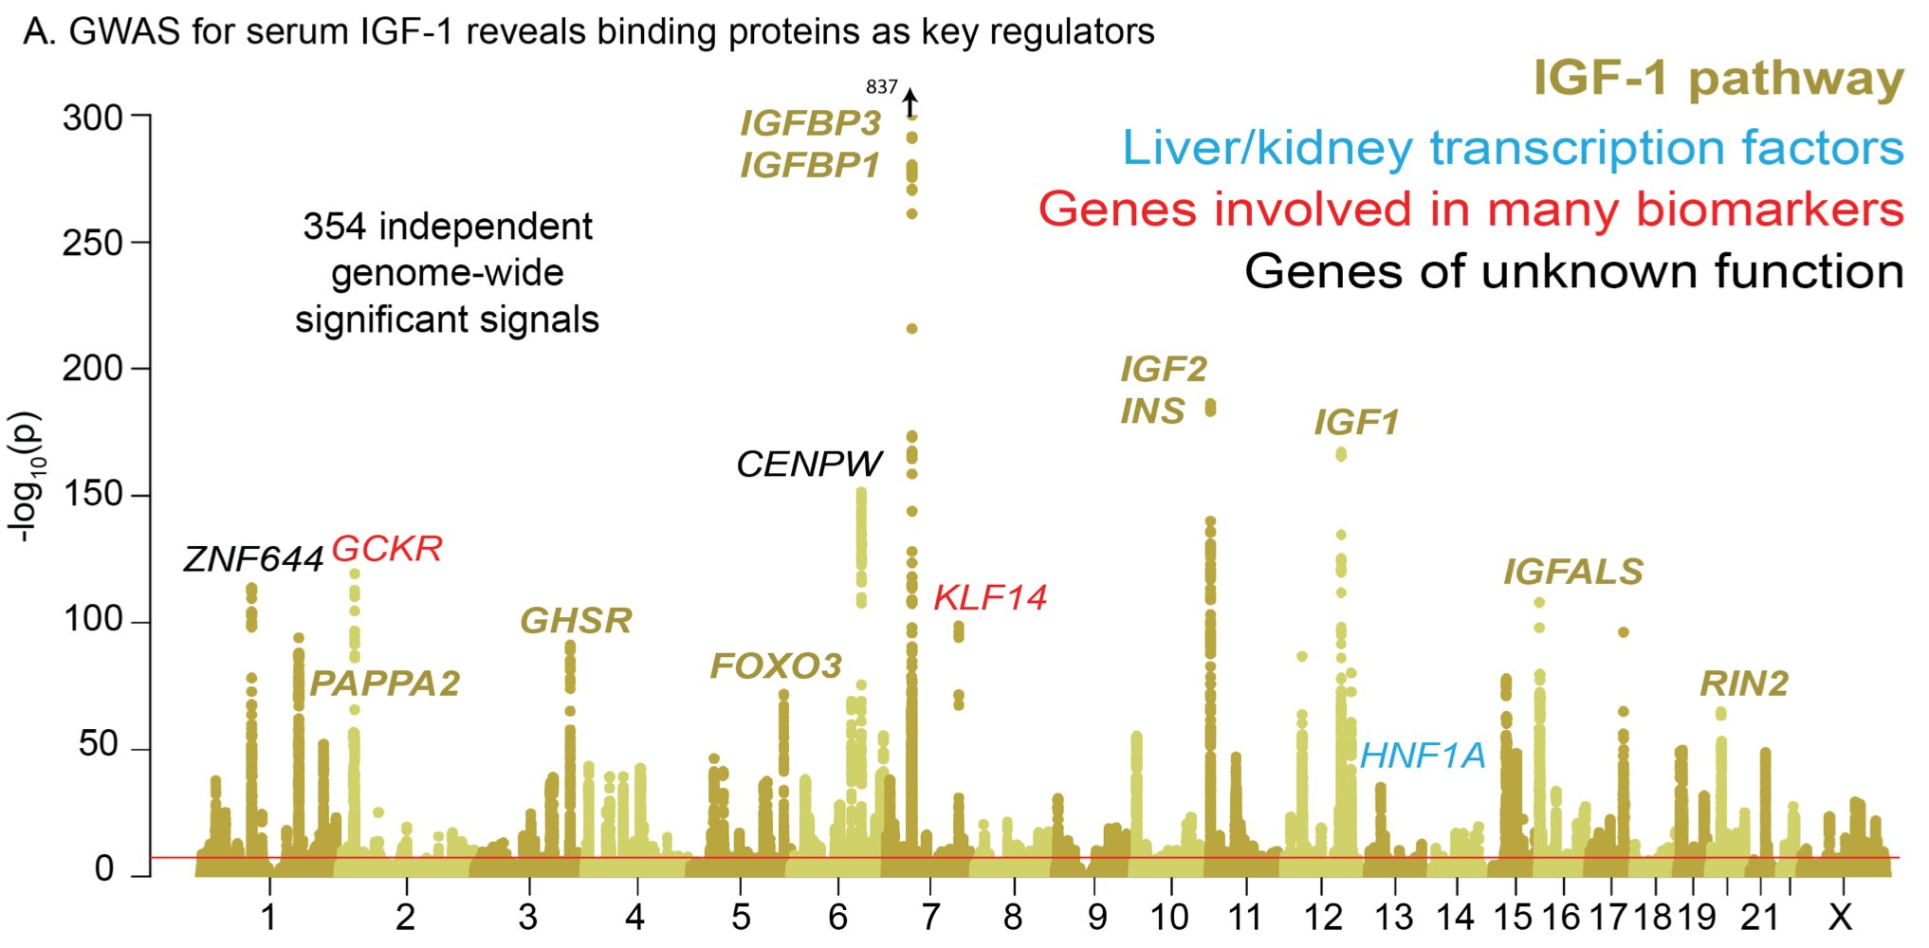
IGF-1 GWAS
Notes:
insulin-like growth factor 1
- IGF-1 is a key signaling protein linking growth hormone released from the pituitary to growth effects in peripheral tissues. The top hits are highly enriched with the IGF-1 pathway
- Eight of the top-associated hits are key parts of the IGF-1 pathway

Slide 9
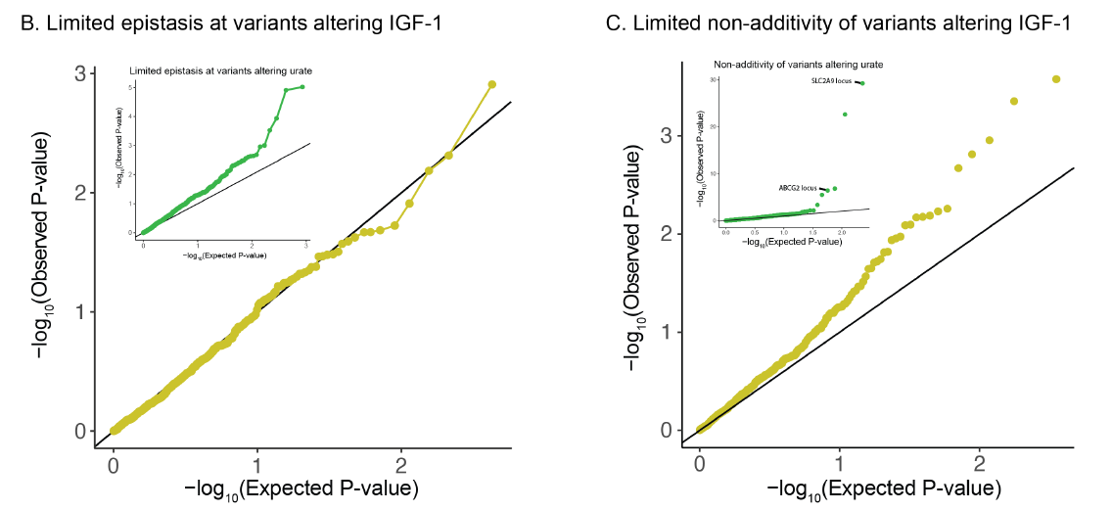
Notes:
QQ-plot testing for epistasis plots all pairs of lead variants with p<1e−20 for IGF-1 levels
Recessive/dominant effects
- tiny compared to the main effects

Slide 10
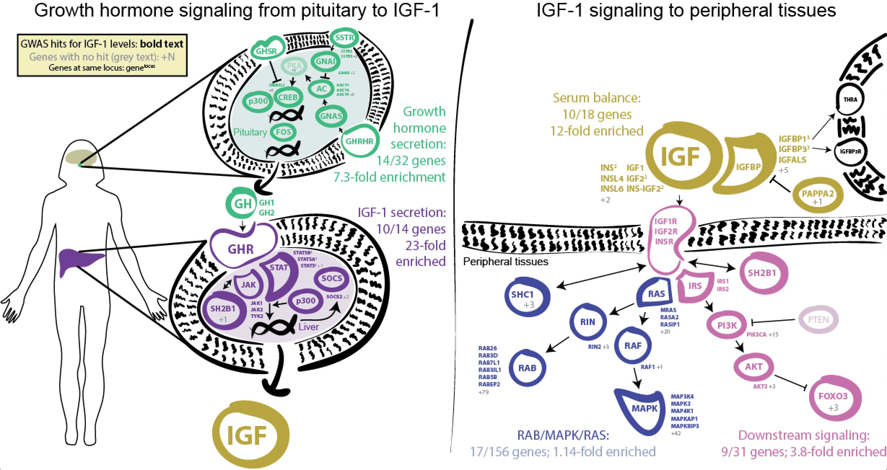
IGF-1 pathway
Notes:
The upstream pathways from pituitary to liver to IGF-1 balance in serum all show huge signal enrichments
1- Growth hormone secretion (7x)
2- IGF-1 secretion (23x enrichment)
3- serum balance of IGF (12x)
3- Weaker enrichment downstream; presumably implicate feedback loops (<4x)

Slide 11
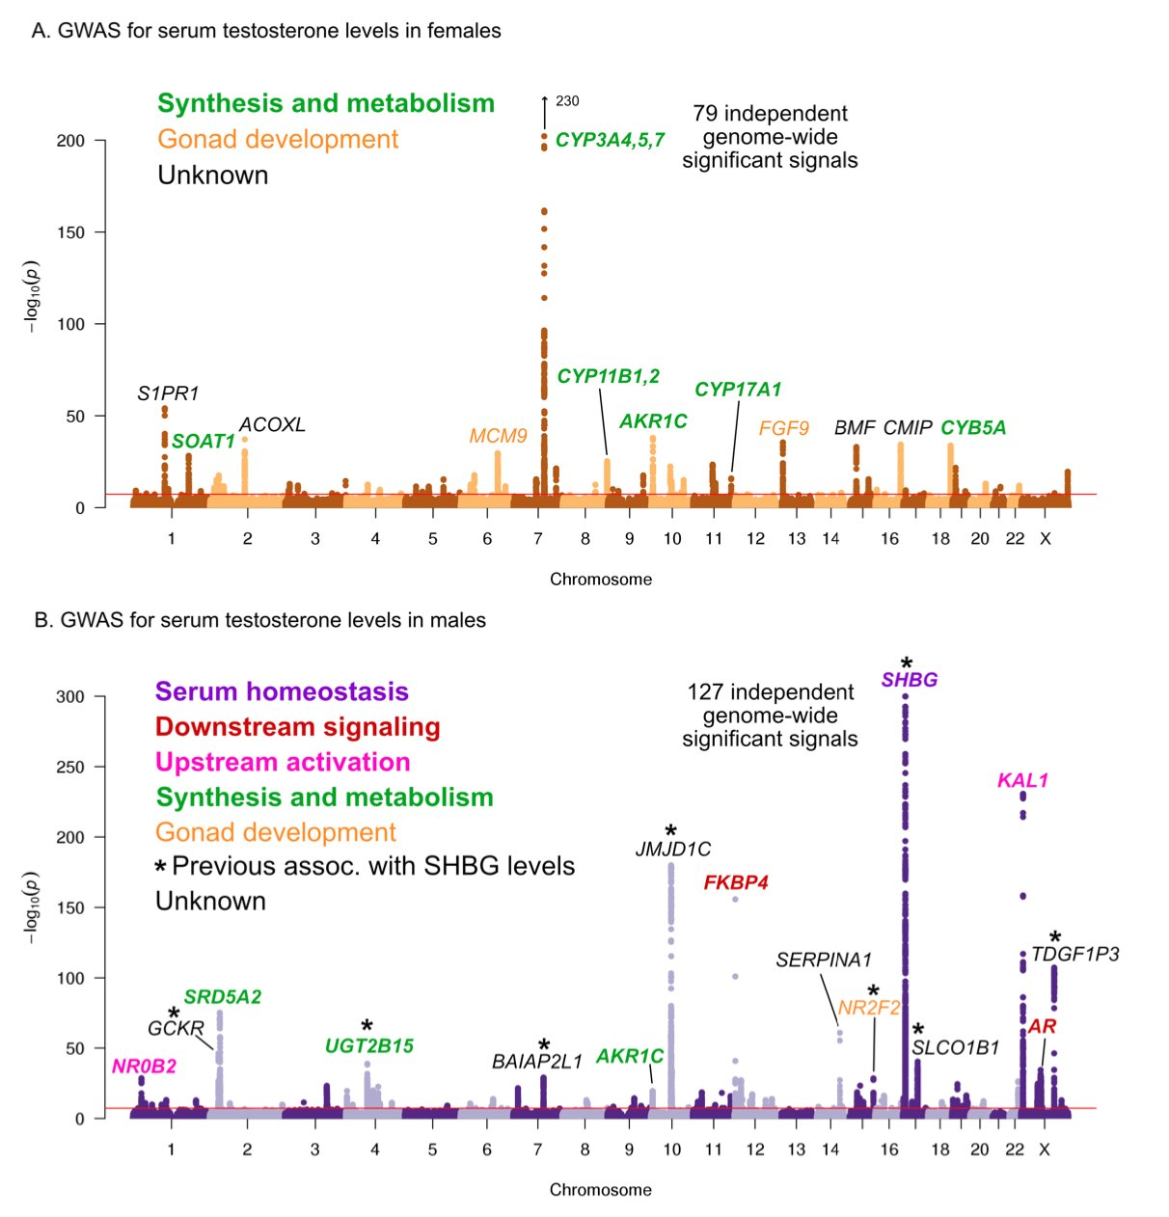
Notes:
- Testosterone is an anabolic steroid in both sexes, and the primary male sex hormone. We see essentially no overlap between male and female hits
- the top hits in males are largely non-overlapping with the top hits in females

Slide 12
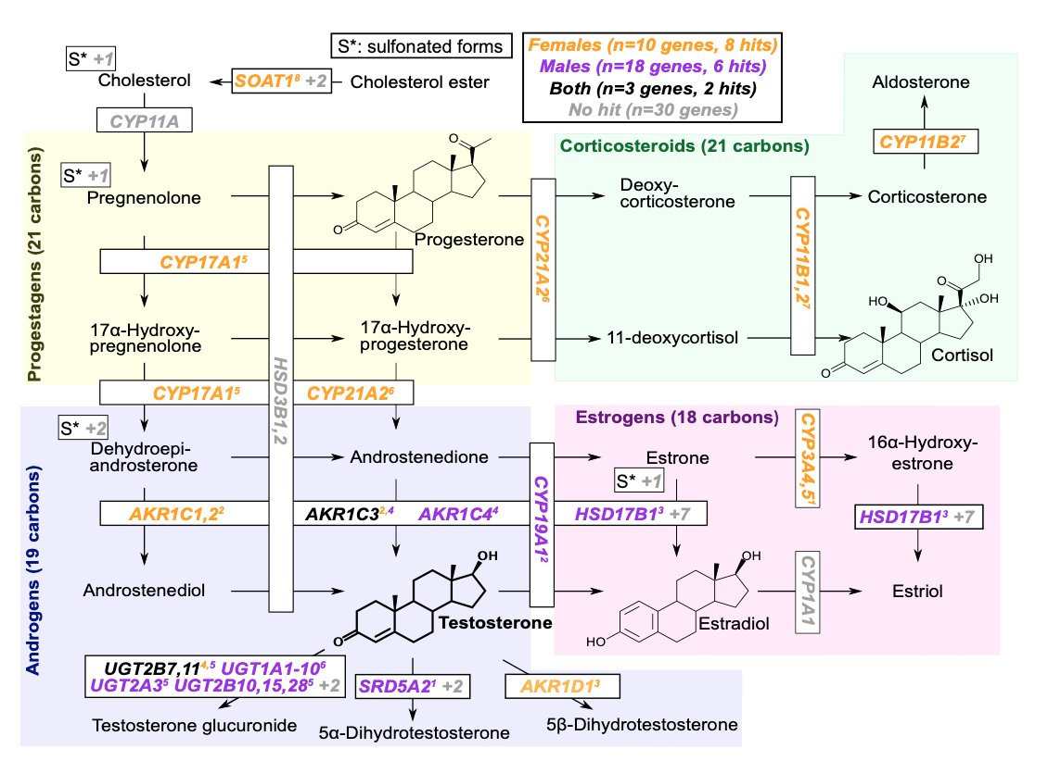
Notes:
steroid hormone biosynthesis pathway
Unlike for urate, there is huge enrichment (26x females, 11x males) of testosterone hits within the relevant biosynthetic pathway. Notably male and female hits tend to fall in different parts of the pathway, probably because the major products of the steroid pathway differ.
rG=~0

Slide 13
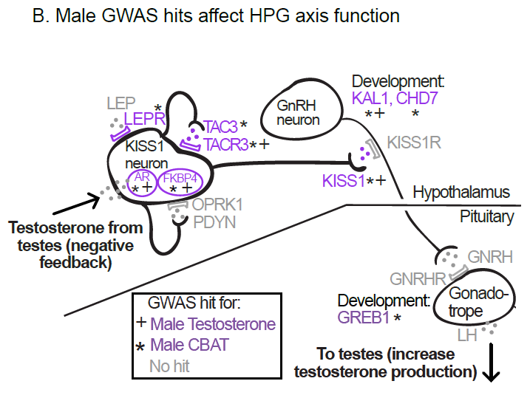
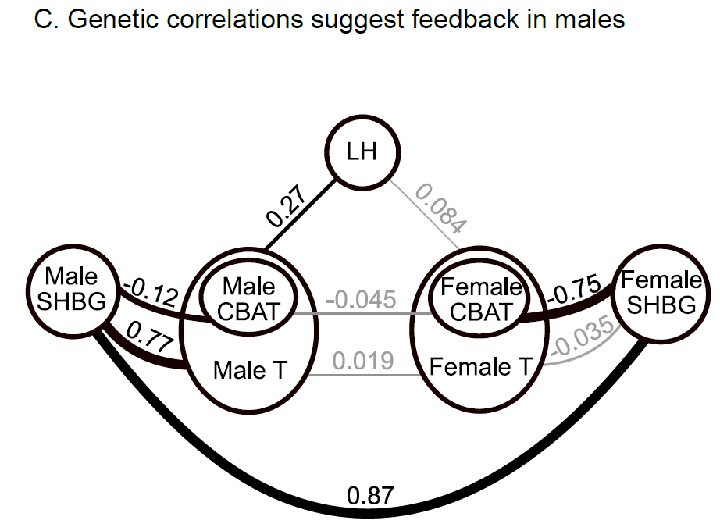
Notes:
Two reasons why there’s no overlap: 1- hypothalmic-pituitary-gonadal axis plays a more significant
role in regulating testosterone production in males than in females
2- SHBG plays an important role in mediating the negative feedback portion of the HPG axis
in males but not in females
calculated bioavailable testosterone - controls for genetic effects on total testosterone
that are mediated by SHBG production
luteinizing hormone - variants affecting LH levels should also affect testosterone levels in males but not females

Slide 14
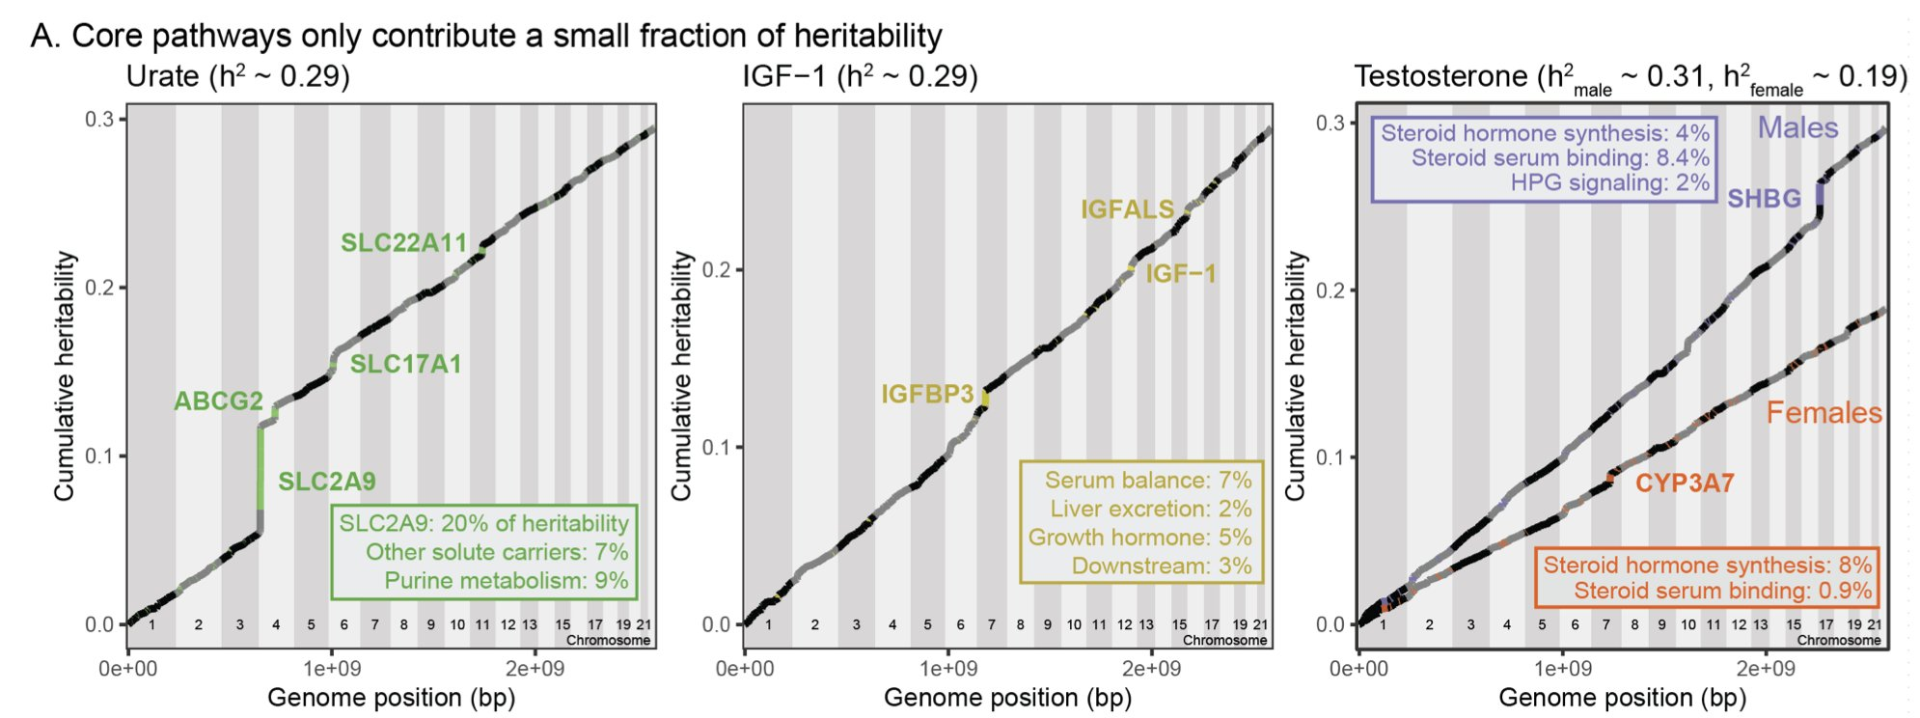
Omnigenic model
Notes:
how much of the SNP heritability comes from the core pathways, vs the polygenic background. Indeed for all 3 traits, the core genes make modest contributions
most important core pathways contribute up to about 10% of the total SNP heritability

Slide 15
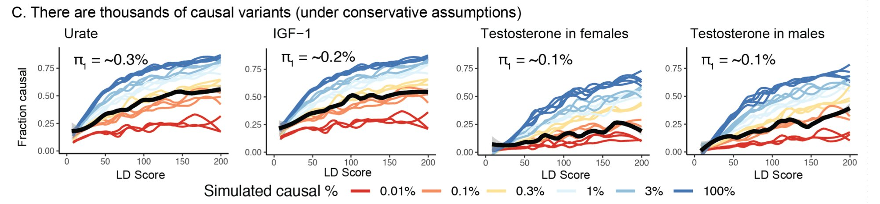
Notes:
Using ashR (empirical Bayes method that estimates the fraction of non-null test statistics in large-scale experiments), they divided SNPs into bins of similar LD Score and then looked to see what % of these tag a putatively causal SNP. Estimate that the bulk of the heritability comes from a large polygenic background: around 5k-10k causal variants, under conservative assumptions. (Black is data; lines are sims. Fractions out of 4.4M variants. Estimate for height is 80k.)
~4,000 causal sites for testosterone female

Slide 16
Conclusion
All three traits we find huge enrichment of top signals at core genes within the primary pathways that regulate these traits.
But these core pathways only explain modest fractions of the heritability, and most heritability is due to a polygenic background of ~10^4 variants.
Supports ‘Omnigenic’ model for common complex diseases
Notes:
In summary these 3 traits are relatively simpler traits than diseases. The lead variants are highly interpretable, and known core pathways show huge enrichment. But most heritability comes from a polygenic background of ~10k variants spread broadly across the genome. These data are broadly consistent with the "omnigenic" model we put forth previously: Most heritability comes from huge numbers of trans-regulatory effects at peripheral genes that have no direct relationship to the trait in question. most disease traits depend on inputs from many distinct biological processes, including sometimes the 3 studied here. So then they absorb the polygenicity of every trait they depend upon

