Slide 1
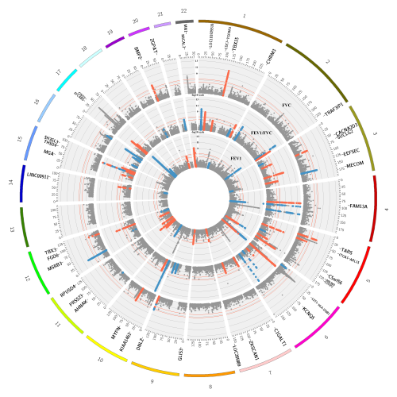


Genome-wide association studies of smoking behaviour and COPD
A. Mesut Erzurumluoğlu
Boehringer Ingelheim Pharma
Human Genetics team
(Biberach an der Riß, Germany)
@mesuturkiye
bit.ly/mesutblog
Erzurumluoglu, Liu and Jackson et al, 2020. Mol Psy
Dr Mesut Erzurumluoglu, Boehringer Ingelheim, Germany

Slide 2

DISCLOSURES
Commercial Interest | Relationship(s)
Boehringer Ingelheim Pharma | Working for Boehringer Ingelheim as Senior Scientist in the Human Genetics team (located in Biberach, Germany)
@mesuturkiye
bit.ly/mesutblog
Dr Mesut Erzurumluoglu, Boehringer Ingelheim, Germany

Slide 3
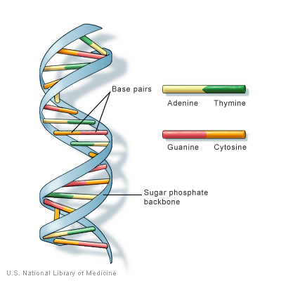
Our genome
3 billion base-pairs long
  Made up of Adenine (A), Guanine (G), Cytosine (C) & Thymine (T)
Inherit a copy each from our parents
  >99.5% similar
Some variants are widespread in the population
  Single nucleotide changes (incl. SNPs) represent the largest group of variants
Sugar backbone
Dr Mesut Erzurumluoglu, Boehringer Ingelheim, Germany

Slide 4
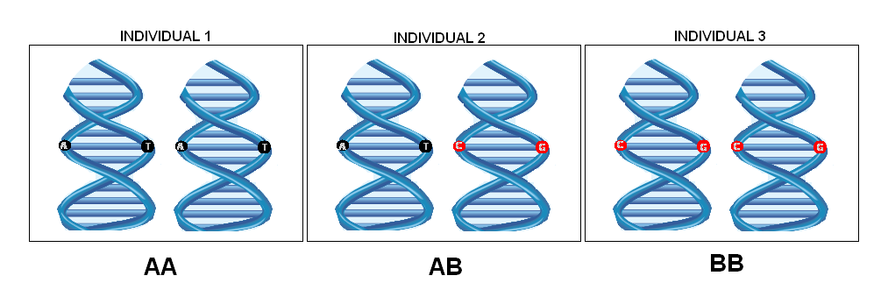
Alleles
Chr. 1
… INDIVIDUAL N
100,000
C
C
C
C
C
C
SNP 1
100,001
A
A
A
G
G
G
100,002
T
T
T
T
T
T
AA
AG
GG
… SNP N
SNP: Single nucleotide polymorphism (single nucleotide change that is relatively ‘common’ in the population)
Genotypes
Dr Mesut Erzurumluoglu, Boehringer Ingelheim, Germany

Slide 5
Genome-wide association study (GWAS)
… INDIVIDUAL N
A
A
A
G
G
G
AA
AG
GG
Does not smoke
Smokes
Smokes a lot
Dr Mesut Erzurumluoglu, Boehringer Ingelheim, Germany

Slide 6



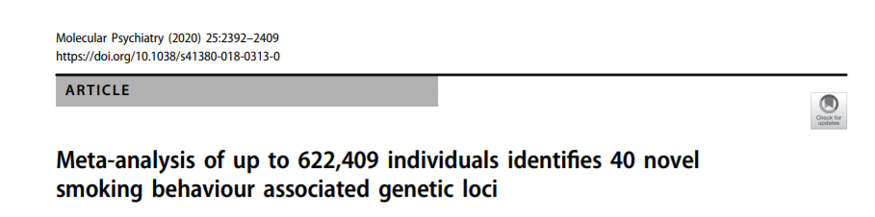
Alsaadi and Erzurumluoglu et al, 2014. Hum Mut
Wain et al, 2017. Nat Genet
Shrine, Guyatt, and Erzurumluoglu et al, 2019. Nat Genet
Erzurumluoglu, Liu and Jackson et al, 2020. Mol Psy
Dr Mesut Erzurumluoglu, Boehringer Ingelheim, Germany

Slide 7
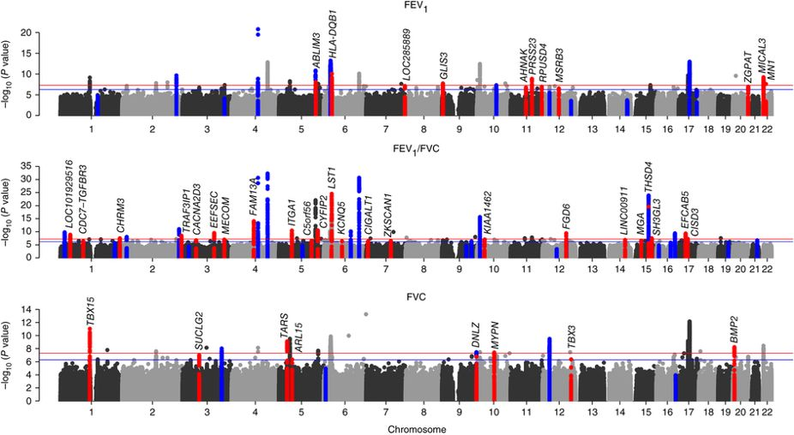
Manhattan plots from Wain et al, 2017
FEV1: Forced expiratory volume in 1 second
FVC: Forced vital capacity
References:
54 -> 97 genetic associations:
Wain et al, 2017. Nat Genet
140 -> 279 genetic associations:
Shrine, Guyatt, and Erzurumluoglu et al, 2019.
Nat Genet
Dr Mesut Erzurumluoglu, Boehringer Ingelheim, Germany

Slide 8
GWAS to biology and drug target
Trans-ethnic GWAS
Variant effect prediction
Other -omics studies
Druggability
Fine-mapping
Protein-Protein interactions
Causal SNP(s) Target Gene(s) Relevant Tissue(s) Pathways
e/pQTL studies
Pathway enrichment
Colocalisation
Disease & drug targets
Mendelian Randomisation
GWAS associations
Dr Mesut Erzurumluoglu, Boehringer Ingelheim, Germany
Source URL: mesuturkey.wordpress.com

Slide 9

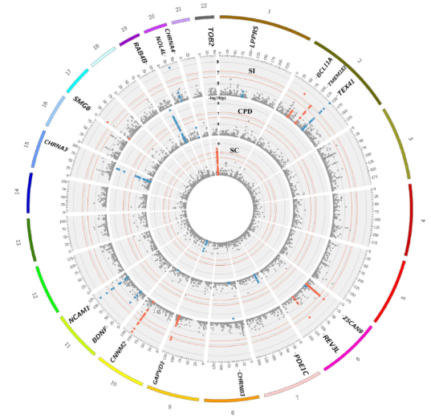
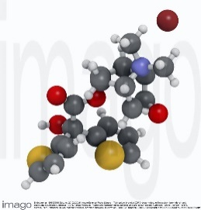
Smoking GWAS to drug targets for COPD
Increase smoking (by reducing aversive effects of smoking? Jensen et al, 2015)
Increase inflammation, abnormal cell repair, extracellular matrix destruction
Decrease in
CHRNA5 expression?
Brain Cortex?
rs1051730 (A)?
Therapy
Prevention
Obstruction
GWAS association
at 15q25
COPD
Dr Mesut Erzurumluoglu, Boehringer Ingelheim, Germany
Source URL: mesuturkey.wordpress.com

Slide 10
Drug target validation: CHRM3
CHRM3 for chronic obstructive pulmonary disease (COPD)
  Muscarinic cholinergic receptor 3 (encoded by CHRM3) controls smooth muscle contraction
  Increased smooth muscle contraction => airway obstruction
Evidence:
  High eQTL-GWAS colocalisation in lung and smooth muscle cells & desirable direction (inhibition => lower disease risk)
  Mendelian Randomization between CHRM3-specific eQTLs and COPD risk => significant association
Pathology mechanism:
  Exaggerated acetylcholine release => enhanced expression of downstream signalling components in airway smooth muscle => bronchoconstriction
Treatment: Acetylcholine receptor inhibitors
  Reverse the action of (vagally derived) acetylcholine on airway smooth muscle contraction
  Incl. anticholinergic drug Ipratropium by Boehringer Ingelheim
    Induced bronchodilation => Lowers bronchospams
Mostly from Wain et al, 2017. Nat Genet
Dr Mesut Erzurumluoglu, Boehringer Ingelheim, Germany

Slide 11
Drug repurposing: ITGAV for COPD?
  The allele associated with reduced expression of ITGAV was associated with increased lung function, suggesting that inhibitors of αvβ6 integrin might also have a beneficial effect in COPD
  ITGAV encodes a component of the αvβ6 integrin heterodimer, which is inhibited by a monoclonal antibody in development for pulmonary fibrosis (NCT01371305) and for which the small molecule GSK3008348 (NCT03069989) is an antagonist
Shrine, Guyatt, and Erzurumluoglu et al, 2019.
Nat Genet
Dr Mesut Erzurumluoglu, Boehringer Ingelheim, Germany

Slide 12
Possible off-target effects
Finemapping + PheWAS
  Atacicept blocks B cell stimulation by TNFSF13 to reduce systemic lupus erythematosus disease activity (in a Phase 2b trial) but may also reduce lung function
Shrine, Guyatt, and Erzurumluoglu et al, 2019.
Nat Genet
Drug target invalidation: harmful
REV3L for smoking cessation
  DNA polymerase in brain?
Many potential drug targets identified for COPD
  Chemotherapy drug\carcinogenic
Erzurumluoglu, Liu and Jackson et al, 2020. Mol Psy
Dr Mesut Erzurumluoglu, Boehringer Ingelheim, Germany

