Slide 1
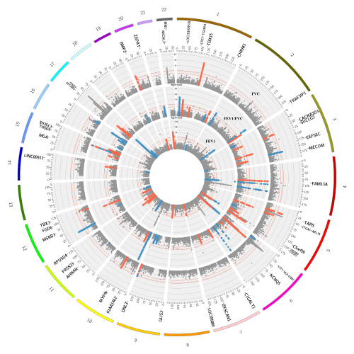


Safety minute: 7 March 2022
What do I do to keep my physical and mental wellbeing – esp. during home office work hours?
A. Mesut Erzurumluoglu on behalf of the
Human Genetics Team (lead: Zhihao Ding)
@mesuturkiye
bit.ly/mesutblog

Slide 2
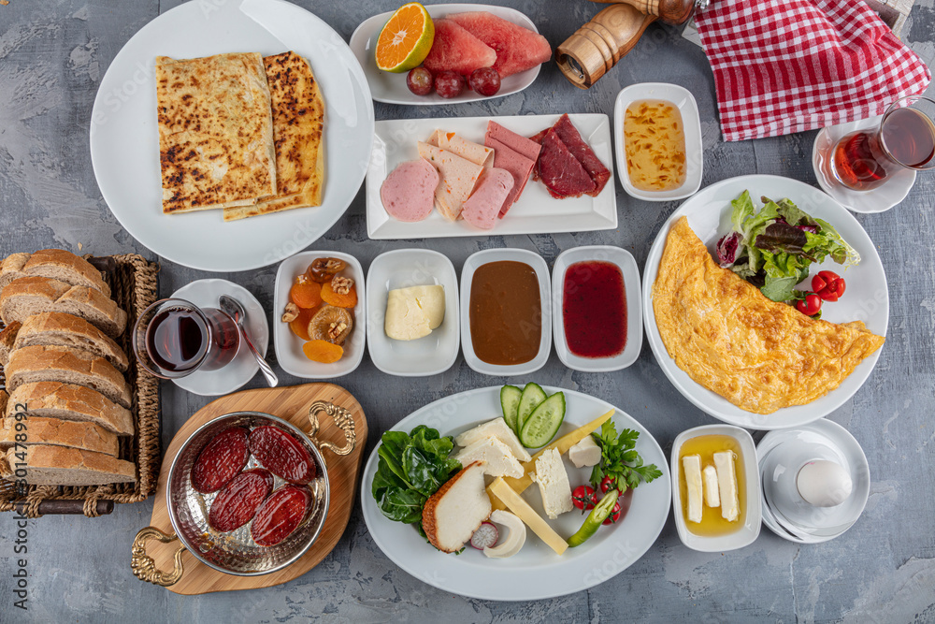

Physical well-being
Keep the home clean
  Get a dishwasher (wear a glove if not)
Have iron-fortified cereal in the morning (with lactose-free milk) and a good (Turkish) breakfast during lunch time (NB: black tea or coffee an hour later from both – place it far from me)
A spoon of Manuka honey every day (UMF 15+)
‘A-Z’ vitamin & mineral supplement once a week
Neti syringe to rinse my sinuses ~once a month
  Use good quality salt & lukewarm filtered water
Wrist & elbow rest on table (tennis/computer elbow)
Face exercises
Good sleep: Raise my thorax & head and put night-mode on mobile phone before sleep
Fruit & water on table (nudge)
I don’t eat anything after 9pm (only Jasmine/linden tea allowed)
Mental well-being
Keep home tidy
Sell/give away unnecessary stuff
Open windows and meditate/sit/lie on the floor several times
Have photos of people and quotes that make me happy & motivate me on office desk/table
Fast internet
Go to a (English) movie at Traumpalast once a week
Play Wordle and/or Sudoku every day
Get help/meet up with friends

